Slide 1

This Lab Week, we celebrate connecting and supporting Medical Laboratory Professionals with Building Bridges.
MEDICAL LABORATORY PROFESSIONALS WEEK | April 19-25, 2026
Notes:
3 min

Slide 2
Building Bridges Across Laboratory Community
April 22, 2026

Slide 3
Format of Today’s Session
Introduction of Building Bridges Webinar
  "Professional Identity"
Best Practices from today's speakers
  Dana Powell Baker, EdD, MBA, MS, MLS(ASCP)^{CM}, CPH
  Senior Manager, Academic Partnerships – Experiential Learning, Association of Public Health Laboratories
  Catherine Bammert, PhD, CT(ASCP)MB^{CM}, CMIAC
  Program Director, Diagnostic Cytology Program, Associate Professor, UT MD Anderson Cancer Center
  Jerry Santiago, PhD, HTL(ASCP)QIHC^{CM}
    Professor of Histology, Program Director Histologic Technology, Florida State College at Jacksonville
Q & A
Session Wrap-Up

Slide 4
Professional Identity:
Medical Laboratory Scientists
  Dana Powell Baker, EdD, MBA, MS, MLS(ASCP)^{CM}, CPH

Slide 5
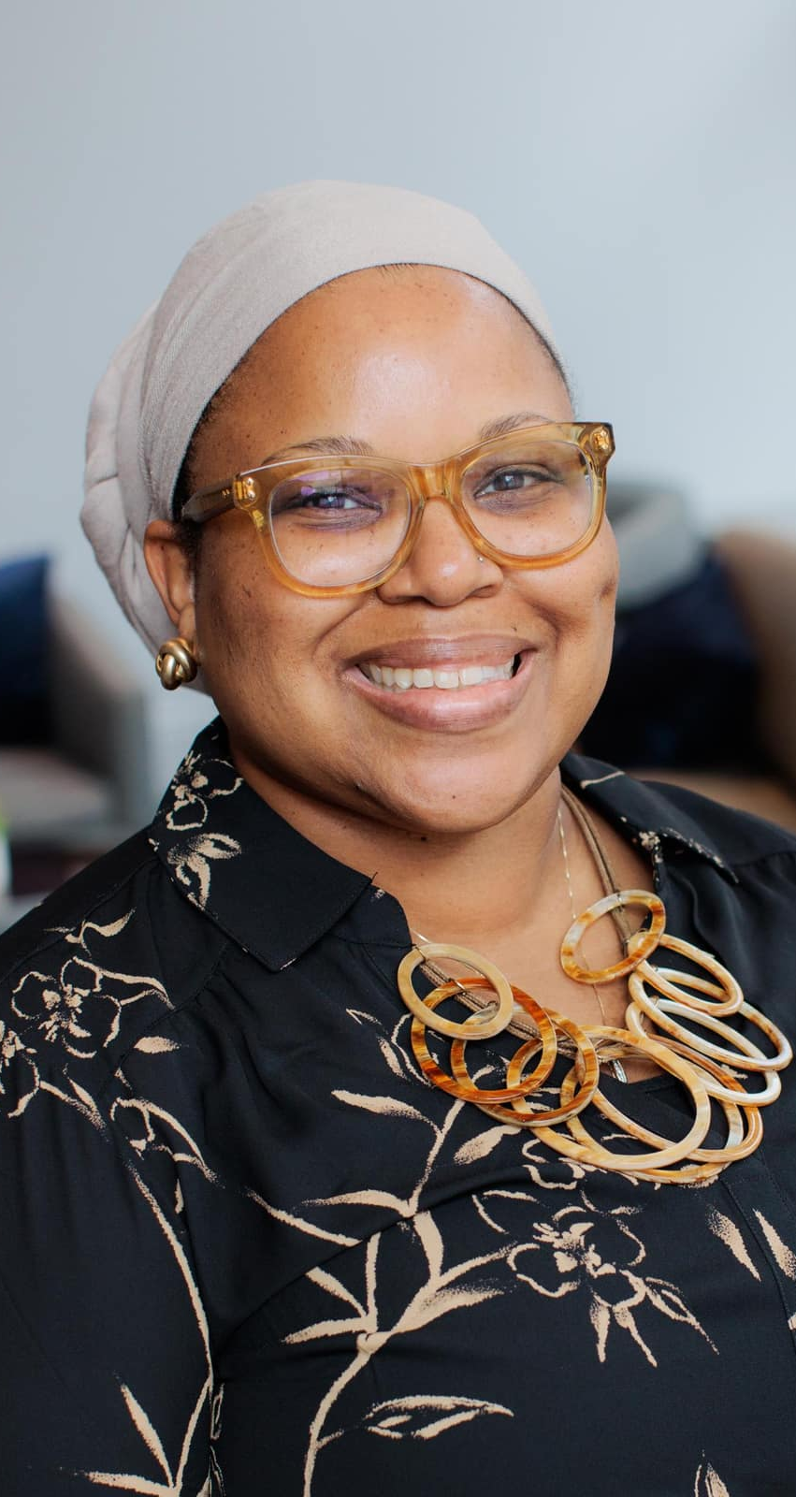
Hello
Senior Manager, Academic Partnerships
  Association of Public Health Laboratories (APHL)
ASCP-certified Medical Laboratory Scientist
Certified in Public Health
ASCP Career Ambassador & CPH Ambassador
ASCP Commission on Continuing Professional Development
Areas of Expertise: Strategic Partnerships, Leadership, Healthcare Simulation, Interprofessional Education, Postsecondary Education

Slide 6
Medical Laboratory Scientists
What my friends think I do
What my family thinks I do
What my kids think I do
What I actually do
What society thinks I do
What I think I do

Slide 7
What is Professional Identity?
Refers to the values, beliefs, and behaviors with the expectations (and norms) of a profession
Represents how individuals define themselves and their experiences in relation to their work roles, professional communities, and career trajectories in the profession.
Key aspects include:
  Values guiding one’s professional behavior
  Skills or competencies that define one’s professional abilities and contributions to the work
  Belonging and connection to other colleagues in the profession, including involvement with professional associations and engagement with professional communities
  Role perception in how individuals view their responsibilities in the profession.

Slide 8
The Development of Professional Identity
Shaped by educational settings, workplace interactions, and professional networks
Strong professional identity = enhanced job satisfaction, psychological well-being, and staff retention
“Not so strong” professional identity = work-related stress and increased staff turnover within the laboratory workforce
Otto (2018) stated that the foundation of identity is acquired during the academic preparation of clinical laboratory science students.

Slide 9
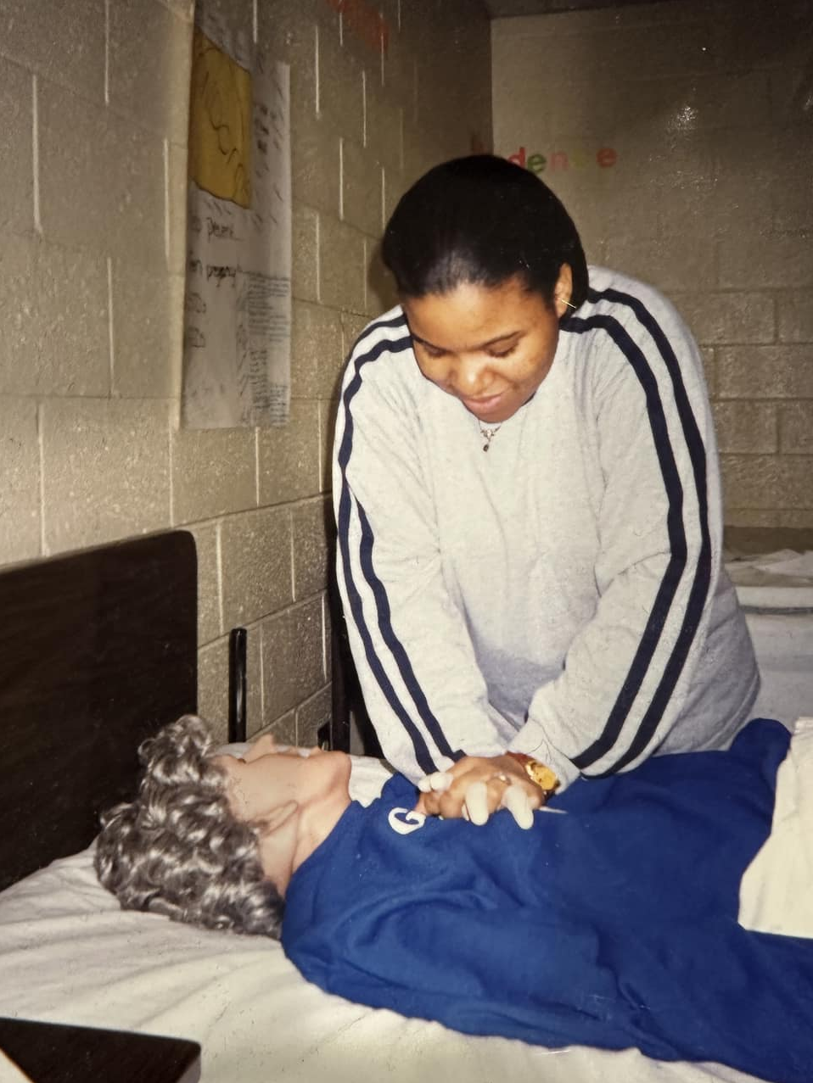

Education to Career Pathway to MLS
Education
High School: Health Occupations
Undergraduate: BS, Medical Technology
  Participation in student organizations
Clinical Training
Internship/Practicum: Interactions with mentors, preceptors, and trainers
Professional Associations: ASCLS and ASCP Student Memberships
Notes:
Influential factors that shaped the foundation of my professional identity (from healthcare to a profession-specific role on the healthcare team)
Limited to no exposure to this role before choosing major in college (early and often exposure is key)

Slide 10
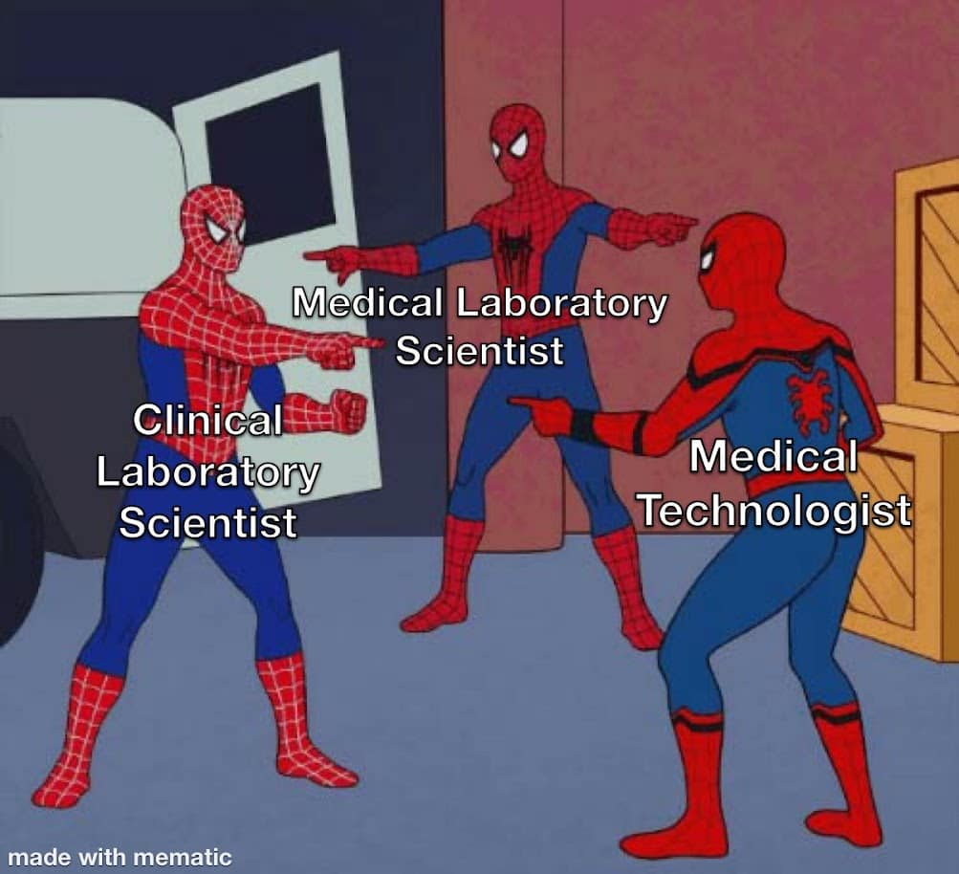
What is My Professional Identity?
Who am I in relation to the profession?
Who am I in relation to others?
Who am I?
Baker, D. P., & Rohde, R. E. (2023, April 28). Public Health and Medical Laboratory Professional Identity. American Society for Microbiology. https://asm.org/articles/2023/april/public-health-and-medical-laboratory-professional
Notes:
Discussion about challenges and opportunities for the medical and public health laboratory workforce.

Slide 11


Who Am I?
Medical Technologist → Medical Laboratory Scientist
  Graduate of a NAACLS-accredited program
  ASCLS Code of Ethics
Stages of Career and Professional Growth
  “I want to advance into laboratory leadership”: MBA
  “I am ready to find my niche”: Advanced degree in Healthcare Simulation
  “I’m in my transition from bench to academia”: Doctoral degree
  “I want to demonstrate my competency in public health”: CPH (NBPHE)
Consideration of the development of transferable skills
Notes:
Discussion about my professional identity

Slide 12
I am a/an…
Medical Laboratory Scientist
Educator
Leader
Public Health Professional
Advocate
Notes:
MLS is my foundation, with all other career roles connecting to this professional identity

Slide 13

Professional Identity and STEM
The study explored how professionals in STEM (Science, Technology, Engineering, Mathematics, and Medicine) define their identities.
The key findings that emerged from the study are as follows:
  Participants primarily defined themselves by their job-related responsibilities in STEM fields.
  They emphasized their competence in STEM through their educational backgrounds and areas of expertise.
  Recognition from others was influenced by their perceived job performance and related skills.
  STEM professionals expressed a desire to advance in their careers and to stay at the forefront of their fields by pursuing continuous learning and making positive contributions to society.
Source: Tripp, J.N. & Liu, X (2025). Towards Defining STEM Professional Identity: A Qualitative Survey Study. Journal for STEM Education Research, 8, 348–386. https://doi.org/10.1007/s41979-024-00131-2
Notes:
STEM is an essential part of our professional identity. There are opportunities to enhance visibility of the medical and public health laboratory workforces in STEM. We all belong in STEM and our roles (including MLS) should become increasingly recognized as a part of STEM fields.

Slide 14
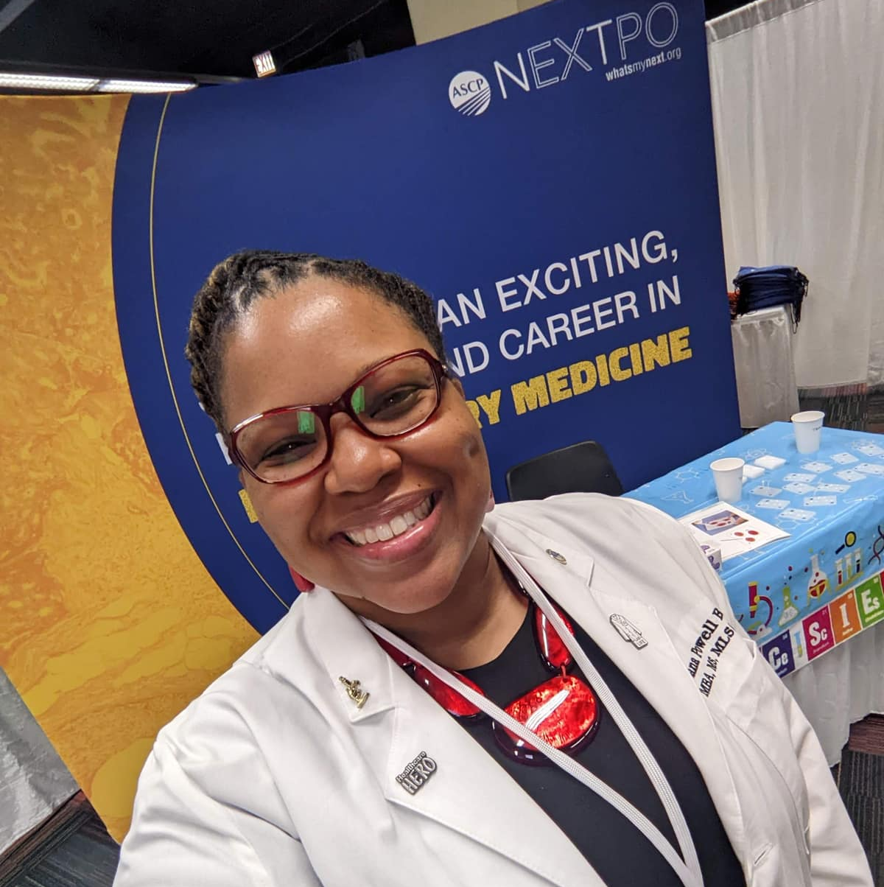
Advocacy and Visibility
The intersection of education, organizational role, and career level is significant.
Professional identity comprises the attributes and experiences that shape who we are in our occupation.
Engage in advocacy for the profession to increase awareness and visibility of our work, including societal impact.
Notes:
Identity is used to describe how learners develop their identity through their associations with multiple groups in society and the impact of how they are identified within a community (Learning for Justice, 2019). The concept of identity includes visible and invisible characteristics such as language, career, and education. In an article about professional identity, Otto (2018) expanded upon the education, professional culture, and careers of laboratory professionals. Professional competencies, such as ‘work in interprofessional teams’ and ‘provide patient-centered care,’ were identified as approaches to emphasize the professional identity of laboratory professionals, thereby improving patient safety and reinforcing our critical role as vital members of the healthcare team (Otto, 2018).

Slide 15
Promotion of the Profession
Own your voice — promote the profession with confidence
  Share your story
Leverage social media strategically
  Use platforms to showcase your expertise and interact with others in our professional community
Identify and develop your niche
Engage with professional associations
  Stay informed and connect with other colleagues
Volunteer for committees and leadership roles
Participate in outreach activities and events in your communities
Gain experience and enhance your own understanding of your role in the profession

Slide 16

The Path to Professional Identity
Effective mentorship is crucial
Showcase your skills and expertise with relevant credentials
Understand best practices within the laboratory workforce
Expand your professional network
Participate in ongoing professional development and lifelong learning
Focus on personal growth as a key element
Notes:
Final points about the value of PI through perspectives as a MLS (perspectives can be broadly applied)

Slide 17
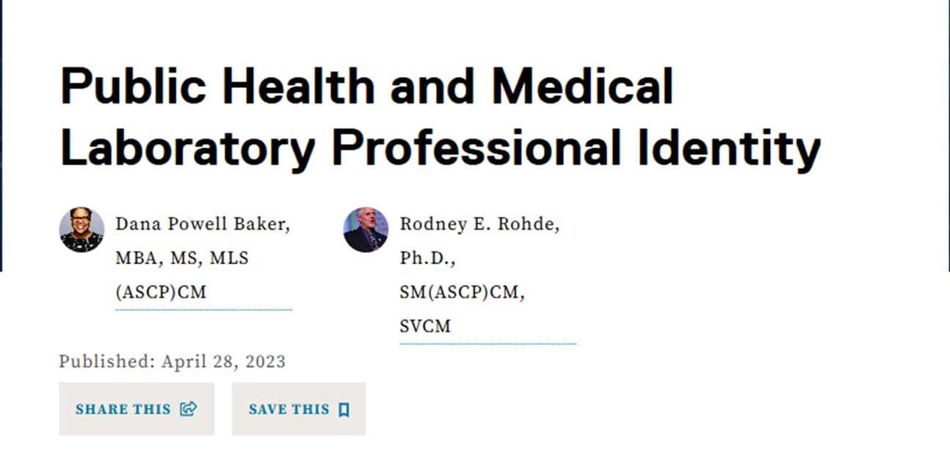

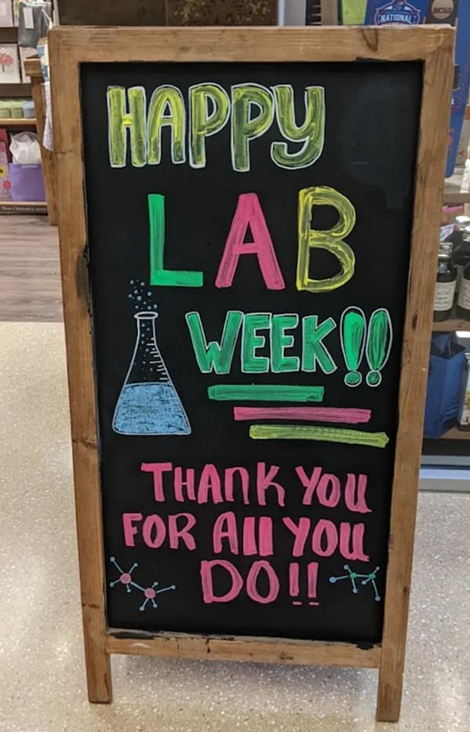
Publication: #LabWeek
Notes:
Check it out! Link: Public Health and Medical Laboratory Professional Identity

Slide 18
References
American Society for Clinical Laboratory Science. (2021). Becoming a clinical laboratory professional. https://ascls.org/how-do-i-become-a-laboratory-professional/
American Society for Clinical Laboratory Science. (2021). Patient safety advocacy. https://ascls.org/patient-safety-advocacy/
Baker, D. P., & Rohde, R. E. (2023, April 28). Public Health and Medical Laboratory Professional Identity. American Society for Microbiology. https://asm.org/articles/2023/april/public-health-and-medical-laboratory-professional
Otto, C. N. (2018). Professions, Professionalism, and Professional Identity. Clinical Laboratory Science, 31(3), 142-147. https://doi.org/10.29074/ascls.2018000570
Tripp, J.N. & Liu, X (2025). Towards Defining STEM Professional Identity: A Qualitative Survey Study. Journal for STEM Education Research, 8, 348–386. https://doi.org/10.1007/s41979-024-00131-2

Slide 19
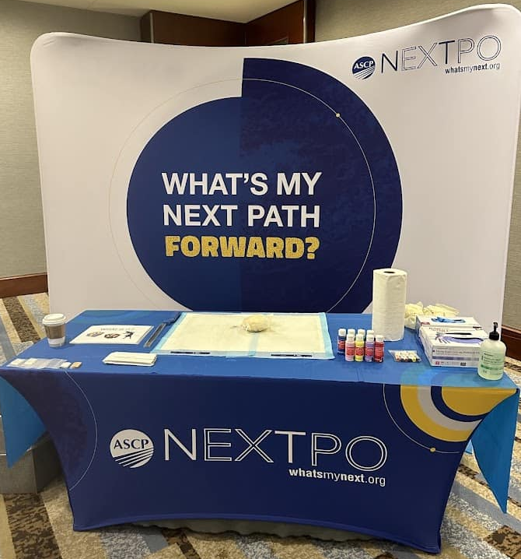
Thank You
Contact Information
dana.baker@aphl.org
@danapowellbaker
@dr.danapbaker

Slide 20
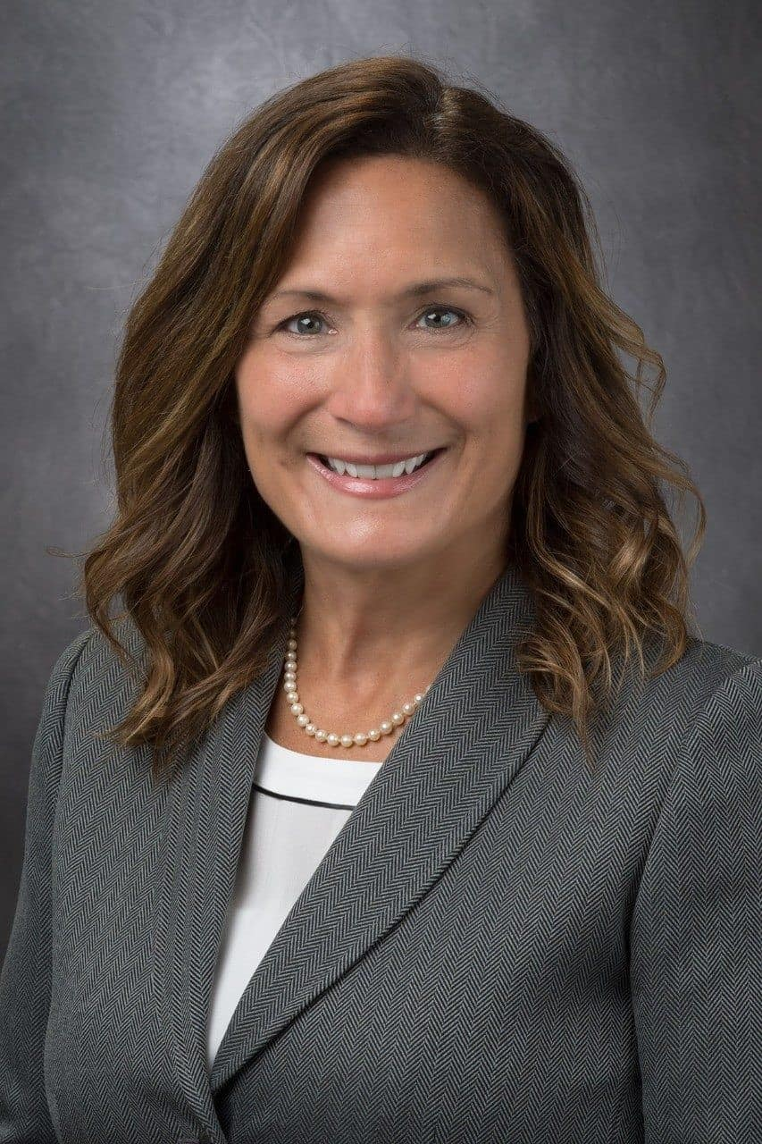
Professional Identity: Cytology
  Catherine Bammert, PhD, CT(ASCP)MB^{CM}, CMIAC

Slide 21
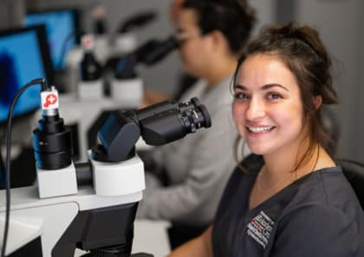
Professional Identity:
Definition: how professionals perceive their role, responsibilities, and value
Shaped by the professions:
  education, professional governance, organizational culture, expertise, and impact on patient care.
Dynamic
  evolves over time
Important because it strengthens clarity of role, guides practice, supports patient care, and reinforces the value of a profession within the broader healthcare system.

Slide 22
National Factors Shaping and Elevating Cytology’s Professional Identity: CAAHEP
The Commission on Accreditation of Allied Health Education Programs (CAAHEP)
  Accredits all educational cytology programs across the nation
  Issues Standards and Guidelines
    Reflects the needs of the profession, current scope of practice, and expectations of entry-level cytologists in the field.
    Are regularly updated as field evolves
  On Jan.1, 2025, Standards and Guidelines were expanded to also include:
    Small biopsy grossing
    Ancillary testing (e.g. principles, clinical indications, clinical significance, correlation with cytomorphology)
    Digital cytology (telecytology / ROSE)
    Specimen curation (e.g. small sample stewardship, specimen triage, adequacy for downstream testing)
    Communication and teamwork (e.g. healthcare inequities, diversity, equity, inclusion)

Slide 23
National Factors Shaping and Elevating Cytology’s Professional Identity: CAAHEP
Change in degree requirement:
  All accredited programs must award a minimum of a Masters degree upon completion by 2030
Change in professional name to “Cytologist” and “Cytology”
  Dropped “technologist” terminology
These changes:
  Reflect the complexity of the scope of practice and the essential contributions cytologists make to healthcare and patient care.
  Validate and clarify the cytologist’s professional identity within the healthcare ecosystem.
  Increase the visibility of the entire medical laboratory sciences workforce which may help alleviate staffing shortages.

Slide 24
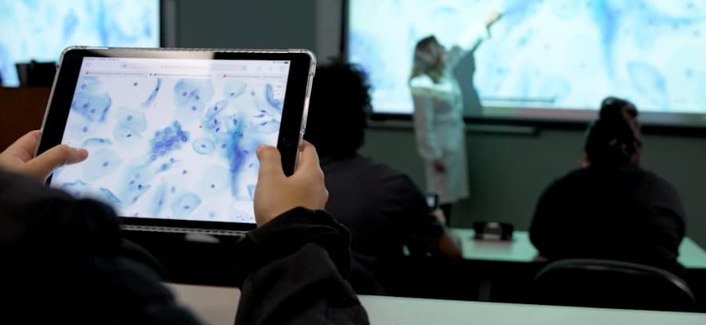
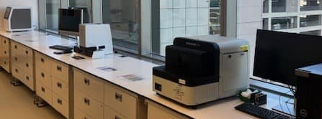
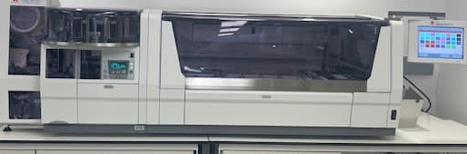
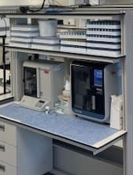
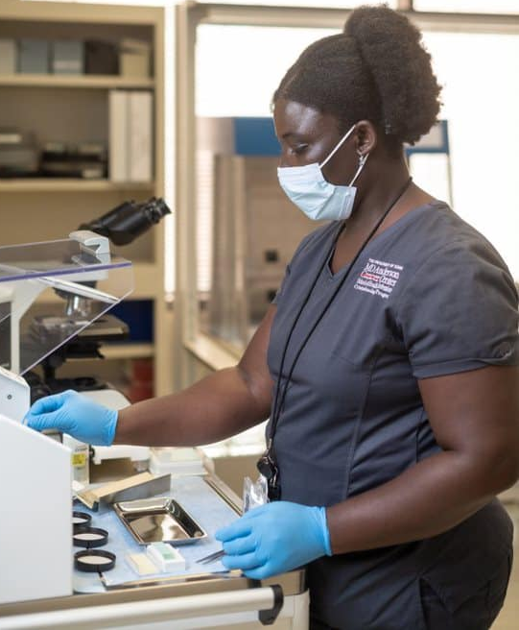
Shaping the Cytologist’s Professional Identity through Academic Experiences
Academic experiences play a key role in shaping professional identity.
How?
  Model the cytologist’s clinical role, scope of practice, and responsibilities
    Hands-on training using industry‑standard and emerging clinically relevant instruments
    Replicate authentic workplace conditions
    Leverage interdisciplinary simulation activities
    Cultivate “patient centered” culture
Outcomes
  Mastery of entry‑level competencies while reinforcing professional standards, ethical practice, and quality expectations
  Cultivate confidence as individuals take ownership of their role as cytologists

Slide 25
Common Misconceptions About Cytology
Only work at the microscope
  Cytologists are highly-specialized laboratory scientists who are often cross-trained to perform a variety of interdisciplinary tests: ROSE / specimen triage, cytoprep, flow cytometry, molecular testing, research, new instrument / test validations, etc.
Mostly evaluate gynecologic cytology
  Cytologists working in full-service hospitals predominately evaluate non-gyn specimens
Field will be “sunset” by AI
  AI improves efficiency and performance, but human expertise remains essential for rendering the final diagnosis

Slide 26
Advice to Early Career Professionals
Say “yes” to opportunities to grow
  Examples: cross-training, leadership, research
  Prepares you for expanded roles and new professional adventures
Remain passionate about your field and life-long learners
  Stay abreast of the changes in our field
  Participate in upskilling initiatives
Become active members of professional communities
  Learn, network, collaborate, advocate, share your knowledge

Slide 27
Summary
Professional identity formation is central to preparing cytologists for an expanded, mid‑practitioner scope of practice
Academic experiences intentionally shape how learners think, act, and identify as clinical cytology professionals
Aligning education with workforce and laboratory needs reinforces accountability, autonomy, and professional responsibility
This model supports professional growth across laboratory disciplines, setting a framework for broader role recognition and advancement

Slide 28
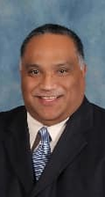
Professional Identity: Histotechnology
  Jerry Santiago, PhD, HTL(ASCP)QIHC^{CM}

Slide 29
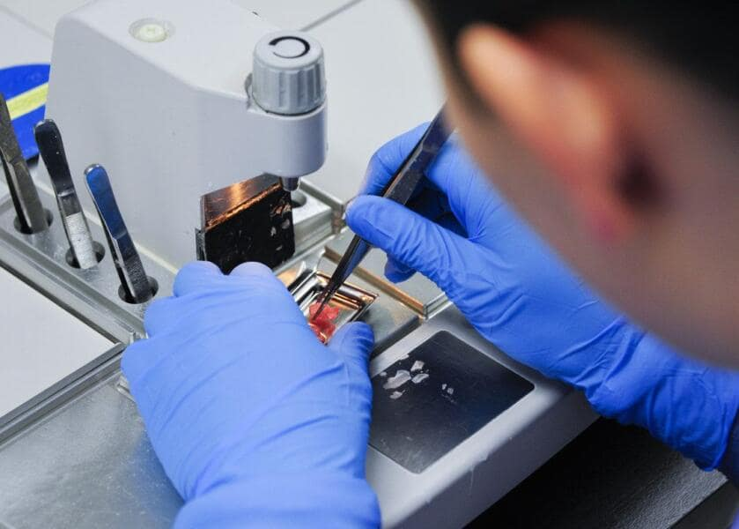
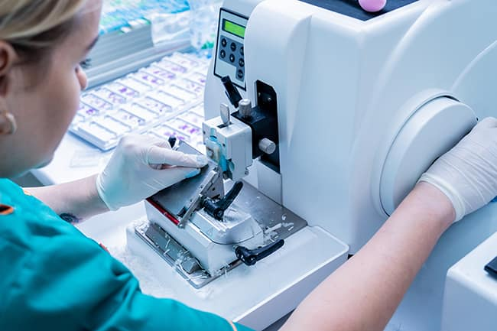

Histotechnology
Histotechnology is a hands-on profession, requiring mastery of equipment, excellent manual dexterity, and practice staining tissue samples.
Histotechnicians (HT) and Scientists in Histotechnology (HTL) are medical laboratory professionals who prepare tissue samples to be analyzed microscopically.
A Scientist in Histotechnology is a medical scientist who prepares, examines and tests samples and specimens from humans, animals and plants.

Slide 30
Misconceptions About Histotechnology
Seen as routine or technical work
Critical role often overlooked
Underestimate scientific expertise
Limited visibility in patient care

Slide 31
Professional Identity & Decision-Making
Focus on precision and quality
Commitment to patient safety
Adherence to CLIA & CAP standards
Accountability in every step

Slide 32
Impact of Greater Role Awareness
Increased recognition of lab role
Improved collaboration with clinicians
More investment in lab resources
Enhanced patient outcomes

Slide 33
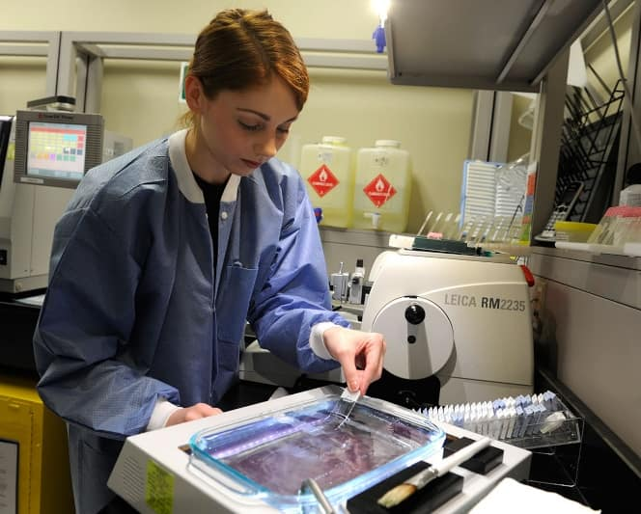



Strengthening Professional Identity
Increase visibility
Interdisciplinary collaboration
Credentialing
Leadership
Continued education
Advocacy

Slide 34
Advice for Early-Career Professionals
Build strong technical foundation
Develop critical thinking skills
Commit to lifelong learning
Advocate for your role

Slide 35


Slide 36


Access more ASCP Resources:
Support CDC OneLab
Workforce Initiatives Websitet

Slide 37

Next Month's Webinar:
TOPIC: Making the Lab’s Value Heard in the C-Suite
DATE: May 20, 2026, 11am – 12:30pm CDT
Sign up for the webinar here!

