Slide 1
Building Bridges Across
Laboratory Community
Making the Lab’s Value Heard in the C-Suite
May 20, 2026

Slide 2

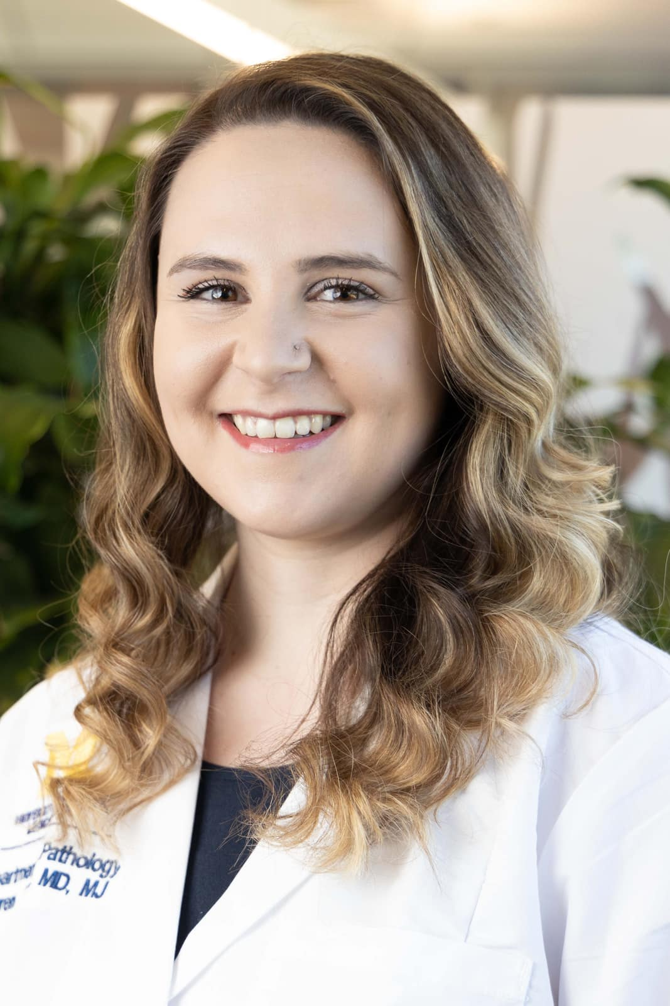
Today’s Facilitators
Sean Tucker, MBA, MLS(ASCP)^{CM}
Ex. Director of Laboratories at BJC Health Academic Campus
ASCP Past-Chair of Council of Lab Management and Administration
Dr. Lauren Miller, MD, MJ, CHC, CMQ, MLS(ASCP)^{CM}
House Officer IV – Department of Pathology

Slide 3
Format of Today’s Session
Introduction of Building Bridges Webinar
  "Making the Lab’s Value Heard in the C-Suite"
Best Practices from today's speakers
  John Baci, MBA, C-PM
    Senior Director, Pathology Foundation Financial Operations & Strategic Planning | Boston Children’s Hospital Chief Operating Officer | Children’s Hospital Pathology Foundation, Inc.
  Aaron Odegard, MS, MLS(ASCP)^{CM}SM^{CM},QLS^{CM}
    Medical Microbiologist, Laboratory Quality Coordinator, Baptist Health Jacksonville
  Scott Shone, PhD, HCLD (ABB)
    Laboratory Director, NC State Laboratory of Public Health, NC Division of Public Health, NC Department of Health and Human Services, APHL President
Q & A
Session Wrap-Up

Slide 4

The Laboratory as a Strategic Enterprise Asset
  John Baci, MBA, CPM
Notes:
ON BEHALF OF MY ASCP FRIENDS AND COLLEAGUES, WELCOME TO ANOTHER CHAPTER OF THE BUILDING BRIDGES WEBINAR SERIES.
BEFORE I BEGIN, I WOULD LIKE TO THANK THE ALWAYS OUTSTANDING ASCP STAFF WHO PUT THIS ENTIRE SERIES TOGETHER. THESE WEBINARS TAKE A SMALL VILLAGE TO ROLL OUT AND ALONG WITH THE WONDERFUL FOLKS IN CREATIVE AND MARKETING, A VERY SINCERE THANKS TO
JENNY DIAZ
DANIELLE JACKSON
ELENA TSAI
DEBBY BASU
EDNA GARCIA

Slide 5
Major Touch Points
Enterprise Medical Center Information
  Where is your department in the organizational chart
  Physical location, size, personnel, pictures
  Standard medical center contributions and participation information
Department Level Overview
  Business metrics
  Safety/quality, satisfaction surveys, regulatory, revenue, strategic initiatives, etc.).
Specific Details
  Important targeted facts, statistics, unknown/little known details
  Investment in the laboratories

Slide 6
Laboratory Image Concern …Your Objective!
Laboratories are often perceived as an ancillary testing center, rather than the foundation for diagnostic accuracy and patient safety, as well as a significant contributor to operational efficiency and overall financial health of the institution.

Slide 7
Enterprise Medical Center
General Department Statistics
  Organization chart
  What division is the laboratory part of?
  Where is the laboratory located (buildings/floors/satellite locations, etc.)
  Medical practice plan (if applicable)
  Shifts supported
  Annual test volume and/or billable units
  Net patient service revenue
  Research division (PIs, managers, post-docs, laboratory, other)

Slide 8
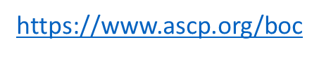
Enterprise Medical Center, cont’d
Staffing Statistics
    Medical Staff
    House Staff
    Administrative Leadership
    Administrative Personnel
    Laboratory professionals (NOTE: Use Up-to-Date ASCP BOC Credential Nomenclature)
      Scientists
      Specialists
      Certified Technicians
      Diplomates
      Interns

Slide 9
Department Level Contributions
Active Participant in Corporate Enterprise Initiatives
  Patient Safety/Quality Initiatives
    “The laboratory addresses/resolves XXX patient/employee safety issues annually”
    “Recently decreased TAT for frozen sections by 20%”
  MD/Employee/Patient Satisfaction Survey Results
    Present results and summary action plan (if applicable)
  Governing Regulatory Organizations
    Joint Commission, CAP, FDA, Department of Public Health, etc.
    General regulatory performance information

Slide 10
Department Level Overview, cont’d
Active Participant in Corporate Enterprise Initiatives, continued
  Significant Revenue Contributor
    “The clinical lab is responsible for X% of the hospital and/or clinical services revenue”
  Outreach/Global Health
    “The laboratories now process specimens from 3 states and 14 private clinics”
  Strategic Initiatives
    Molecular laboratories link to precision medicine
    Pandemic preparedness

Slide 11
Specific Department Details
Identify Recent Department Successes
  An outsourced test that is now performed in-house with faster TAT and/or cost cutting.
  A frozen section diagnosis that altered the course of a scheduled surgery.
  Showcase blood bank supplies available for trauma cases.
  Cardiac marker TAT.
  How the lab testing works to minimize length of stay.
  Outreach revenue data and/or growth.
  Showcase a complex decedent affairs case.

Slide 12
A Great Way to End
Underinvestment in the Laboratories Results in:
  Disruption to all supported services (outpatient, O.R., private offices, E.R., ICU, etc.).
  Delayed diagnoses.
  Increased potential for regulatory citations.
  Increased outsourcing to private entities.
  Employee burnout and turnover.

Slide 13
Closing
Little-Known or Forgotten Things About the Laboratories
  Labs are directly involved in every organ donation/transplant.
  Labs make every cancer diagnosis.
  Labs provide autopsy and decedent affairs support for families.
  Labs are directly involved in teaching ALL/MOST house staff.
  Unrecognized specialty teaching.
  Over 90% of medical decision-making is based on laboratory data.
  Primary supported of global health/pandemic response (Covid, Hanta)

Slide 14
Final Comments
Think “hospital/medical center ambassador.”
Grandmother rules apply:
  Well-dressed
  Politeness counts
  “Please” and “thank you”…..always.
This is NOT the time for any negativity.
Practice, practice, practice.
Prompt follow-up email to express thanks. Send a handwritten note or card with a lab photo signed by all.
Offer a tour…don’t forget pizza! Pizza = People = Discussion

Slide 15

From Cost Center to Growth Engine
How Lab Leaders Turn Value into Investment and Growth
  Aaron Odegard, MS, MLS(ASCP)^{CM}SM^{CM},QLS^{CM}
  Christina Nickel, MHA, MLS(ASCP)^{CM}, CPHQ

Slide 16


Just a few slides ahead…

Slide 17

Top challenges confronting U.S Community Hospitals – Survey Says…
1. Workforce challenges
2. Financial challenges
3. Access to care/Population Health
4. Governmental mandates
5. Technology, Patient Safety, Quality
6. Reorganization and Partnership
  **Order in how pressing an issue is to hospital CEO**
Top Issues Confronting Hospitals | American College of Healthcare Executives (ache.org)

Slide 18

Diving Deeper: Specific Concerns of the C-suite within the Top Issues
Notes:
Within these issues, respondents identified specific concerns facing their hospitals. Let’s dive in deeper…

Slide 19

Workforce Challenges (n = 228)
87%
Shortages of technicians (e.g. medical technicians, medical laboratory scientists (MLT/MLS).
86%
Shortages of registered nurses
Top Issues Confronting Hospitals | American College of Healthcare Executives (ache.org)
79%
Burnout amongst non-physician staff

Slide 20

Financial Challenges (n = 228)
94%
Increasing cost of staff, supplies, etc.
66%
Managed care and other commercial insurance payments
61%
Medicare & Medicaid Reimbursement
58%
Reducing Operating Cost
51%
Revenue Cycle Management
Top Issues Confronting Hospitals | American College of Healthcare Executives (ache.org)
50%
Inadequate funding for capital improvements

Slide 21
How Executives Decide
Executives fund 3 things:
Growth Potential
Financial Return
Strategic Alignment
Funding
If it doesn’t hit all 3 → it doesn’t get funded

Slide 22
"Making the Lab’s Value Heard in the C-Suite“
No visibility
No Investment
Missed Growth
External Competitors Win
Why It Matters:
Can influence strategy
Drives outcomes
Can be a strategic asset

Slide 23
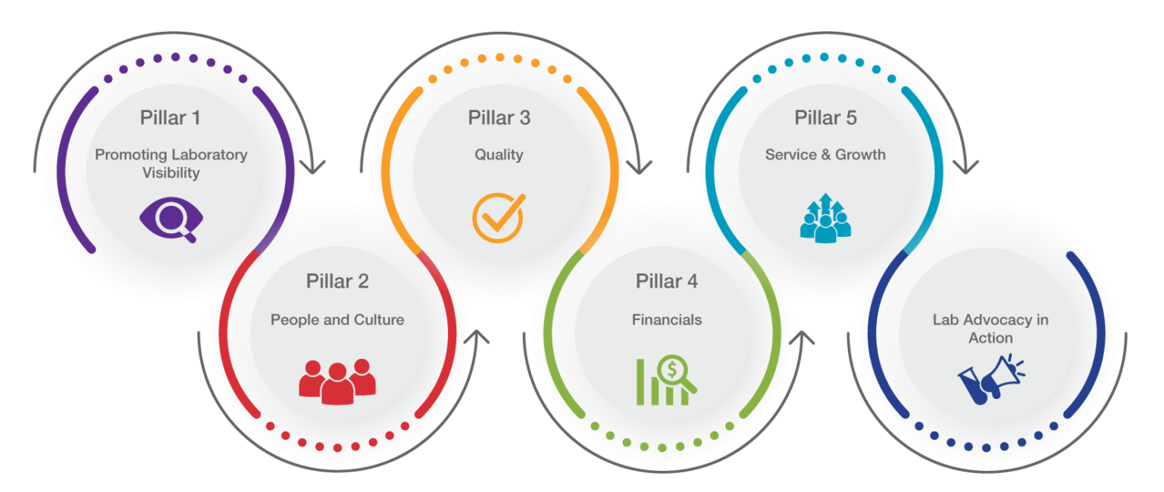

FREE Tools for Advocating for the Lab to the C-Suite

Slide 24
*Most Popular*
Tools and Resources by Pillar
Introduction to the Toolbox
1. Promoting Lab Visibility
2. People & Culture
3. Quality
4. Lab Finance
5. Service and Growth
  Introduction PowerPoint
  Example of Strategic Plan Presentation
  Sample Lab Newsletter
  Lab Newsletter Template
  Leader Rounding on Staff Log
  Leadership Potential Development Tool
  Using Quality Metrics to Justify Staffing (Guide)
  Quarterly Quality Report Template
  Using Lab Finance to Advocate for Equipment and Staff (Guide)
  Mini ROI Tool
  Harnessing Growth Tactics to Champion your Laboratory’s Goals (Guide)
  Leveraging Service to Advocate for the Lab (Guide)
Notes:
Ask if there are other tools they can think of that would be helpful for lab leaders – demo or put on list to add
On to the competition!

Slide 25

The Critical Mindset Shift
Old Approach | New Approach
Asking for Approval of Initiatives | Presenting Initiatives as Solutions
Talking Lab Metrics | Talking System Impact
Focusing on Lab Operations | Focusing on Growth & ROI
Addressing Issues When Asked | Proactively Identifying Opportunities

Slide 26

Think Like a Business: Identify Opportunity
Identify System Inefficiencies and Lost Revenue
Translate to Executive Terms
SWOT

Slide 27

Strategic Response: Reference Lab and On-Demand Testing
Retention + Expansion = Growth Engine
Reference Lab = Retention
On-Demand = Expansion

Slide 28
Strategies to expand laboratory outreach services
Grow in Your Own Community
Laboratory services to all physician practices owned by the hospital
Partner with local businesses to provide screening tests/pre-employment screening
Reference work for surrounding rural/local laboratories
Laboratory Services can aide in hospital corporate health division programs and executive health checks
Partner with home health, hospice, rehabilitation clinics
Laboratory services for independent physicians
Reference testing from surrounding businesses outside the hospital (e.g. vet, zoo, factories)

Slide 29

How do you start ?
Sell your vision to the C-suite!
  Be specific - Impact to institution and ROI*
  Leverage with data (e.g., number of draws at outpatient site; average number of tests)
  Project based on Medicare Part B paying 80% cost for most outpatient care & services
  Take expected 50% to be paid to laboratory subtract cost of testing
  = Net Projected ROI!
Analyze your business & perform a market analysis
Map your service area
Identify your top clients and prevent any leakage to competitors
Develop a marketing plan
Direct outreach: sales & marketing
Social Media
Outside outreach established
Service Level Agreements
*Not below Medicare rate/reimbursement**
Laboratory growth is essential to demonstrate value and contribute to the health system’s sustainability!
Source: 15, 16, 17

Slide 30
How do we advocate your future vision?
Start with defining laboratory service line.
What? –
The deliverable
These upper levels: be specific when talking to administrators
How? – The process of vision into reality.
Don’t be too granular! Emphasize need and added value when talking to administrators
Why? – Purpose behind your vision
Laboratory service line often viewed by administrators as an ancillary department with limited potential to increase revenue streams. Push back on this misconception!

Slide 31

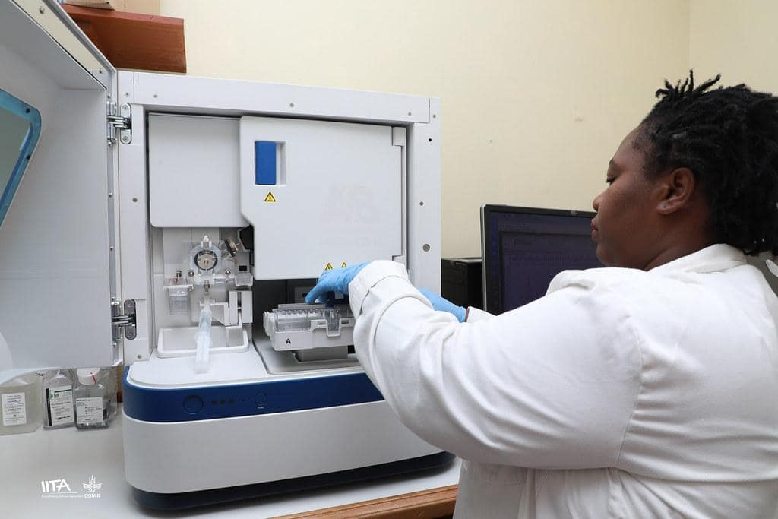



Let’s build an argument –
Only 10 minutes in the Shark Tank
Current state/Why:
Aging population is driving demand for outpatient healthcare service facilities.
Demands for more outpatient laboratory testing
Laboratory service line expansion needed
Financial Estimates:
Initial investment (e.g. infrastructure, personnel, equipment)
Payback period
Internal rate of return
Net projected ROI
Reducing impact loss from inpatient DRG reimbursement rates
Expansion Needs:
  Outpatient contracts with private payers
    *Facility can provide payer mix and big payers*
    Capital Cost (e.g., equipment, staffing, expanded infrastructure)
    Supply Cost (e.g., increased reagents)
Deliverables:
Laboratory increasing revenue through outpatient services
Decreasing impact of inpatient losses in minimal reimbursement.
Keeping hospital outpacing competitors.
Scope/Background: Demonstrated Value:
  Outpatient healthcare service and facilities set to continue exponential growth
  Additional revenue opportunity
  Benefits to other service lines
Notes:
C-suite is made up finance backgrounds, nursing/other backgrounds, realtors. Your VP of operations may have a nursing background and not know/care about the laboratory.

Slide 32
Why Leadership Leaned In
Aligning with Strategic Priorities
Transforming Expertise into Value
Building Trust through Alignment

Slide 33

Build Support by Socializing the Plan
Plant Seeds
Stakeholder Engagement
Business case + ROI
Pilot

Slide 34

Reference Lab Services:
Demonstrating Business Impact
Addressing Cost and Quality
Reduction in Sendouts
Internal Capability Building
Expanded Capacity – Automation Line
Strengthening Provider Relationships
22 New Clients (Yr 1)
Executive Business Case
New Service Line - Flow Cytometry
Revenue Captured/Generated
Reduced Sendout Spend
Higher quality services with integrated EHR for care continuity
Gateway for new Community Connect clients

Slide 35

Reference Laboratory partnerships – alternative strategies to extend your outreach laboratory service
Reference Laboratory Agreements
Reverse Reference Agreements
Independent Laboratory Specimen Draw
  Improve laboratory stewardship
  Expand existing test menu, better staff utilization, and shift resources
  Cost savings moving out specialized test with low volumes
  National reference laboratory lacks local testing capacity
  Agrees to transfer certain tests to hospital-based laboratory.
  *Geography specific*
  If not able to support outreach laboratory testing:
            Extend outpatient draw stations
            Offer blood draw for a convenience fee
            Value & Revenue

Slide 36

Translate Risk. Pivot Fast. Scale What Works.
Scale what works
Evaluate and evolve
Watch for opportunities
Issue | Opportunity
Mislabeled Specimens | IRBLs
Lost Revenue/Volume from Wellness Fairs (Closed) | Absorb Wellness as a Lab Service
We didn’t present lab problems.
We presented organizational risk.

Slide 37

On-Demand Testing:
Capturing the Consumer Market
Consumer-Centric Care Shift
Strategic Business Benefits
Strategic Health System Access
Collaboration for Success

Slide 38

Closing: Earning and Keeping a Seat at the Table
Speak Executive Language
Demonstrate Strategic Value
Act with Agility and Alignment
If you want a seat at the table—bring a growth strategy.

Slide 39

Future Self – extending your vision beyond the hospital walls
Laboratory service line needs to be transformative not merely helpful to the present state.
Vision must focus on creating a successful future for your health system.
Paint an image of the future
  Who do we want to be?
  Where do we want to go?
  **These answers represent growth in some direction**

Slide 40


Elevating the Voice of Public Health
Laboratories
  Scott M. Shone, PhD, HCLD(ABB)
  Laboratory Director

Slide 41
Conflict of Interest Disclosure
I have no conflict of interest to disclose.
Opinions shared do not represent those of the NC Department of Health and Human Services

Slide 42
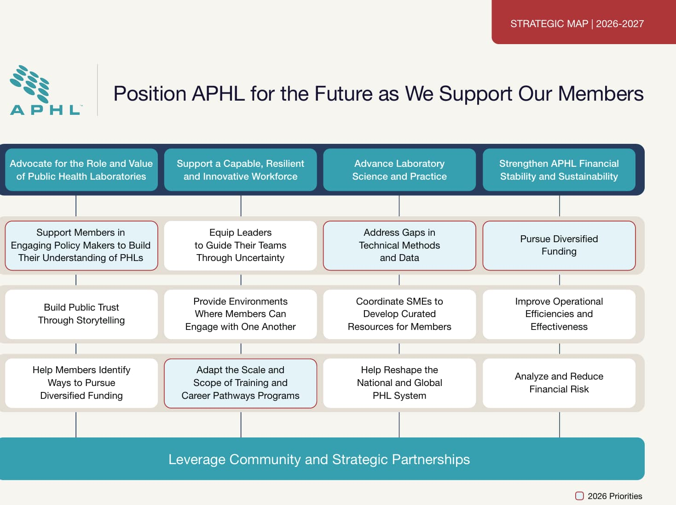
Public Health Laboratory Strategic Priorities
https://aphl.org/docs/default-source/technical/aphl-strategic-map.pdf?sfvrsn=232e9483_9

Slide 43

Tell Our Own Story
https://www.siliconrepublic.com/careers/10-memes-pay-cheeky-tribute-to-scientists

Slide 44
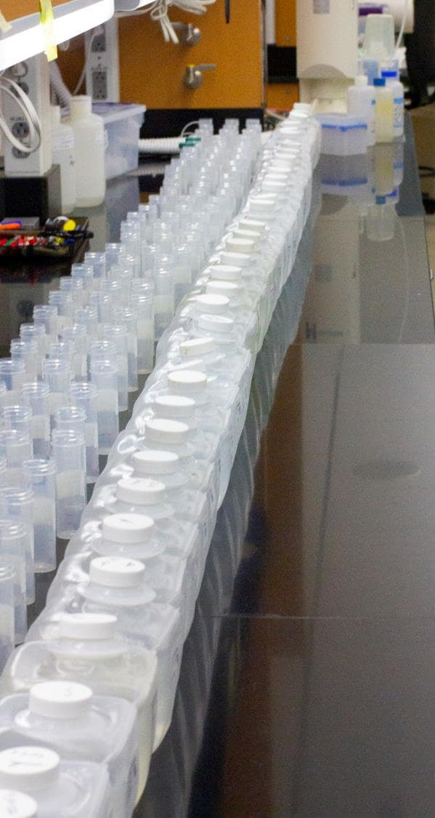
Why Tell Stories?
General Awareness
Budget
Staffing
Legislation

Slide 45

When to Tell Stories
Peacetime
During a response
When asked
In anticipation of a need
Notes:
Final points about the value of PI through perspectives as a MLS (perspectives can be broadly applied)

Slide 46
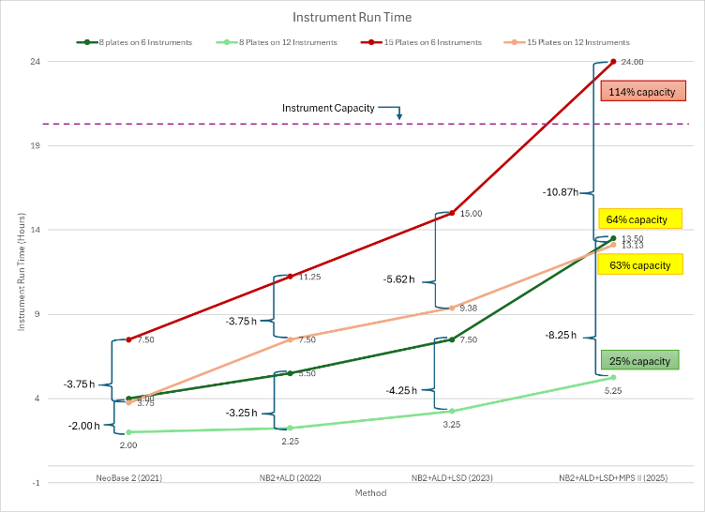
How Should I Tell Stories?
Word choice
  Test vs. Assay
Frame the issue
  Not just a laboratory issue
  Relate to agency and Division priorities
Link to previous success
  Lead in cinnamon applesauce
Data choice
Date | #PRs
Nov-24 | 15
25-Jan | 15
25-May | 15
11/7/2024 | 3
12/10/2024 | 1
1/7/2025 | 1
12/10/2024 | 1
11/7/2024 | 3
1/7/2025 | 3
8/27/2025 | 13
11/14/2025 | 13
8/20/2025 | 7
5/13/2025 | 7
11/26/2025 | 1
12/3/2025 | 2
Total | 100
100 PRs instead of 3 PRs
More than 275 Hours Spent Processing PRs & performing QA studies
~7 Weeks over 18 months
Notes:
Final points about the value of PI through perspectives as a MLS (perspectives can be broadly applied)

Slide 47

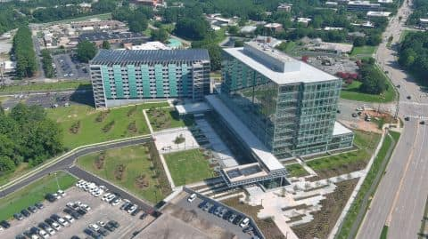


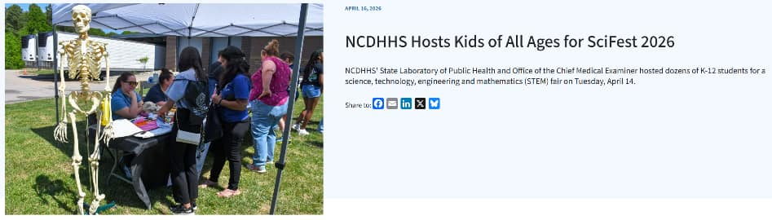
Who Should Hear The Stories
https://360.articulate.com/review/content/2396fed3-9cc7-483f-8435-253da6519588/review
https://www.visitraleigh.com/listing/north-carolina-state-legislative-building/60002/

Slide 48

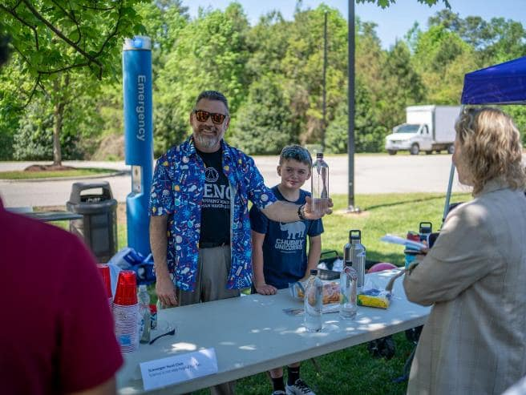
Lab Geek Corner

Slide 49
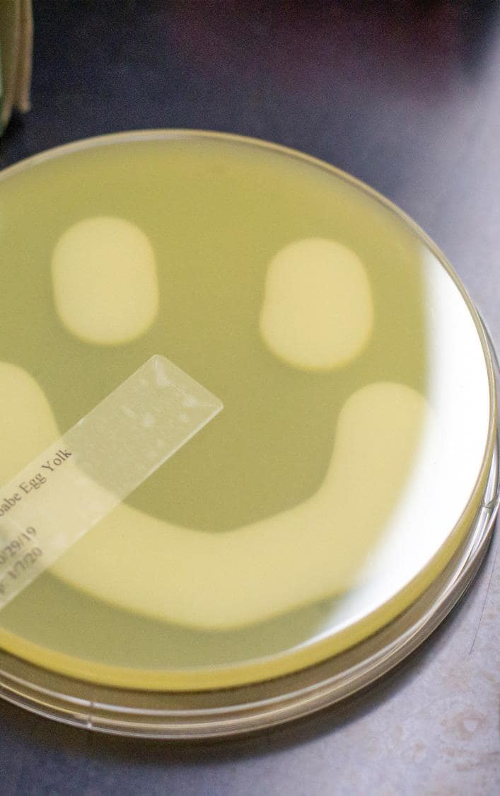
If we don’t tell our story, someone else will do it wrong.
The lab is more than tests — it is infrastructure.
We protect communities and systems every day.
Lab work drives outcomes and prevents risk.
From newborn screening to outbreak response to environmental threats, the lab is a strategic asset.
When we tell our story well, leaders understand our value.
Continues impact relies on sustained investments

Slide 50

Contact Information
Scott M. Shone, PhD, HCLD(ABB)
scott.shone@dhhs.nc.gov

Slide 51


Slide 52

Next Month's Webinar:
TOPIC: Collaboration in Action
DATE: June 17, 2026, 11am – 12:30pm CDT
Sign up for the webinar here!

Slide 53



Access more ASCP Resources:
Support CDC OneLabTM
What's My Next
Workforce Initiatives Websitet

