Slide 1
Future of Pathology: Technology, AI and Diagnostic Excellence
PATHOLOGIST WORKFORCE

Slide 2
Technological Advancements: Digital Pathology
^{Reference 1,2,3}
In pathology, the diagnostic process has been transformed by technological advancements.
1968
First instance of telepathology occurs with the real-time “television microscopy” service established between Mass General Hospital and Logan Airport Medical Station
1986
The term “telepathology” is
coined by American pathologist
Dr. Ronald S. Weinstein
1990s
Virtual microscopy and whole slide imaging (WSI) gains traction in research
2000s
As digital slide scanners become commercially available, whole slide imaging becomes more widespread
2017
The Philips IntelliSite Pathology Solution becomes the first WSI scanner approved by the FDA
2018
IDx-DR becomes the first medical device approved by the FDA to conduct diagnosis using AI
2021
The first AI tool for primary diagnosis, Paige Prostate, receives FDA authorization to assist in detecting prostate cancer on slides

Slide 3
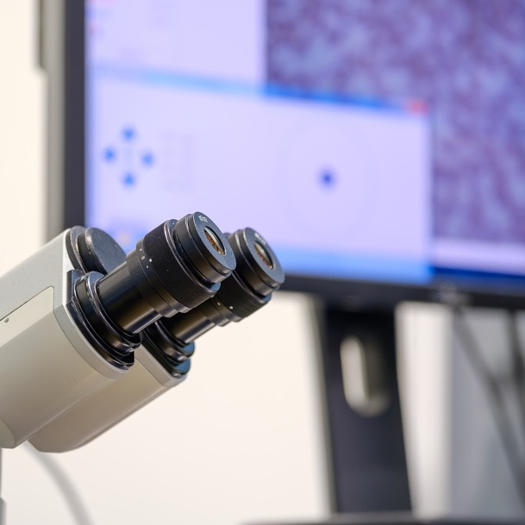
Technological Advancements:
Digital Pathology Today
^{Reference 4,5,6}
Digital pathology is the practice of pathology using digital imaging made possible through technologies like whole slide imaging, replacing glass slides and microscopes.
It enables remote collaboration, the integration of artificial intelligence into diagnostic workflows and cloud-based data sharing for research.^{4,5}

Slide 4
Expanding Applications of Digital Pathology
^{Reference 4,5,6}
Primary diagnosis
Remote consultations (Telepathology)
Molecular pathology
Digital pathology allows pathologists to review slides at sufficient resolution for a diagnosis without a microscope, increasing efficiency, speed and accuracy.
Digital pathology systems facilitate collaborative workflows both between colleagues internally and externally with experts at other institutions. It is also particularly useful for intraoperative (‘frozen section’) consultations, which involve real-time assessments of patient specimens during surgery.
Pathology laboratories are using molecular testing technologies to provide more comprehensive, accurate and personalized care to patients.
Multidisciplinary team meetings
Digital pathology systems can be used to share and review pathology digital images among healthcare professionals from different medical domains, improving the quality of medical education and training.
Image Analysis
Image analysis is being increasingly used for IHC quantification of predictive and prognostic biomarkers, increasing the accuracy and standardization of biomarker quantification.
Future Technologies
Multispectral imaging and slide-less pathology imaging techniques like multiphoton imaging and fluorescence imitating bright-field imaging (FIBI) are currently emerging clinical pathology research topics, but have the potential to significantly advance pathology as a discipline.

Slide 5
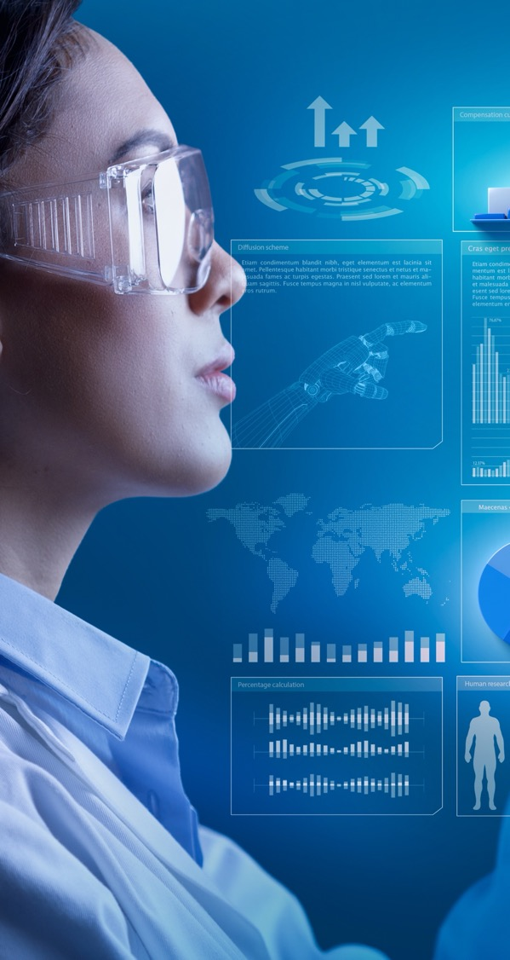
Current Applications of AI in the Pathology Workflow
^{Reference 7,9,11}
AI algorithms are used to analyze digitized pathology slides for disease detection, classification and grading
AI accelerates and improves pathology workflows by analyzing digitized slides for disease detection, classification, and grading.
Automates repetitive tasks such as feature detection, biomarker quantification, and tissue segmentation, reducing inter‑observer variability.
Boosts diagnostic accuracy by identifying subtle patterns often missed by human review.
PROVEN IMPACT: At Ohio State’s Wexner Medical Center, AI‑supported remote sign‑out has enabled faster, more accurate cancer diagnoses.

Slide 6
What’s Next for AI in Pathology?
^{Reference 8}
Experts predict that by 2030, AI applications would be in routine use for::
Automated quantification of immunohistochemical (IHC) and immunofluorescent (IF) biomarkers
Counting mitotic figures and lymphocytes
Lymph node metastasis identification
The applications projected to be in routine use by 2030 are basic, repetitive tasks currently performed by pathologists, in contrast to the more “aspirational” topics amongst researchers and industry stakeholders such as predicting molecular biomarker status.

Slide 7
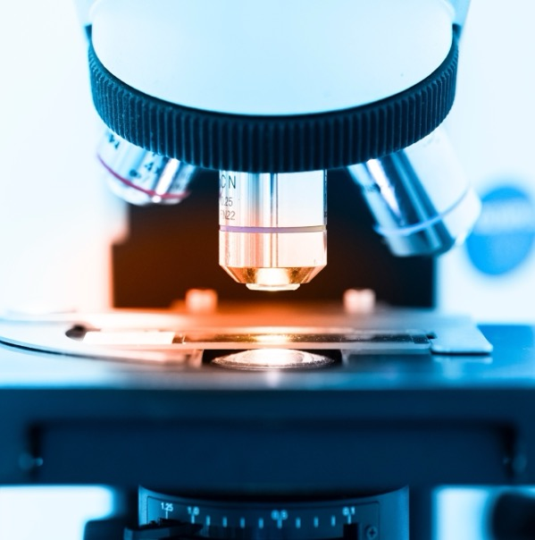
Where Do We Go From Here? Striving for Diagnostic Excellence
Pathologists are essential to clinical diagnosis and will continue to play a critical role in providing oversight and expertise as the pathology practice evolves.
As increasing implementation of digital pathology systems and machine learning/AI applications shift how diagnostics is practiced, there are both increasing challenges and possibilities for advancing pathology and patient outcomes as a whole.

Slide 8
Current Challenges for Digital Pathology
^{Reference 4,9}
Technical
“Black-box” issues concerning the interpretability and transparency of AI algorithms prevail
Variability in image quality and lack of standardized image format impact accuracy of image analysis
Logistic
Significant financial investments are needed for robust IT infrastructures capable of supporting WSI system demands
Integration of digital pathology tools into existing pathology workflows
Regulatory
Establishing robust, validated regulatory frameworks
Gaining regulatory approval and compliance for AI-based diagnostic tools
Ethical
Data privacy and security rights of patients must be addressed as sensitive patient data is being transferred between institutions at large volumes
Ensuring that AI algorithms are promote health care equity and incorporate diverse population data

Slide 9

Where Do We Go From Here?
Global & Workforce Impact
^{Reference 10}
Diagnostics is critical to quality healthcare, but this is underrecognized, leading to “underfunding and inadequate resources at all levels”
47%
  47% of the global population has little to no access to diagnostics
19%
  In low and middle income countries, only 19% of the population have access to basic diagnostic tests

Slide 10
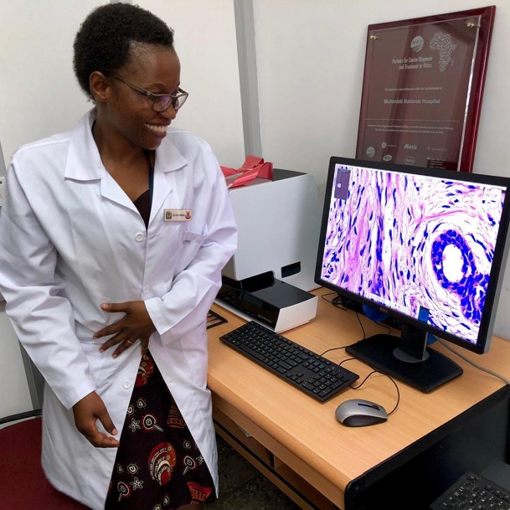
Strategies to Improve
Global Access and Pathology Workforce Shortages
^{Reference 10}
Address workforce shortages through telepathology and remote collaboration
Support equitable access for rural/underserved regions through virtual diagnostics
Continuous AI learning from global datasets will help with improved accuracy and fairness.

Slide 11
References
Bashshur RL, Krupinski EA, Weinstein RS, Dunn MR, Bashshur N. The Empirical Foundations of Telepathology: Evidence of Feasibility and Intermediate Effects. Telemedicine and e-Health. 2017;23(3):155-191. doi:https://doi.org/10.1089/tmj.2016.0278
‌Pantanowitz L, Sharma A, Carter A, Kurc T, Sussman A, Saltz J. Twenty years of digital pathology: An overview of the road travelled, what is on the horizon, and the emergence of vendor-neutral archives. Journal of Pathology Informatics. 2018;9(1):40. doi:https://doi.org/10.4103/jpi.jpi_69_18
‌Ahuja S, Zaheer S. Advancements in pathology: Digital transformation, precision medicine, and beyond. Journal of Pathology Informatics. Published online November 19, 2024:100408. doi:https://doi.org/10.1016/j.jpi.2024.100408
Zhang DY, Venkat A, Khasawneh H, Sali R, Zhang V, Pei Z. Implementation of Digital Pathology and Artificial Intelligence in Routine Pathology Practice. Laboratory Investigation. 2024;104(9):102111. doi:https://doi.org/10.1016/j.labinv.2024.102111
Masjoodi S, Anbardar MH, Shokripour M, Omidifar N. Whole Slide Imaging (WSI) in Pathology: Emerging Trends and Future Applications in Clinical Diagnostics, Medical Education, and Pathology. Iranian journal of pathology. 2025;20(3):257-265. doi:https://doi.org/10.30699/ijp.2025.2044210.3367

Slide 12
References
Hanna MG, Ardon O. Digital pathology systems enabling quality patient care. Genes, Chromosomes and Cancer. 2023;62(11):685-697. doi:https://doi.org/10.1002/gcc.23192
Kim I, Kang K, Song Y, Kim TJ. Application of Artificial Intelligence in Pathology: Trends and Challenges. Diagnostics. 2022;12(11):2794. doi:https://doi.org/10.3390/diagnostics12112794
Berbís MA, McClintock DS, Bychkov A, et al. Computational pathology in 2030: a Delphi study forecasting the role of AI in pathology within the next decade. eBioMedicine. 2023;88:104427. doi:https://doi.org/10.1016/j.ebiom.2022.104427
Fatima G, Hekmat Alhmadi, Mahdi AA, et al. Transforming Diagnostics: A Comprehensive Review of Advances in Digital Pathology. Cureus. Published online October 19, 2024. doi:https://doi.org/10.7759/cureus.71890
Fleming KA, Horton S, Wilson ML, et al. The Lancet Commission on diagnostics: transforming access to diagnostics. The Lancet. 2021;398(10315):1997-2050. doi:https://doi.org/10.1016/s0140-6736(21)00673-5
Lujan GM, Savage J, Shana’ah A, et al. Digital Pathology Initiatives and Experience of a Large Academic Institution During the Coronavirus Disease 2019 (COVID-19) Pandemic. Archives of Pathology & Laboratory Medicine. 2021;145(9):1051-1061. doi:https://doi.org/10.5858/arpa.2020-0715-SA

