Slide 1
Fighting Misinformation in the Public Sphere
Today's Speakers: Rodney Rohde, Kamran Mirza, Brian Castrucci
Building Bridges Across the Laboratory Community – March 11th, 2026

Slide 2
Format of Today’s Session
Introduction of Building Bridges Webinar
  "Fighting Misinformation in the Public Sphere"
Best Practices from today's speakers:
  Rodney E Rohde, PhD, MS, SM(ASCP)^{CM},SV^{CM},MB^{CM}, FACSc
  Texas State University System University Distinguished Chair & Professor, Medical Laboratory Science [MLS] Program.
  Kamran M. Mirza, MD, PhD, FCAP, FASCP
  Godfrey Dorr Stobbe Professor of Pathology Education, Clinical Professor of Pathology (Hematopathology) and Assistant Chair for Education Director, Division of Training Programs & Communication Department of Pathology and Clinical Laboratories, University of Michigan
  Brian C. Castrucci, DrPH
  President and Chief Executive Officer, de Beaumont Foundation.
Q & A
Session Wrap-Up

Slide 3
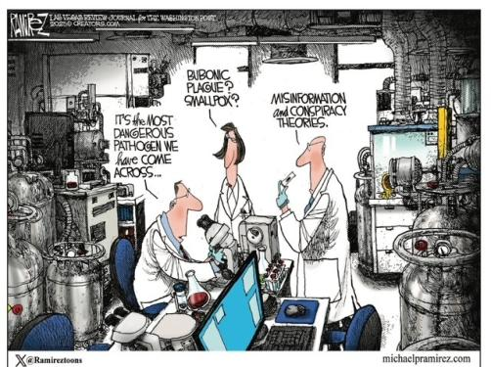
Building Bridges Across the Laboratory Community: Fighting Misinformation in the Public Sphere
Talking Points:
Misinformation is not just a communications issue — it is a patient safety issue.
Laboratory professionals are among the most trusted scientific experts — but often the least visible.
As educators, we have a responsibility to prepare laboratorians to engage ethically and effectively in the public sphere.
This is about trust, transparency, and professional integrity.

Slide 4
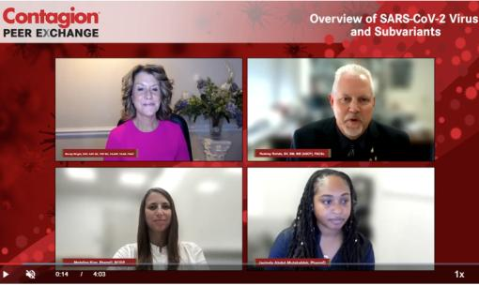
Why Misinformation Matters to Laboratory Medicine
From Bench to Public Trust
False narratives about testing, vaccines, pathogens, and public health erode trust.
Laboratory data drives clinical decisions — if trust in diagnostics declines, healthcare outcomes suffer.
During COVID-19, we witnessed how rapidly misinformation spreads — often faster than peer-reviewed evidence.
Silence from experts leaves a vacuum filled by speculation.
Source: Contagion Live – Dr. Rodney E. Rohde Webinar Series. https://www.contagionlive.com/view/overview-of-sars-cov-2-virus-and-subvariants

Slide 5
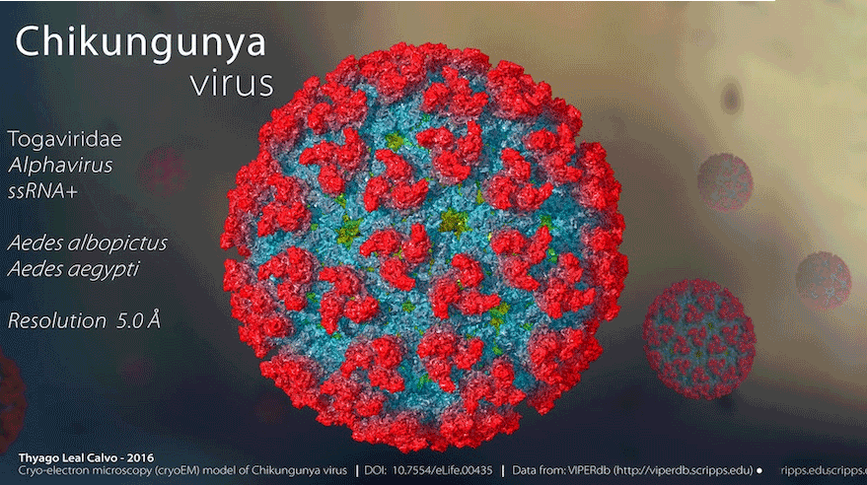
The Educator’s Responsibility -
Training Scientists Who Can Communicate
Technical competency alone is no longer sufficient.
Students must learn:
  Risk communication principles
  Media literacy
  Public engagement skills
We must normalize communication training in MLS/CLS curricula.
Scientific accuracy and accessibility are not mutually exclusive.
Source: ASM – R. Rohde author – Climate, Vectors and Virus Keep Chikungunya a Global Focus
https://asm.org/articles/2025/november/climate-vectors-viruses-chikungunya-global-focus

Slide 6
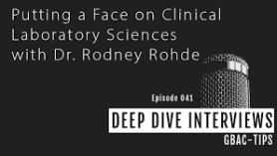
Enhancing Scientific & Public Health Literacy –
Teaching Beyond the Textbook
Talking points
Talking points
Scientific literacy includes understanding:
  How evidence evolves
  How uncertainty is communicated
  How peer review works
Teach students to explain:
  Sensitivity vs. specificity in plain language
  What “false positive” really means
Literacy empowers professionals to confidently address misconceptions.

Slide 7
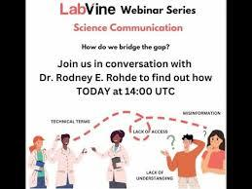
Where Should Laboratory Professionals Engage?
Identifying Appropriate Platforms
Professional engagement can occur on:
  Institutional websites
  Community forums
  LinkedIn / Social media
  Public webinars / Podcasts
  Explainer articles
Not every platform fits every message.
Encourage professionalism and ethical boundaries online.
Model appropriate digital conduct for students.

Slide 8
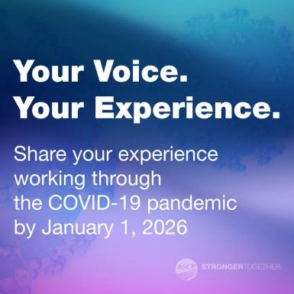
Strategies to Counter Misinformation - Practical Approaches
Lead with empathy, not confrontation.
Correct misinformation with evidence — not ridicule.
Use storytelling to humanize laboratory science.
Reinforce consensus from credible organizations like:
  Centers for Disease Control and Prevention
  World Health Organization
Teach students to cite responsibly and transparently.

Slide 9
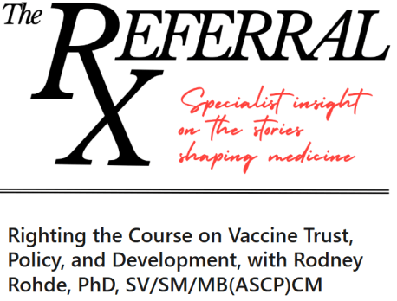

Upholding the Integrity of the Laboratory Profession
Ethics in the Public Sphere
Protect patient confidentiality at all times.
Distinguish personal opinions from evidence-based statements.
Follow institutional and professional codes of ethics.
Represent the profession with clarity and professionalism.
Credibility takes years to build — and seconds to lose.
Source: The Referral – Dr. Rodney E. Rohde Editorial. https://www.linkedin.com/newsletters/the-referral-7355592224778133505/

Slide 10
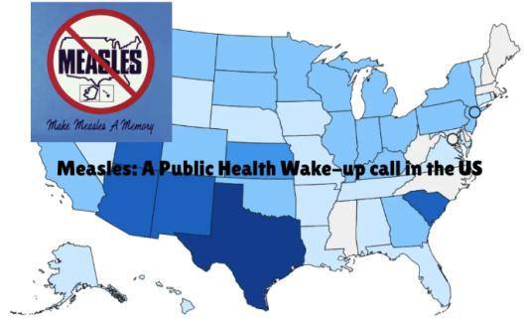
Building Public Trust Through Transparency - What the Public Needs to Hear
Explain how laboratory testing actually works.
Be honest about limitations and evolving science.
Acknowledge uncertainty when it exists.
Share how quality control and accreditation protect patients.
Transparency strengthens confidence.
Source: Rodney E. Rohde – Podcast Guest Outbreak News https://outbreaknewstoday.substack.com/p/measles-a-public-health-wake-up-call

Slide 11
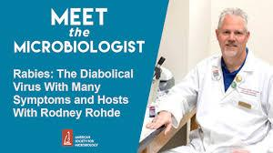
Preparing the Next Generation - Embedding Communication in Laboratory Education
Talking points
Talking points
Integrate mock media interviews into coursework.
Assign evidence-based myth-busting projects.
Evaluate students [and colleagues] on clarity of explanation — not just technical precision.
Encourage participation in professional societies.
The next public health crisis is not a matter of if — but when.

Slide 12
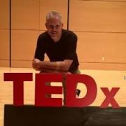
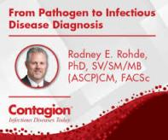
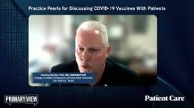
Call to Action & Q&A
From Discussion to Action
Laboratory professionals must step into visible leadership roles.
Educators must intentionally cultivate communicators.
Professional societies like ASCP, APHL, ASCLS, and ASM provide a unified voice.
We cannot allow misinformation to define our profession.
Invite participants to engage during the moderated Q&A.

Slide 13
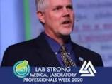

“Laboratory professionals generate the data that guides medicine, shapes public health policy, and saves lives — but data alone does not build trust. People do. As educators and scientists, we must step beyond the bench, communicate with clarity and integrity, and ensure that truth travels farther than misinformation. Our profession depends on it — and so do our patients.”
Doc R’s Final Thoughts!

Slide 14
From Diagnostic Truth to Public Trust:
The Pathologists Role in Fighting Misinformation in the Public Sphere
Kamran M. Mirza, MD, PhD, MLS(ASCP), FASCP
Notes:
From Diagnostic Truth to Public Trust:
The Pathologists Role in Fighting Misinformation in the Public Sphere

Slide 15
My Lens
Practicing pathologist
Educator of medical students, residents and medical laboratory professionals
Member of the laboratory community
Notes:
Dr. Rohde will highlight the critical role of laboratory education and scientific literacy. My perspective complements that. I want to focus on what happens when laboratory data leaves the bench and enters the diagnostic ecosystem — physicians, trainees, patients, and the public.

Slide 16
My Focus
Diagnostic interpretation
Trainee education
Patient-facing pathology
Protecting trust in diagnostics

Slide 17
The Information Environment Has Changed
Three shifts define the current era
Information spreads instantly
Patients access reports directly
Trust must be earned continuously
Notes:
The laboratory used to communicate largely through patient-facing physicians.
That model has changed dramatically with patient portals and digital communication.
Diagnostic information now travels directly to patients and the public.
That changes our responsibility.

Slide 18

Misinformation in Medicine Is Often Subtle
Not just falsehoods
It is often:
Oversimplification
Loss of clinical context
Misinterpretation of risk
False certainty
Notes:
The most dangerous misinformation in medicine often begins with a true statement presented without the necessary context.
A biomarker becomes a diagnosis.
A screening test becomes certainty.
A mutation becomes destiny.
Pathology exists to prevent those errors.

Slide 19
Pathology: Medicine’s Discipline of Uncertainty
Pathologists routinely interpret
Probabilities
Imperfect tests
Sampling limitations
Context-dependent results
Notes:
Diagnostic medicine is fundamentally probabilistic.
Sensitivity and specificity matter.
Pre-test probability matters.
Clinical context matters.
Pathologists spend their careers navigating this complexity responsibly.
That makes our voice uniquely important when misinformation distorts diagnostic reasoning.

Slide 20
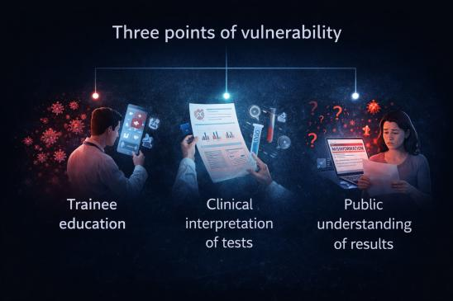
Where Misinformation Enters Diagnostic Medicine
Notes:
The problem begins long before social media.
It begins when trainees misunderstand evidence.
It continues when tests are interpreted outside their intended context.
And it reaches the public when complex results are encountered without explanation.

Slide 21
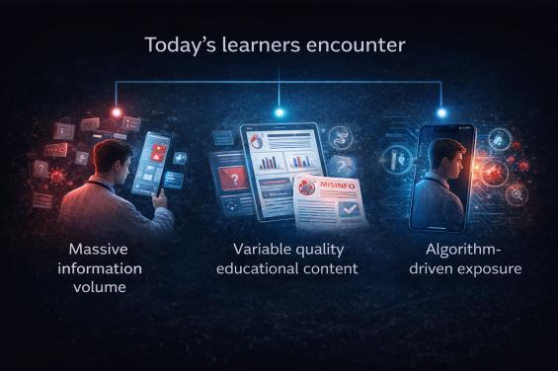
The Trainee Challenge
Notes:
Students and residents are brilliant and motivated.
But the learning environment has changed.
Information now arrives faster than context.
Our responsibility as educators is not only to teach facts, but to teach how to interpret evidence responsibly.

Slide 22
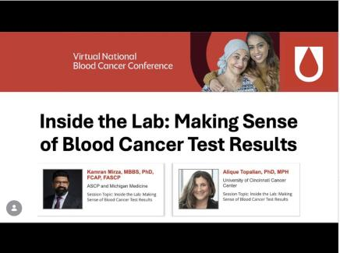
When Diagnostic Results Reach Patients
Patient portals changed the audience for pathology reports.
Patients now encounter:
Technical terminology
Diagnostic uncertainty
Unexpected abnormal results
Notes:
The 21st Century Cures Act greatly expanded transparency in medicine.
This is a positive step.
But access does not guarantee understanding.
Without context, laboratory results can generate confusion or anxiety.

Slide 23
Scientific Literacy and Diagnostic Literacy
Understanding diagnostics requires knowing
How evidence evolves
What uncertainty means
Why tests have limitations
Notes:
Scientific literacy is not just knowing facts.
It is understanding how knowledge changes.
It is understanding why different tests answer different questions.
And it is understanding why responsible medicine acknowledges uncertainty.

Slide 24
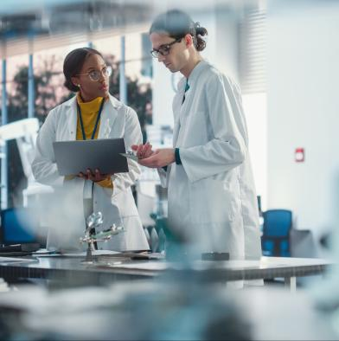
The Pathologist’s Communication Framework
Four responsibilities
Clarify
Contextualize
Communicate early
Collaborate
Notes:
We do not need every pathologist to become a public communicator.
But we do need every pathologist to communicate clearly within their professional sphere.
Clarify terminology.
Contextualize results.
Communicate early in training.
Collaborate across the laboratory team.

Slide 25
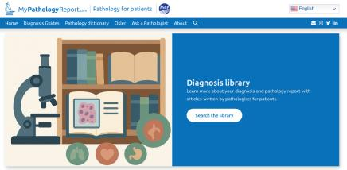
Where to Direct People for Trusted Information
Encourage use of vetted sources
Professional societies
Public health agencies
Institutional educational resources
Peer-reviewed literature
Evidence-based clinical guidelines
Notes:
Correcting misinformation is not just about saying “that’s wrong.”
It is about directing people toward trustworthy information ecosystems.
Professional societies and public health institutions play a crucial role in maintaining those resources.

Slide 26
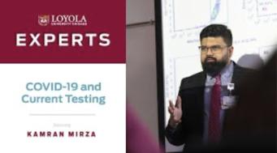
Defending the Integrity of the Laboratory Professions
Integrity depends on
Scientific rigor
Professional standards
Transparency
Respect across laboratory roles
Notes:
Misinformation does not only harm patients.
It harms trust in the laboratory workforce.
Pathologists, Medical Laboratory Scientists, Cytologists, and laboratory professionals all contribute to diagnostic truth.
Protecting that ecosystem requires visible professionalism and clear communication.

Slide 27
Communicating With Different Stakeholders
Patients
Trainees
Clinical colleagues
Policymakers
Notes:
Each audience requires a slightly different approach.
Patients need clarity.
Trainees need intellectual humility.
Clinicians need contextual interpretation.
Policymakers need clear articulation of how diagnostics support public health.

Slide 28
What Pathologists and Educators Can Do Now
Teach diagnostic reasoning explicitly
Review patient-facing report clarity
Promote vetted educational resources
Engage responsibly in public discussions
Support laboratory professional visibility
Notes:
The goal is not to win arguments online.
The goal is to strengthen the information ecosystem around diagnostics.
Small, consistent actions in education, reporting, and professional engagement can have significant impact.

Slide 29
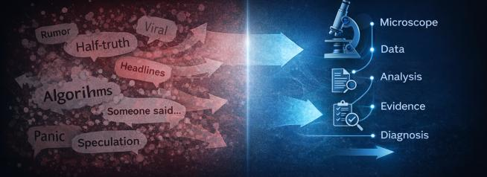
From Diagnostic Truth to Public Trust
Misinformation is not defeated by volume.
It is defeated by rigor.
Notes:
Every day in the laboratory we practice disciplined reasoning under uncertainty.
We question assumptions.
We verify findings.
We interpret evidence in context.
That same mindset must extend beyond the laboratory.
Because when patients read their reports, when trainees search for answers, and when the public tries to understand risk, they are looking for clarity.
And clarity is what the laboratory profession provides.
If we bring the intellectual honesty of pathology into the public sphere, we do more than defend our profession.
We strengthen trust in medicine itself.

Slide 30
Misinformation Is Often a Matter of Perspective
My misinformation is your trust. Your truth is my misinformation
People evaluate information through identity, trust, and worldview
This makes misinformation a trust problem, not just a knowledge problem

Slide 31
Why This Moment Is Hard
Science advances through disagreement. Misinformation thrives on confusion
Experts disagree publicly
Conflicting signals spread rapidly
Audiences struggle to decide who to trust

Slide 32
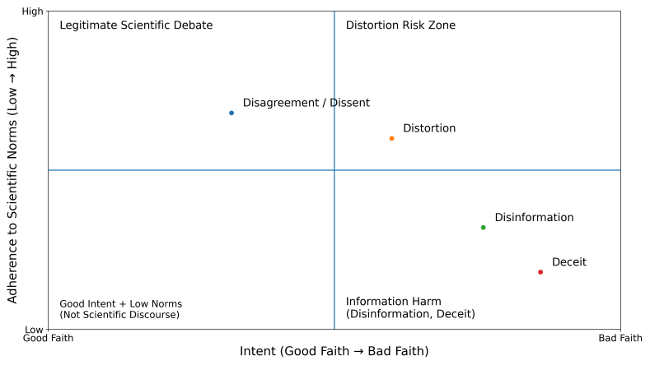
Intent-Norms Framework Four D’s of the Information Ecosystem

Slide 33
Intent-Norms Framework Four D’s of the Information Ecosystem
Disagreement/Dissent – good faith debate that advances science
Distortion – information simplified, exaggerated, or taken out of context
Disinformation – false information spread intentionally
Deception – deliberate manipulation or fabricated credibility
A healthy information ecosystem makes room for disagreement but has zero tolerance for deception

Slide 34
Building Resilience Against Misinformation
The fight against misinformation is not just a fight for facts. It’s a fight for trust
Prepare people before misinformation spreads (pre-bunking)
Focus on trust, not just accuracy
Strengthen trusted messengers and networks

Slide 35
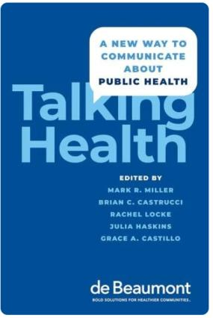
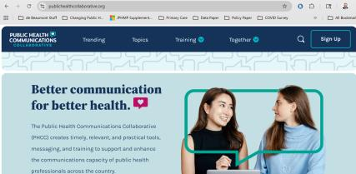
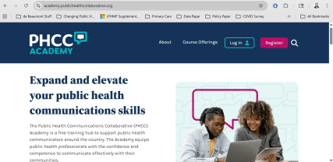
Resources

Slide 36


Slide 37
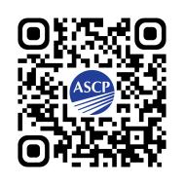
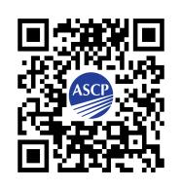
Support CDC OneLab
Workforce Initiatives Website
Access more ASCP Resources here:

Slide 38
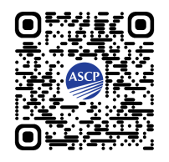
Next Month's Webinar:
TOPIC: PROFESSIONAL IDENTITY
DATE: April 22, 2026, 11am – 12:30pm CDT
Sign up for the webinar here!

