Slide 1
Demographics
PATHOLOGIST WORKFORCE

Slide 2
The US Pathologist:
Who Are We?
^{Reference 1,2,3}
MEDIAN AGE
50-59
MEDICAL SCHOOL
GENDER
$
AVERAGE SALARY
$388,000
RACE/ETHNICITY

Slide 3
By The Numbers:
An Overview
^{Reference 1,2}
21, 244
Total Number of
US Pathologists in 2023
1,010,892
Total Number of
US Physicians in 2023
2.1%
% of US Physicians in Pathology

Slide 4
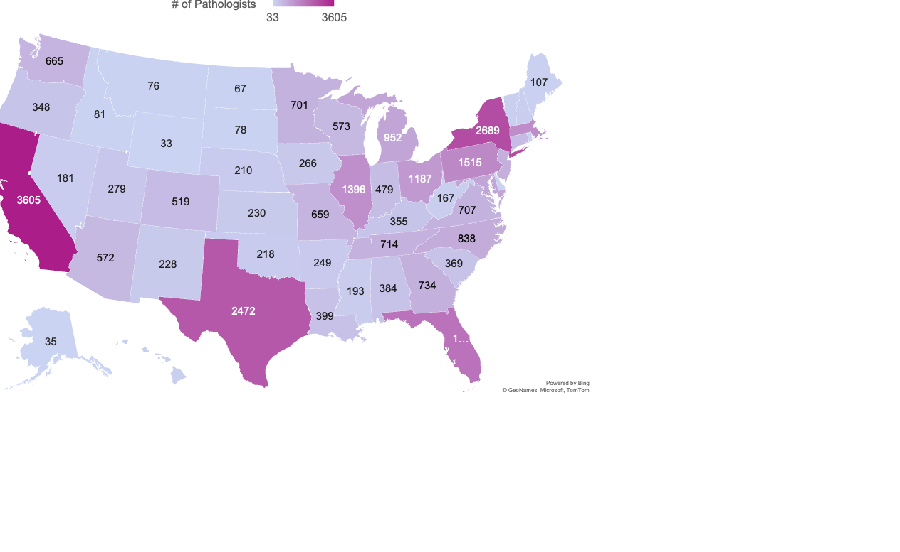
Number of Pathologists by State
TOP 3
California: 3,605
New York: 2,689
Texas: 2,472
BOTTOM 3
North Dakota: 67
Alaska: 35
Wyoming: 33

Slide 5
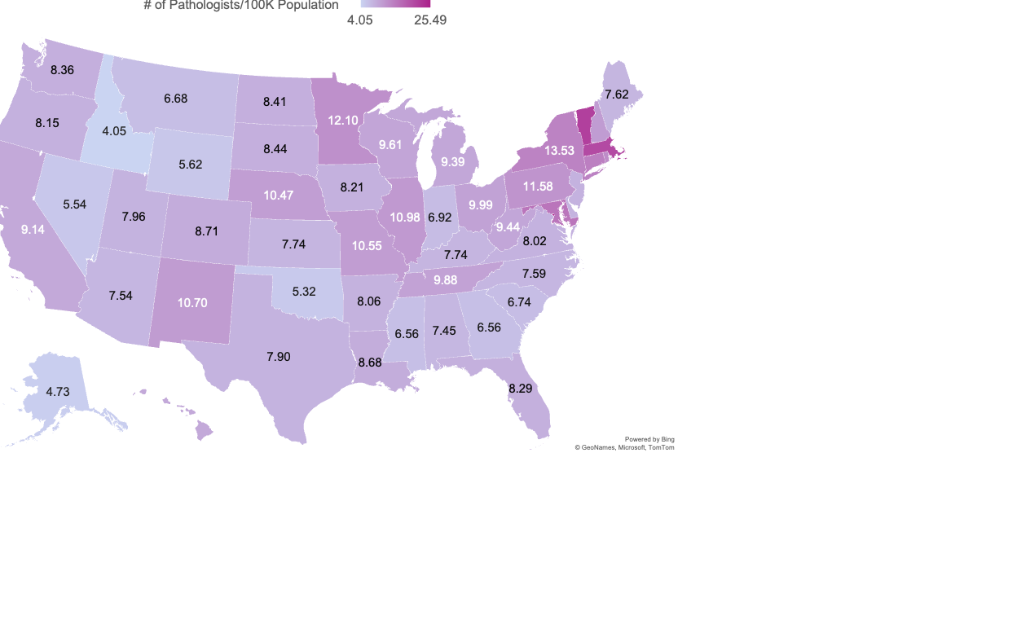
Number of Pathologists per 100K of Population
TOP 3
District of Columbia: 25.49
Vermont: 21.4
Massachusetts: 20.3
BOTTOM 3
Oklahoma: 5.32
Alaska: 4.73
Idaho: 4.05

Slide 6
Top 5 US Pathology
Specialties
^{Reference 4}
59.6%
Anatomic/Clinical Pathology
6.5%
Cytopathology
5.9%
Hematology
5.1%
Selective Pathology
4.4%
Dermatopathology

Slide 7
Age Profile (2023)
^{Reference 2}

Slide 8
Gender Profile (2023)
^{Reference 2}

Slide 9
Race/Ethnicity Breakdown (2023)
^{Reference 2}

Slide 10
Compensation
^{Reference 3}
On average, pathologist salaries have increased by 4.1% every year since 2020.

Slide 11
References
Black-Schaffer SW, Gross DJ, Nouri Z. et al. Re-evaluation of methodology for estimating US specialty physician workforce. Health Affairs Scholar. 2(4). doi: 10.1093/haschl/qxae033
Kelly, R. US Physician Workforce Dashboard. Association of American Medical Colleges. 2024. https://www.aamc.org/data-reports/report/us-physician-workforce-data-dashboard
Medscape Physician Compensation Report, 2020-2025. Medscape. 2025.
American Medical Association. AMA Health Workforce Explorer. Accessed in February 2023. https://www.ama-assn.org/about/research/health-workforce-mapper-app
U.S. Census Bureau. State Population Totals and Components of Change: 2020-2024. Census.gov. Published December 2024. https://www.census.gov/data/tables/time-series/demo/popest/2020s-state-total.html

