Slide 1
DISCOVER YOUR NEXT
Careers In Laboratory Medicine
www.whatsmynext.org

Slide 2
The Challenge
24,000
Medical Laboratory Professionals needed ^{annually through 2032}
8,000
^{Students graduate} ^{each year}
Notes:
Speaking Points
Aging population = increasing demand for laboratory services; however, supply of qualified laboratory professionals is decreasing
U.S. Department of Labor projects 11,000 medical laboratory professionals needed each year through 2018; however, only 5,000 students graduate each year
This means there is a huge potential for young people to get involved in a laboratory career.

Slide 3
Your Opportunity for the Future
^{Pathologist}
^{Pathologist} ^{Assistant}
^{Medical Laboratory} ^{Scientist}
^{Medical Laboratory} ^{Technician}
^{Phlebotomist}
^{$37,000}
^{$68,700}
^{$86,900}
^{$105,500}
^{$300,000}
^{< 2 Years}
^{2 Years}
^{4 Years}
^{5-6 Years}
^{8+ Years}
^{Certificate} ^{Program}
^{Associates} ^{Degree}
^{Bachelor’s} ^{Degree}
^{Bachelor’s &}
^{Master’s Degree}
^{Bachelor’s Degree,} ^{Medical School & Residency}
Notes:
Speaking Points
Laboratory profession offers a variety of careers that have different educational requirements. Many students can begin their career as a Phlebotomist and work their way up by completing more educational requirements.
Phlebotomist
Works on the front lines with patients to collect blood samples
Educational requirement: less than 2 years of school at a community college to complete a certificate program
Mean Annual Salary: $37,000
Medical Laboratory Technician
Conducts tests that influence a doctor’s treatment decision
Educational requirement: 2 years of school at a community college to complete an Associate’s Degree
Mean Annual Salary: $68,700
Medical Laboratory Scientist
Studies patient specimens to help doctors diagnose and treat diseases
Educational requirement: 4 years at a college or university to complete a Bachelor’s Degree
Mean Annual Salary: $86,900
Pathologist Assistant
Provide hands-on assistance that pathologists need to help patients; works directly with specimens and tissues
Educational requirement: 4 years at a college or university to complete a Bachelor’s Degree then another 1-2 years in graduate school to complete a Master’s Degree
Mean Annual Salary: $105,500
Pathologist
Lead laboratory teams to diagnose diseases
Educational requirement: 4 years at a college or university to complete a bachelor’s degree; 4 years at a medical school to earn your Medical Degree (MD); complete a 4-5 year Residency Program
Mean Annual Salary: $300,000

Slide 4
Your Next for a Career in Lab Medicine
STUDY
Classes like biology, chemistry and algebra help you prepare for college.
EXPLORE
There are a variety of medical laboratory occupations. Each role plays an important part in the laboratory
ENROLL
Select a community college or university with a medical laboratory science program. Go to www.naacls.org to search for a program
INTERN
On-the-job experience will help you prepare for working in the laboratory profession.
WORK
Get a job that fits your skills!
CERTIFY
Certification helps laboratory professionals earn a higher income and, also, provides more job opportunities.
Notes:
Speaking Points
Follow these steps to a career in the medical laboratory.

Slide 5
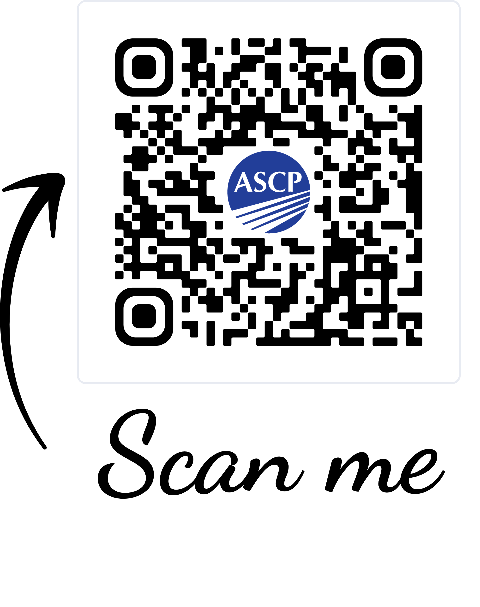
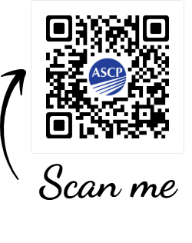
Access ASCP Career Roadmap and Career Ambassadors!
Scan this QR code to request
Career Ambassadors in your area!
Download the
Laboratory Careers Roadmap
& share with your colleagues and students!

Slide 6
DISCOVER YOUR NEXT
Careers In Laboratory Medicine
www.whatsmynext.org

