Slide 1


Multidisciplinary Approach to Diagnosis and Biomarker Testing
Provided by a partnership between the American Society for Clinical Pathology and Clinical Care Options, LLC.
February 15, 2022, 2 - 3 PM Eastern
Location: Live Webinar
This activity is supported by an educational grant from Pfizer Inc. and Seagen Inc.

Slide 2
Disclosures
Dr. Wei Jiang has no disclosures to report.
Dr. Atrayee Basu Mallick has reported the following disclosures:
Consulting, Bayer and Novartis, Research fund to the institution from Bristol-Myers Squibb, Rgenix, Ayala, Tracon, Pyramid, Criterium
Provided by the American Society for Clinical Pathology
in partnership with Clinical Care Options, LLC.
This activity is supported by educational grants from Pfizer Inc. and Seagen Inc.

Slide 3
Multidisciplinary Approach to Diagnosis
and Biomarker Testing
Wei Jiang, MD, PhD
Director, GI, Liver and Pancreas Pathology - Department of Pathology, Anatomy and Cell Biology
Director, Translational Research/Pathology Shared Resource - Sidney Kimmel Cancer Center
Thomas Jefferson University Hospital
Atrayee Basu Mallick, MD
Clinical Associate Professor, Medical Oncology - Enterprise Co-Director, Pancreas Cancer
Associate Director, In-Patient Oncology - Enterprise Director, Bone and Soft Tissue Sarcoma
Thomas Jefferson University Hospital

Slide 4


Today’s videoconference
Colorectal Carcinoma, GEJ/Gastric Cancer, Biliary Tract Cancer
& Pancreatic Ductal Adenocarcinoma
Interactive Polling & Brief Discussion
Multidisciplinary Approach to Diagnosis
and Biomarker Testing

Slide 5
Learning Objectives
Apply the available data and expert recommendations to determine which biomarkers should be assessed in patients with GI malignancies
Implement best practices for molecular testing in GI cancers, including the use of tissue-based biomarker testing for evaluation of KRAS, NRAS, BRAF V600E, HER2, PD-L1, FGFR2, IDH1, BRCA1/2, and tumor agnostic markers (MMR/MSI, NTRK, TMB)
Evaluate the clinical validity, utility, and differences among single biomarker companion diagnostics and available comprehensive genomic testing platforms using next-generation sequencing

Slide 6
Molecular Testing in General
Diagnostic tool
Uncover hereditary syndromes
Biomarkers
  Predictive
  Prognostic
  Research and clinical trials

Slide 7
FFPE Tissue Processing for
Molecular Testing
Quantity
Fixative and fixation time
Bone metastasis (decalcification)
Tumor circling and microdissection (% of tumor) before testing

Slide 8
Colorectal Carcinoma

Slide 9
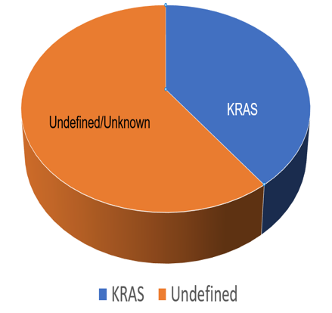

Slide 10
Biomarker Testing in CRC in 2022
For all colon cancers:
  MMR
  Microsatellite stability
Metastatic disease:
  RAS
  BRAF
  HER2
  NTRK
Molecular Classification of CRC and
Associated Targeted Therapies
RAS mutation ±
PIK3CA/PTEN mutation
PIK3CA/PTEN
mutation
45%
8%
1%
2%
Kinase inhibitor
2%
1%
26%
Gene fusion
8%
MET amp
2%
MET inhibitor
HER2 amp
2%
2%
POLE amp
MSI + other
MSI
Wild type
Anti-HER2 Tx
BRAF non-V600
Anti-EGFR therapies
BRAF V600E
Anti–PD-1/PD-L1
BRAF inhibitor + anti-EGFR tx ± MEK inhibitor
Dienstmann. Am Soc Clin Oncol Educ Book. 2018;38:231.
Slide credit: clinicaloptions.com

Slide 11
General Treatment Algorithm for Metastatic CRC
BRAF/RAS wt
RAS mut
BRAF V600 mut
MSI-H/dMMR
NTRK fusion
HER2 amplification
R side: CT + bev
L side: CT +
EGFRi or bev¹⁻⁴
CT + bev⁵⁻⁷
FOLFOXIRI + bev or Doublet + bev
Pembrolizumab
As with BRAF/RAS wt
1L
Consider capecitabine + bev maintenance⁹
CT as with RAS mut;
If bev: in 1L continue bev or change to EGFRi
If EGFRi in 1L, bev
If prior oxaliplatin: irinotecan-based regimen + bev
If prior irinotecan: oxaliplatin-based regimen + bev
If prior FOLFOXIRI: regorafenib¹¹ or
TAS-102 ± bev^{12,13}
Consider encorafenib + EGFRi i¹⁴;
otherwise, CT + bevacizumab
If no prior PD-1i:
PD-1i ± CTLA-4i*;
otherwise, CT/TT as with BRAF/RAS wt
If no prior TRK inhibitor:
consider larotrectinib or entrectinib^{15,16}; otherwise, CT/TT as with BRAF/RAS wt
Consider trastuzumab (+ pertuzumab or lapatinib) or trastuzumab deruxtecan¹⁷⁻¹⁹; otherwise, CT/TT as with BRAF/RAS wt
2L
3L+
If prior oxaliplatin- and irinotecan-based regimens: regorafenib or TAS-102 ± bev
CT, chemotherapy regimens, including oxaliplatin- and/or irinotecan-based regimens (eg, FOLFOX, FOLFIRI, FOLFOXIRI, CAPOX). EGFRi, EGFR inhibitors, including cetuximab or panitumumab.
*If prior PD-1i monotherapy only, can consider PD-1i + CTLA-4i.
1. Tejpar. JAMA Oncol. 2017;3:194. 2. Venook. JAMA. 2017;317:2392. 3. Loupakis. NEJM. 2014;371:1609. 4. Cremolini. Lancet Oncology. 2020;21:497.
5. Parikh. Clin Cancer Res. 2019;25:2988. 6. Douillard. NEJM. 2013;369:1023. 7. Van Cutsem. JCO. 2011;29:2011. 8. Overman. Lancet Oncol. 2017;18:1182.
9. Overman. JCO. 2018;36:773. 10. Van Cutsem. NEJM. 2020;383:2207. 11. Grothey. Lancet. 2013;381:303. 12. Mayer. NEJM. 2015;372:1909. 13. Pfeiffer.
Lancet Oncology. 2020;21:412. 14. Tabernero. JCO. 2021;39:273. 15. Hong. Lancet Oncol. 2020;21:531. 16. Doebele. Lancet Oncol. 2020;21:271.
17. Sartore-Bianchi. Lancet Oncol. 2016;17:738. 18. Meric-Bernstam. Lancet Oncol. 2019;20:518. 19. Siena. Lancet Oncol. 2021;22:779.
Slide credit: clinicaloptions.com

Slide 12
Three Major Molecular
Mechanisms of CRC
Microsatellite
Instability
MSI
CIMP -
CIN -
(5%)
MSI
CIMP+
CIN –
(10%)
Chromosomal Instability (CIN)
CpG Island
Methylator
Phenotype
MSS
CIMP+
CIN –
(10%)
MSS
CIMP-
CIN +
(75%)

Slide 13
Question #1
Which of the following is NOT the utility/purpose for MMR/MSI
testing in colorectal carcinoma?
A. To screen for Lynch Syndrome
B. Serves as a biomarker for PD-L1 immunotherapy
C. Serves a prognostic marker for CRC
D. Serves as a biomarker for anti-EGFR treatment

Slide 14
Utility of MMR-IHC/MSI In CRC
Identify Lynch Syndrome
Biomarker for immune checkpoint inhibitor (ICI) therapy
Biomarker for adjuvant therapy in Stage II CRC
Prognostic marker

Slide 15
Microsatellite Instability (MSI)
Microsatellites are repetitive sequences distributed throughout the genome that consist of mono-, di-, or higher order nucleotide repeats. They are liable for errors during DNA replication.
Accumulation of errors in the sequence of these microsatellites, called microsatellite instability, is the hallmark of the malfunction of mismatch repair (MMR) system.
Cancers with such phenotype are called microsatellite instability (MSI), or by extension, MMR-deficient (dMMR).
Opposite is microsatellite stability (MSS), or MMR-proficient (pMMR).

Slide 16
dMMR/MSI-high in CRC
80% sporadic: due to hypermethylation of MLH1 promotor, causing loss of MLH1
protein expression
20% germline: due to germline mutations of one of the MMR genes
Clinical and pathologic features
Tendency to occur on right side of colon
Medullary carcinoma phenotype with pushing borders
Presence of mucinous or signet ring component
Presence of tumor infiltrating and peritumoral lymphocytes
Crohn’s-like inflammatory response

Slide 17
MSI Testing Methodologies
MMR IHC
- Fast turn around, cheaper, small amount of tumor tissue required, give
specific information about possible germline mutations, widely available
- Dependent upon antibody and interpretation, may be difficult to interpret
MSI PCR
- Independent method, similar sensitivity and specificity to MMR IHC
- Tumor cellularity (20-30%)
- May need normal tissue/DNA if using NCI panel
- Do not give specific information on genes involved in Lynch Syndrome
NGS
- Capture full MSI profile, include multiple other tests
- Longer turn around time, more expensive, bioinformatics, not readily available

Slide 18
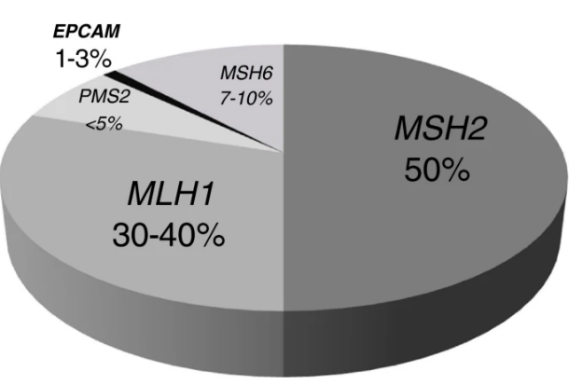
Lynch Syndrome and CRC
Most common hereditary CRC syndrome (3% of all CRC)
Caused by germline mutations in one of the DNA
mismatch repair genes (MLH1, MSH2, MSH6, PMS2)
or deletion in EPCAM causing loss of MSH2 gene
expression (promoter hypermethylation or partial
deletion)
Autosomal dominant
LS cancers form only after second hit (Mono-allelic germline mutation with the somatic mutation in the other allele)
CRC with dMMR/MSI phenotype
Evrard C et al., Cancers, 2019,11,1567; Giadiello FM, et al., Am J Gastroenterol 2014;109:1159-1179; Tutlewwska K et al., Hereditary Cancer in Clinical Practice 2013, 11:9

Slide 19
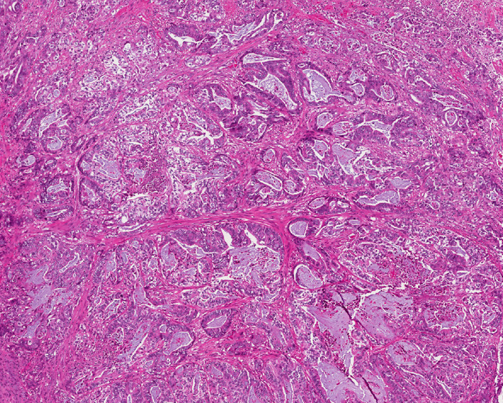
Case 1 - CRC
75 yo man, cecal mass;
No family history of
colon cancer
Bx – Invasive colonic
adenocarcinoma

Slide 20
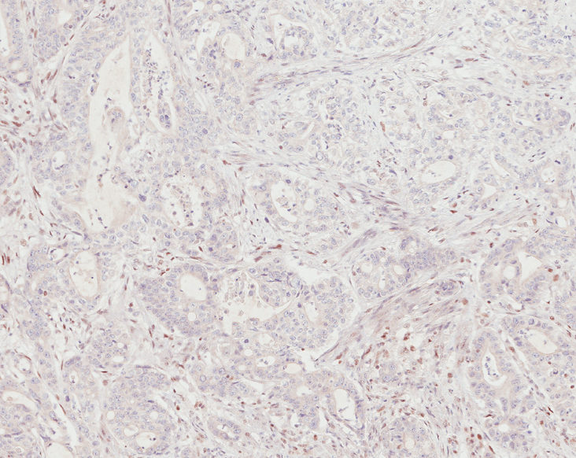
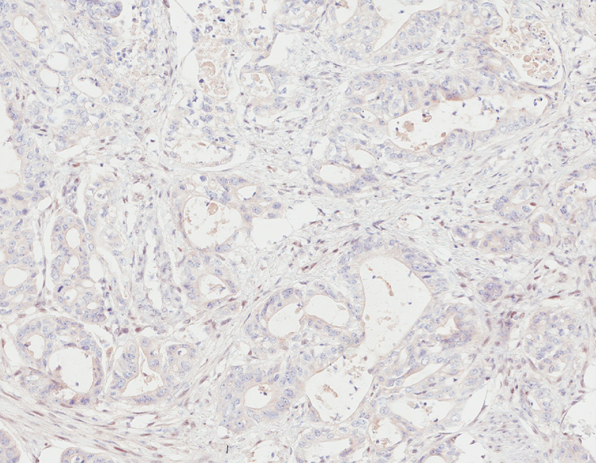
Case 1 – CRC MMR IHC
MLH1
PMS2
Loss
Loss

Slide 21
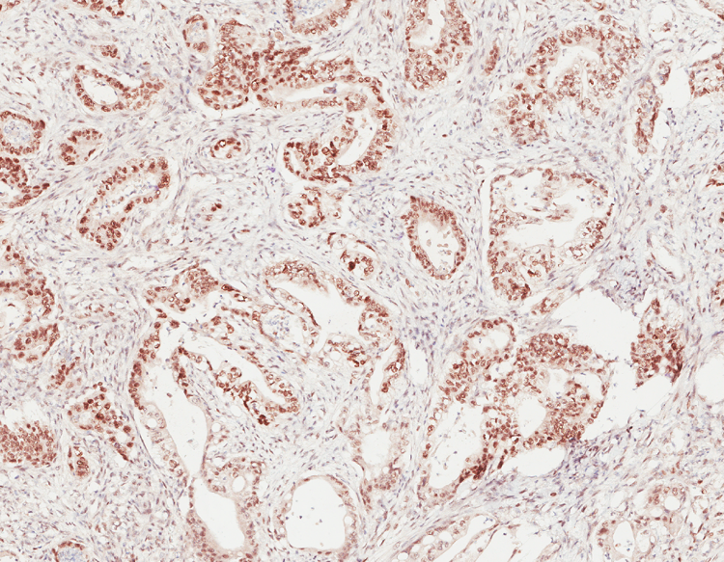
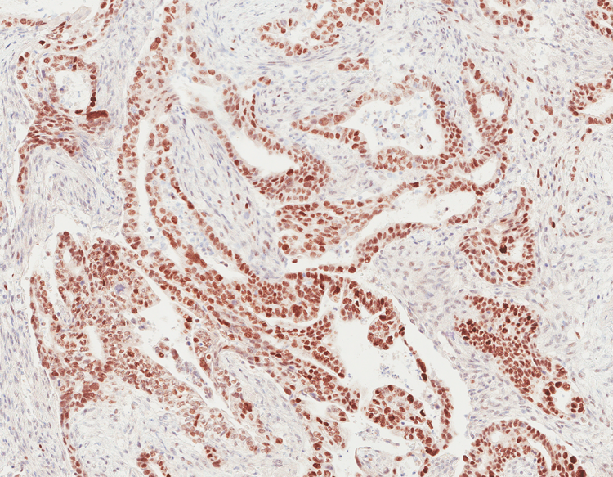
Case 1 – CRC MMR IHC
MSH2
MSH6
Intact
Intact

Slide 22
MMR IHC Patterns with Interpretation for LS
MLH1
PMS2
MSH2
MSH6
MLH1 PMS2 MSH2 MSH6 Interpretation
Intact Intact Intact Intact pMMR; or rare germline point mutation with intact IHC;
or other gene mutation
Loss Loss Intact Intact dMMR: MLH1 methylation silencing or MLH1 germline mutation
Intact Intact Loss Loss dMMR: most likely MSH2 germline mutation
Intact Loss Intact Intact dMMR: most likely PMS2 germline mutation; Rare MLH1 mutation
may also have this pattern
Intact Intact Intact Loss dMMR: mot likely MSH6 germline mutation; Rare post-therapy effect

Slide 23
Case 1 – MMR IHC
Loss of MLH1 and PMS2, intact MSH2 and MSH6 by IHC
Due to either MLH1 promoter hypermethylation or MLH1 germline mutation
Next step: BRAF mutational analysis or MLH1 promoter methylation
Our case: BRAF V600E mutation positive – sporadic, dMMR

Slide 24
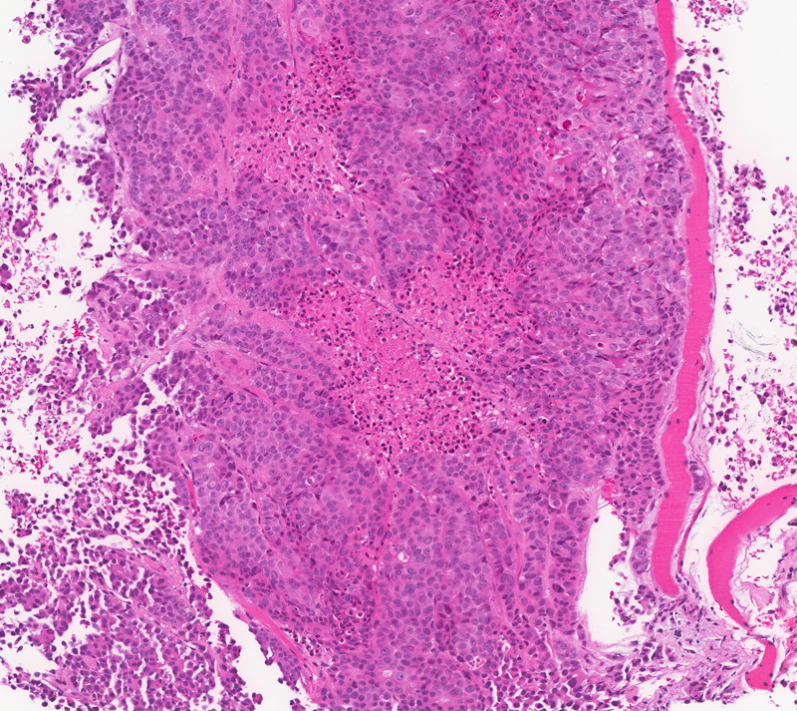
Case 2 - CRC
79 year old man, 12th rib lesion biopsy; h/o invasive cecal adenocarcinoma (pT4a N1b M0) 4 years ago, s/p resection and chemotherapy (FOLFOX); recurrence (9.8 cm colon mass at prior resection site);
IHC: c/w colon primary

Slide 25
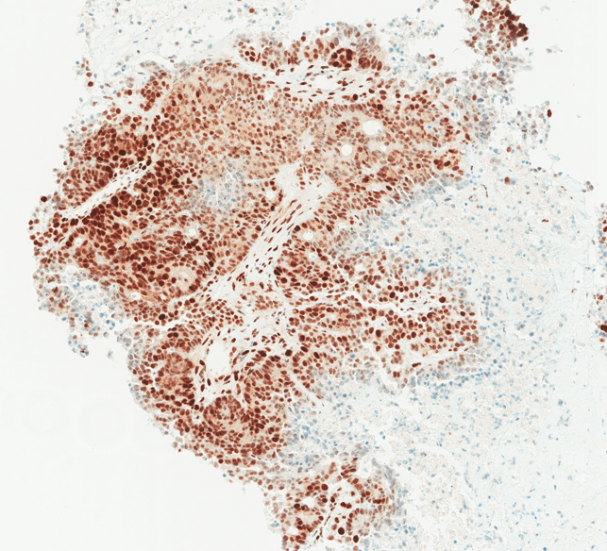
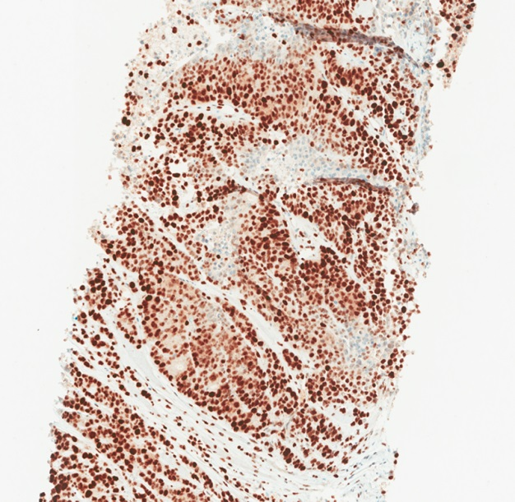
Case 2 – CRC MMR IHC
MLH1
PMS2

Slide 26
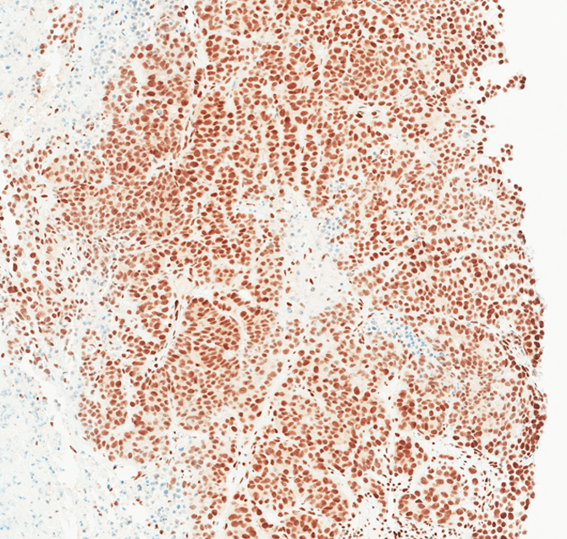
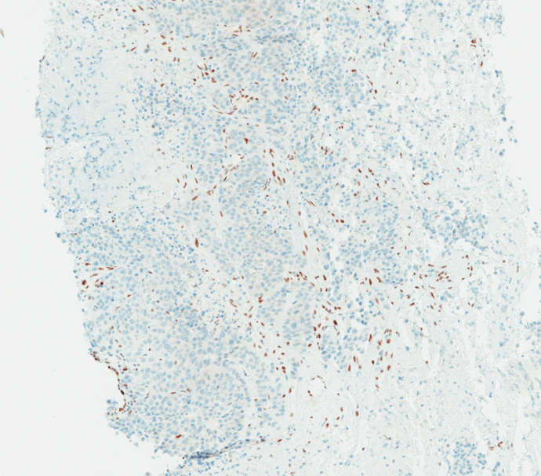
Case 2 – CRC MMR IHC
MSH2
MSH6

Slide 27
Case 2 - CRC
IHC for MMR
MLH1 - Intact
PMS2 - Intact
MSH2 - Intact
MSH6 - Loss
Result: dMMR (deficient MMR)
MSI PCR testing
BAT 25: MSI
BAT 26: MSI
D2S123: MSI
D5S346: MSS
D17S250: MSI
Result: 4 of 5 loci MSI; MSI-High
Germline mutation vs double somatic mutation vs post-treatment effect
Prior CRC form cecum (outside hospital) shows the same MMR IHC with isolated MSH6 loss
Aird J.J. et al., Histopathol, 2020, 76: 521-530.

Slide 28
MMR IHC in CRC
Intact staining commonly found to be patchy
Intact IHC expression for all 4 proteins does not exclude Lynch syndrome:
- ~ 5% of families may have a missense mutation (especially in MLH1),
which can lead to a nonfunctional protein with retained antigenicity
- Defects in lesser-known MMR enzymes may also lead to a similar result,
but rare
Loss of MLH1 - may be caused by Lynch syndrome or methylation of the promoter region (sporadic MSI-H CRC). BRAF mutation and/or MLH1 promoter methylation testing can help in differentiating the cases.
Loss of MSH2, MSH6, or PMS2 alone - highly

Slide 29
Practical Pearls in MMR IHC Interpretation
Always verify the IHC with internal positive controls (stromal cells, lymphocytes, etc.)
Cutoff value – 0%, 5%, 10%
In rare cases with <5-10% intact stainings, or cases with unusual patterns:
- Repeat IHC, using different tumor blocks, using other methods (MSI PCR
testing, NGS panels), correlate with clinical findings
Suggest to refer patient to genetic counseling when there is high clinical suspicion (such as young age, strong family history), even MSS/pMMR

Slide 30
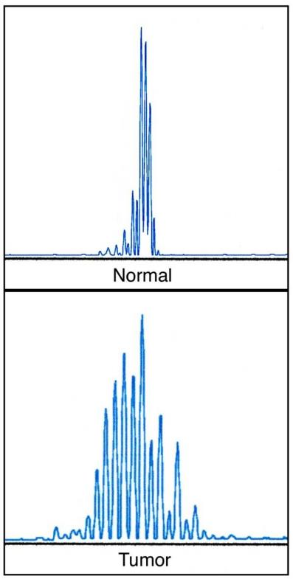
MSI testing by PCR in CRC
Microsatellites = short 1-6 DNA nucleotide repeats highly prone to mismatches during replication.
Frameshift mutations in microsatellites identified by comparing DNA from normal and tumor tissue
DNA extracted from frozen or FFPE tissue
Tumor cellularity: 20-30%

Slide 31
MSI Panels
Bethesda Panel Proposed by NCI in 1998
Two mononucleotide loci – BAT25 and BAT 26, and three
dinucleotide loci (D2S123, D5S346, D17S250)
Normal and tumor tissue
Diagnosis criteria
MSI-H: >= 30% (>= 2 marker)
MSI-low: <30% (1 marker)
MSS: No instability (0 marker)
Generally considered
the same group

Slide 32
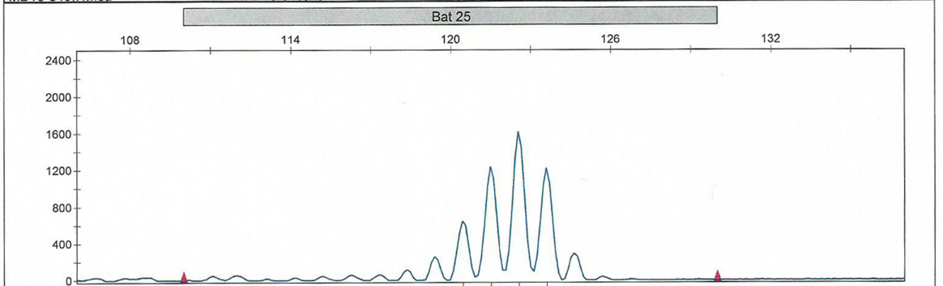
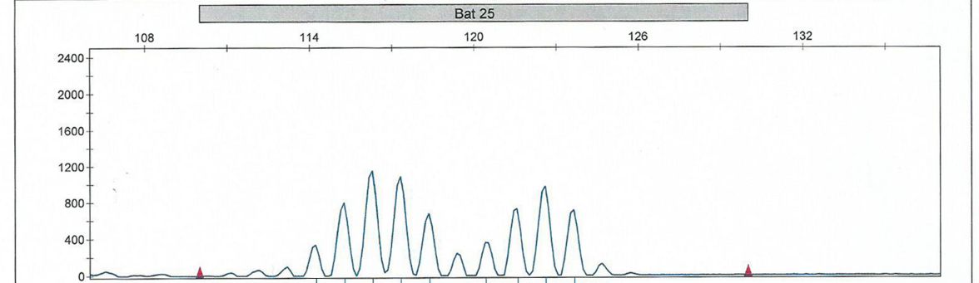
Bethesda Panel
BAT-25
Normal
Tumor

Slide 33
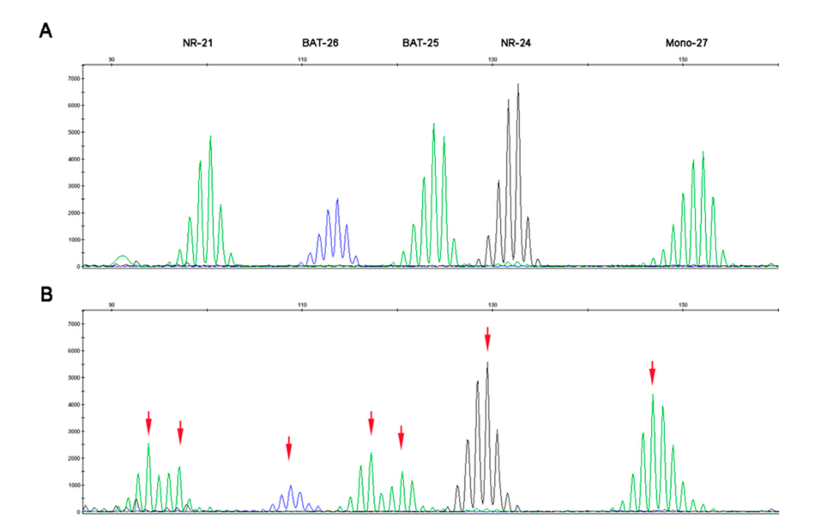
Pentaplex Panel
Five consensus mononucleotide repeats (BAT-25, BAT-26, NR-21, NR-24,
NR-27)
No normal DNA needed
Better performance
MSS: <= 1 of 5 markers unstable
MSI: >= 2 of 5 markers unstable
(If 2 of 5 markers unstable, repeat
using normal and tumor tissue)
MSS
MSI
Suraweera N et al., Gastroenterology, 2002; 123:1804-11; Cancers 2019, 11, 1567

Slide 34
Other Methods To Detect MSI
Other microsatellite repeat panels using different markers
NGS panels coupled with specific computational tools can analyze hundreds or thousands of microsatellite loci simultaneously (specifically designed to detect MSI), with high sensitivity and specificity; more expensive, longer turnaround time, bioinformatics

Slide 35
Screening for LS in CRC
35
ALL PATIENTS WITH CRC
4 MMR IHC testing
Intact IHC
Majority: No further testing
Strong clinical suspicion: MSI testing
Screening for LS in CRC
at TJUH
Loss of MSH2 and/or MSH6,
or loss of PMS2 alone
Loss of MLH1
and PMS2
Likely Lynch syndrome, needs genetic counseling / germline mutational analysis
BRAF V600E mutation and/or
MLH1 promoter methylation
BRAF-WT and/or
No hypermethylation
of MLH1 promotor
BRAF V600E Mutation
Possible Lynch syndrome
Vast majority: no further testing, sporadic
Strong clinical suspicion
Genetic counseling / germline mutational analysis

Slide 36
Utility of MMR-IHC/MSI in CRC
Identify Lynch Syndrome
Biomarker for immune checkpoint inhibitor (ICI) therapy
- dMMR tumors are more responsive to PD-1 blockade than are pMMR
colon cancers
Biomarker for adjuvant therapy in Stage II CRC
- Stage II MSI-H patients may have a good prognosis and do not benefit
from 5-FU adjuvant therapy

Slide 37
Stage II Colon Cancer MSI Status is Prognostic
Ribic, CM et al, New England J Medicine 349 (3):247-257, 2003

Slide 38
MSI and Adjuvant 5FU-based Chemotherapy
MSI-H
MSS/MSI-L

Slide 39
MMR Status in Prediction of Response
to Immunotherapy
dMMR tumors are more responsive to PD-1 blockade than are pMMR colon cancers

Slide 40
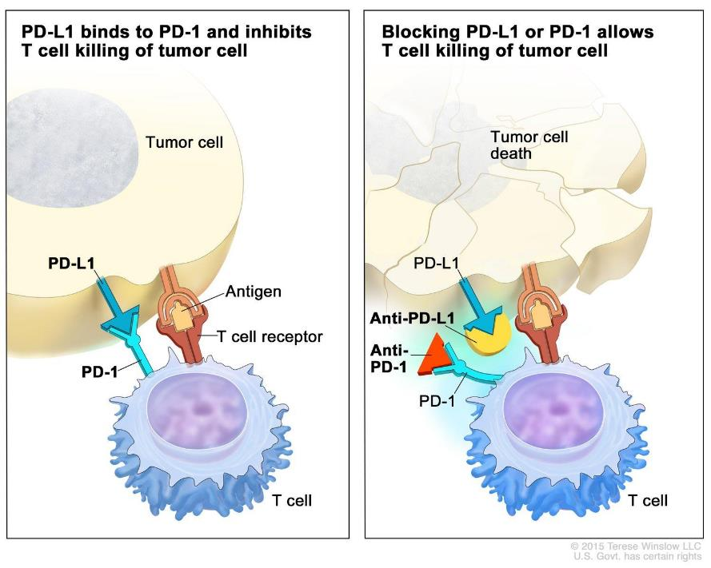
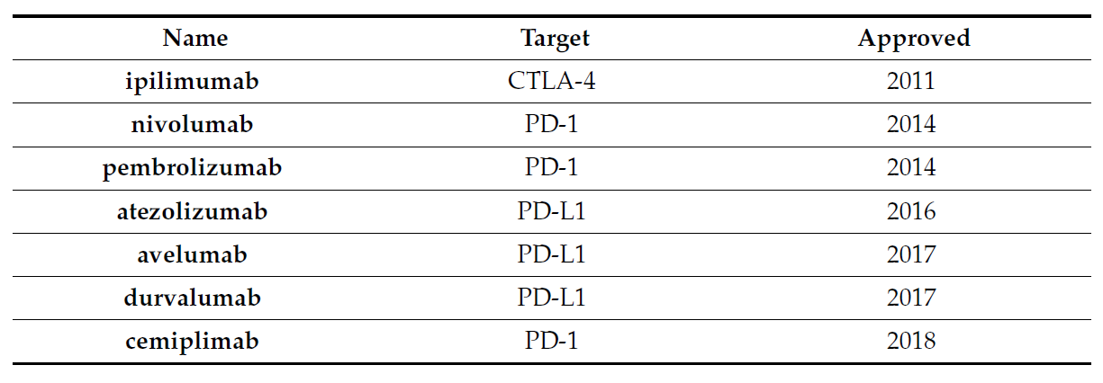
Immune Checkpoint Inhibitor Therapy in Cancer
FDA-Approved Checkpoint Inhibitors
Adam T. et al., Cancers 2021, 13, 277
https://www.cancerresearch.org/en-us/scientists/immuno-oncology-landscape/fda-approval-timeline-of-active-immunotherapies

Slide 41
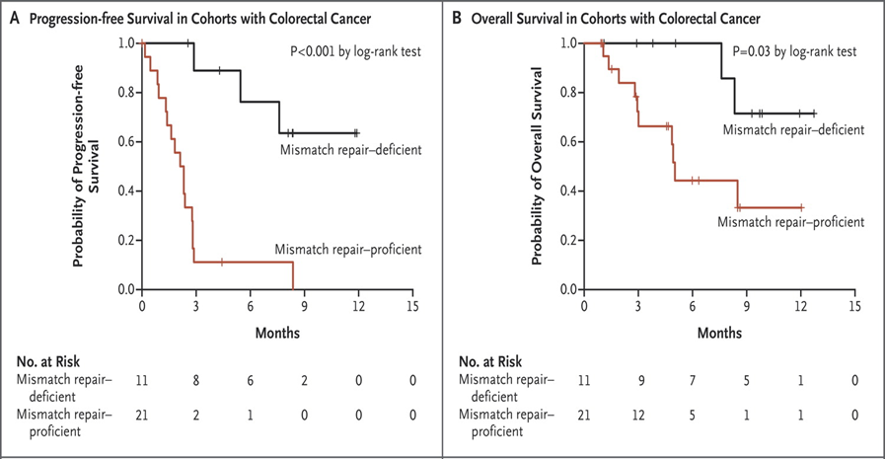
Clinical Benefit of Pembrolizumab Treatment in CRC
According to Mismatch-Repair Status
Phase 2 study of pembrolizumab, an anti–programmed death 1 immune checkpoint inhibitor, in 41 patients with progressive metastatic colorectal carcinoma with or without mismatch-repair deficiency.
Le DT, et al., N Eng J Med 2015, 372:26

Slide 42
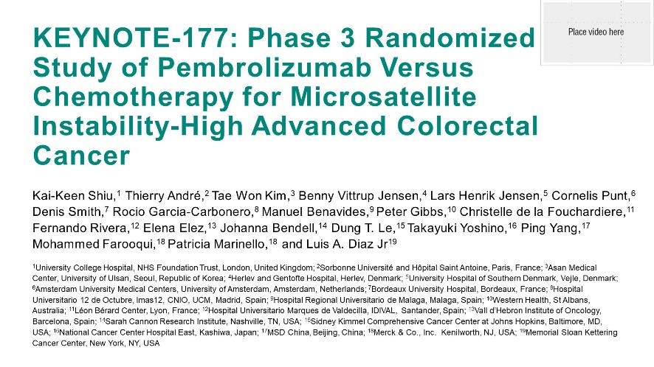
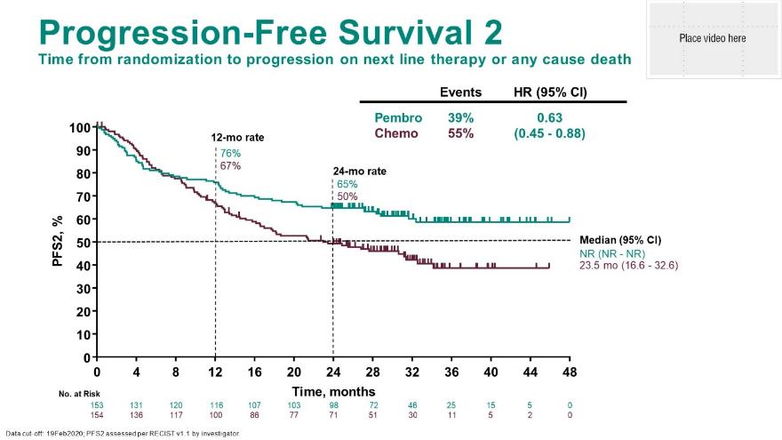
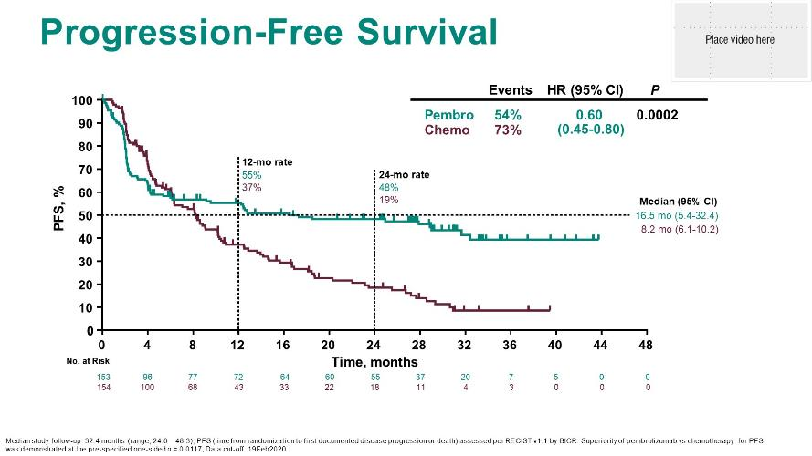
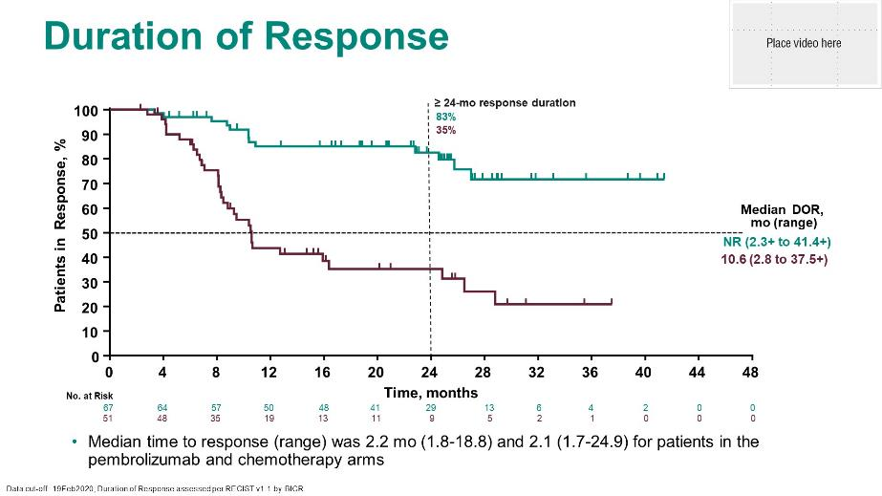
Presented By Kai-Keen Shiu at 2021 Gastrointestinal Cancers Symposium

Slide 43
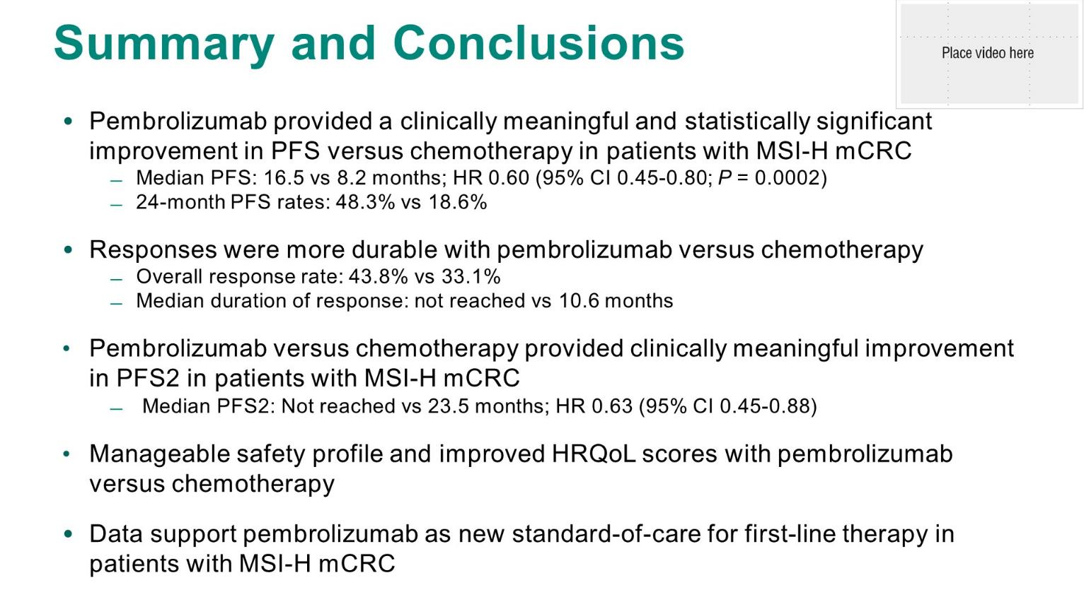

Slide 44
MSI Testing - IHC, PCR, Or NGS? Which One To Choose?
All are sensitive and specific methods
High concordance rates among different methods (1-5%)
No single method is 100% sensitive and specific
Institutional decision
Use multiple methods in complicated/unusual cases
Always correlate with clinical findings

Slide 45
Sensitivity and Specificity for Detection of dMMR/MSI in CRC
Testing Method
Sensitivity
Specificity
MMR IHC 81 - 100% 80 - 92%
MSI PCR
Bethesda/NCI Panel 67 - 100% 61 - 92%
Pantaplex Panel 89 - 100% 79 - 100%
NGS Panels 68 – 100% 73 – 100%
Guyot D'Asnières De Salins A, et al., ESMO Open. 2021, 6:100120; Ratovomanana T et al.,Gastroenterol., 2021, 161:814-826; Evrard C et al., Cancers 2019,11,1567

Slide 46
Common Reasons for Discordance between MMR IHC and MSI in CRC
Low tumor cell percentage (>=20% in MSI testing, pathologist review
and microdissection)
Sample quality
Non-expert interpretation
Neoadjuvant therapy in rectal cancer (discordance is very low; usually
MSH6 decrease/loss with MSS; PMS2)
Polymorphism in non-Caucasian ethnic groups for MSI testing (test both
normal and tumor samples)
Tumor heterogeneity (multiple samples, biopsy vs resection)
Evrard C et al., Cancers 2019,11,1567; Goldstein JB et al., Clinical Cancer Research, 2017, 23: 5246-5254; Bao F et al., Am J Surg Pathol, 2010, 34: 1798-1804

Slide 47
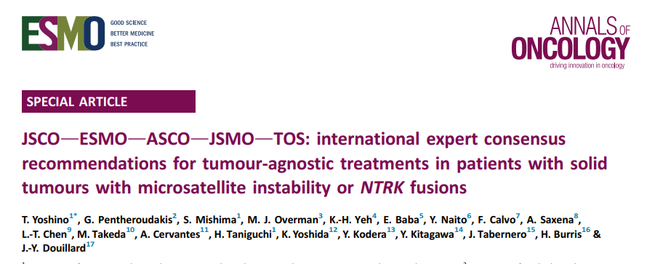
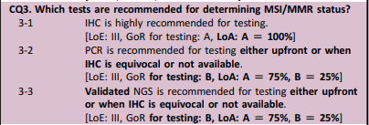
MSI Testing - IHC, PCR, Or NGS? Which One To Choose?

Slide 48
Biomarkers for Immune Checkpoint Inhibitor Therapy
dMMR/MSI: tumor-agnostic
Tumor mutational burden (TMB): >=10/Mb, tumor-agnostic
PD-L1: tumor site specific with companion/complimentary diagnostics

Slide 49
Tumor Mutational Burden (TMB)
Defined by the number of somatic mutations per megabase (Mb) across an interrogated genomics sequence
Keynote-158 clinical trial (pembrolizumab nonCRC with MSI-H/dMMR):
TMB of ≥ 10 or ≥ 13 mutations (mut) per Mb was analyzed by the Foundation One CDx.
Patients with TMBH (≥ 10 mut/Mb) were found to have an ORR of 29% and patients
with TMB ≥13 mut/Mb achieved an ORR of 37%. The higher TMB is expected to
correspond to a higher level of immunogenic neopeptides that would drive T cell-
mediated anti-tumor immunity.
Foundation One CDx TMB >= 10 mut/Mb approved by FDA in 2020 as companion Dx;
tumor agnostic

Slide 50
Colorectal Cancer (CRC) - Biomarkers in 2022
Mismatch Repair Protein and/or Microsatellite Instability Testing
Tumor Mutational Burden (TMB)
KRAS, NRAS, BRAF Mutational Testing
NTRK fusion testing
HER2 testing
NCCN Guideline Colon Cancer Version 3.2021-Sep 10, 2021

Slide 51
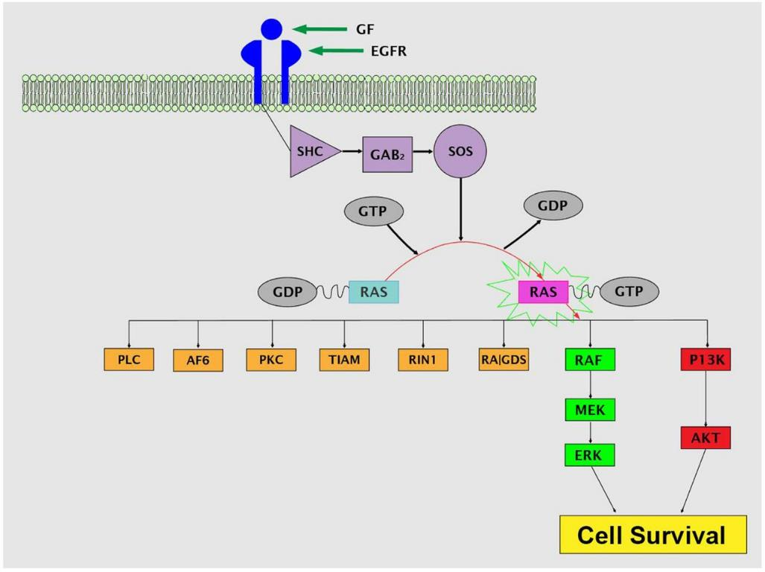
KRAS and NRAS Mutations in CRC
In CRC, KRAS (40-45%), NRAS (4-8%), >95% of mutations occurring in 1 of 3 major hotspots (G12, G13, and Q61)
Biomarker for anti-EGFR treatment
- Any known KRAS mutation (exon 2, 3, 4) or
NRAS mutation (exon 2, 3, 4) should not be
treated with cetuximab or panitumumab
- Primary or metastasis tissue (highly
concordant)
KRAS G12C (4% in CRC)
- FDA approved Sotorasib (Lumakras) in
NSCLC with KRAS G12C mutation
(May 2021)
Cell proliferation,
migration, survival
Saeed O, et al. J Clin Pathol 2019;72:135–139

Slide 52
RAS Mutations (KRAS, NRAS, HRAS)
Panitumumab + BSC vs BSC¹
100
Panit + BSC
BSC alone
Events
76
95
N
84
100
%
90
95
Most frequently mutated oncogenes¹
  90% of pancreatic cancers, 45% of colon cancers, 35% of lung cancers
  KRAS most prevalent in these tumor types
In CRC, RAS testing is required prior to anti-EGFR therapy (eg, cetuximab or panitumumab)
  Patients with KRAS and NRAS mutations should not be treated with anti-EGFR therapy²⁻⁴
  HRAS mutations are much less common (1.7%) but likely have the same negative predictive value
90
Median, Wk
7.4
7.3
80
70
60
HR: 0.99 (95% CI: 0.73-1.36)
50
Proportion Event Free (%)
40
30
KRAS Mutant
20
10
0
0
2
4
6
8
10
12
14
16
18
20
22
24
26
28
30
32
34
36
38
40
42
44
46
48
50
52
Wk
100
Panit + BSC
BSC alone
Events
115
114
N
124
119
%
93
96
Median, Wk
12.3
7.3
90
80
70
HR: 0.45 (95% CI: 0.34-0.59)
60
Stratified log-rank P <.0001
50
Proportion Event Free (%)
40
30
KRAS WT
20
10
0
0
2
4
6
8
10
12
14
16
18
20
22
24
26
28
30
32
34
36
38
40
42
44
46
48
50
52
1. Porru. J Exp Clin Cancer Res. 2018;37:57. 2. Allegra. JCO. 2016;34:179.
3. Al-Shamsi. J Gastrointest Oncol. 2015;6:314. 4. Gong. J Gastrointest Oncol. 2016;7:687.
Wk
Slide credit: clinicaloptions.com
Notes:
BSC, best supportive care; CRC, colorectal cancer; Panit, panitumumab; WT, wild type.

Slide 53
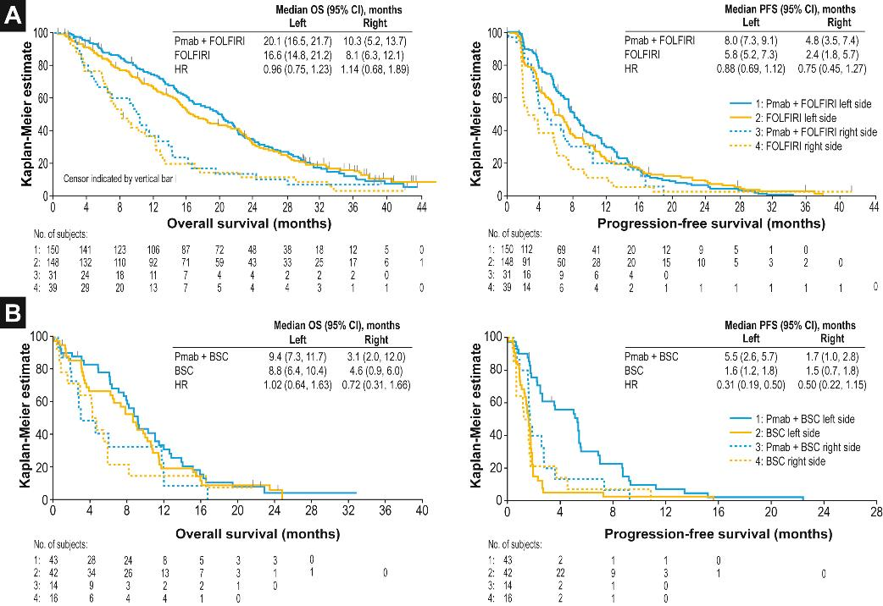
Figure 1
Effect of Primary Tumor Location on Second- or Later-line Treatment Outcomes in Patients With RAS Wild-type Metastatic Colorectal Cancer and All Treatment Lines in Patients With RAS Mutations in Four Randomized Panitumumab Studies (Nele Boeckx et al. Clinical Colorectal Cancer; Volume 17 Issue 3 Pages 170-178.e3 (September 2018)
Clinical Colorectal Cancer 2018 17170-178.e3DOI: (10.1016/j.clcc.2018.03.005)

Slide 54
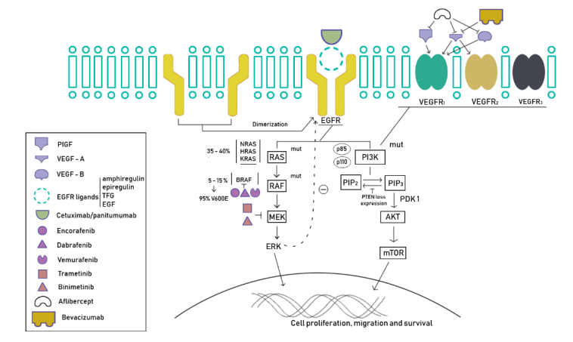
BRAF Mutation In CRC
Molina-Cerrillo J, et al., Cancers 2020, 12, 1571

Slide 55
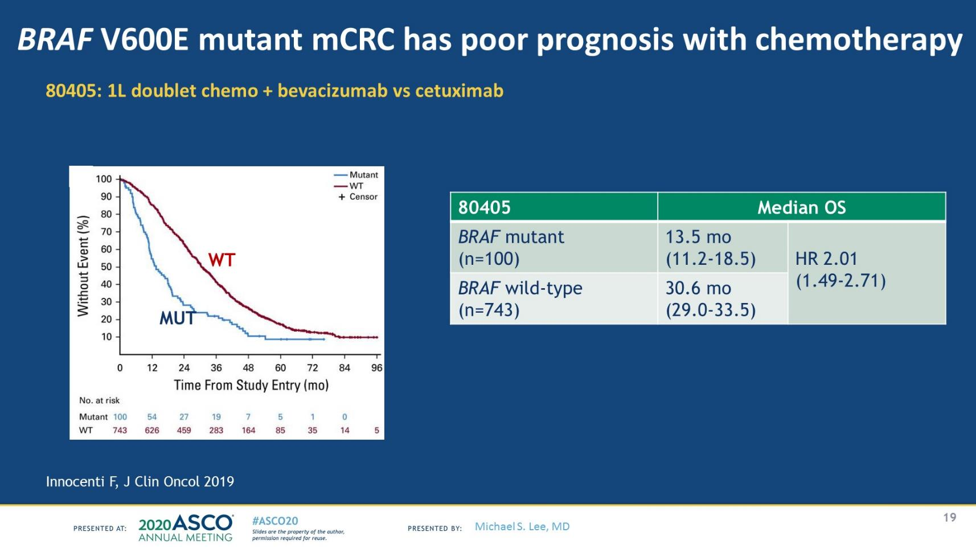

Slide 56
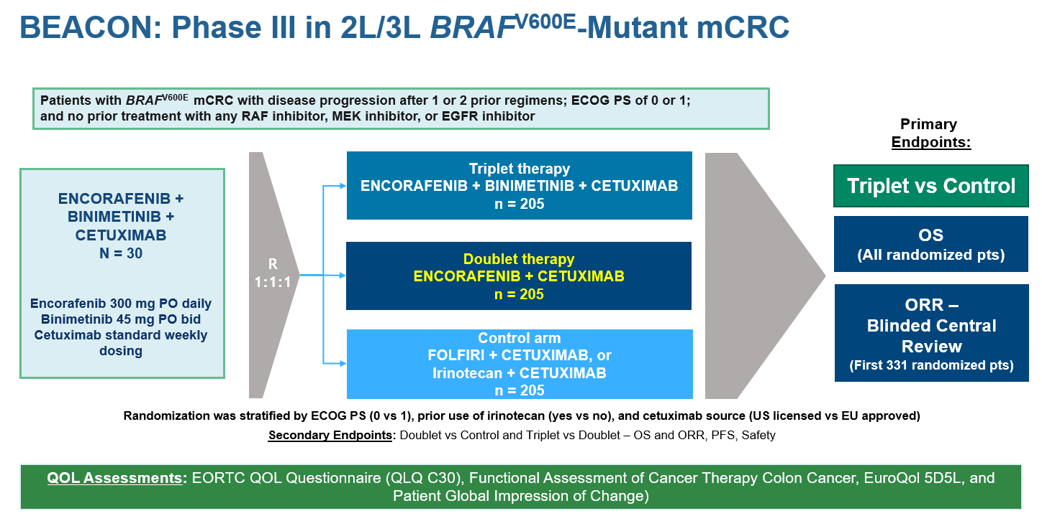
Kopetz S, et al. N Engl J Med. 2019

Slide 57
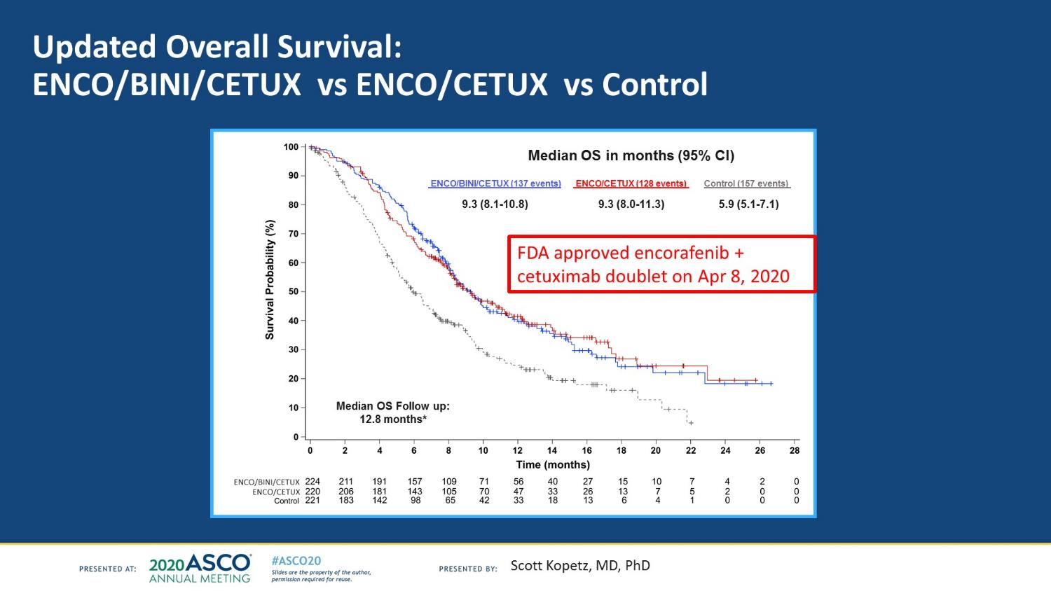

Slide 58
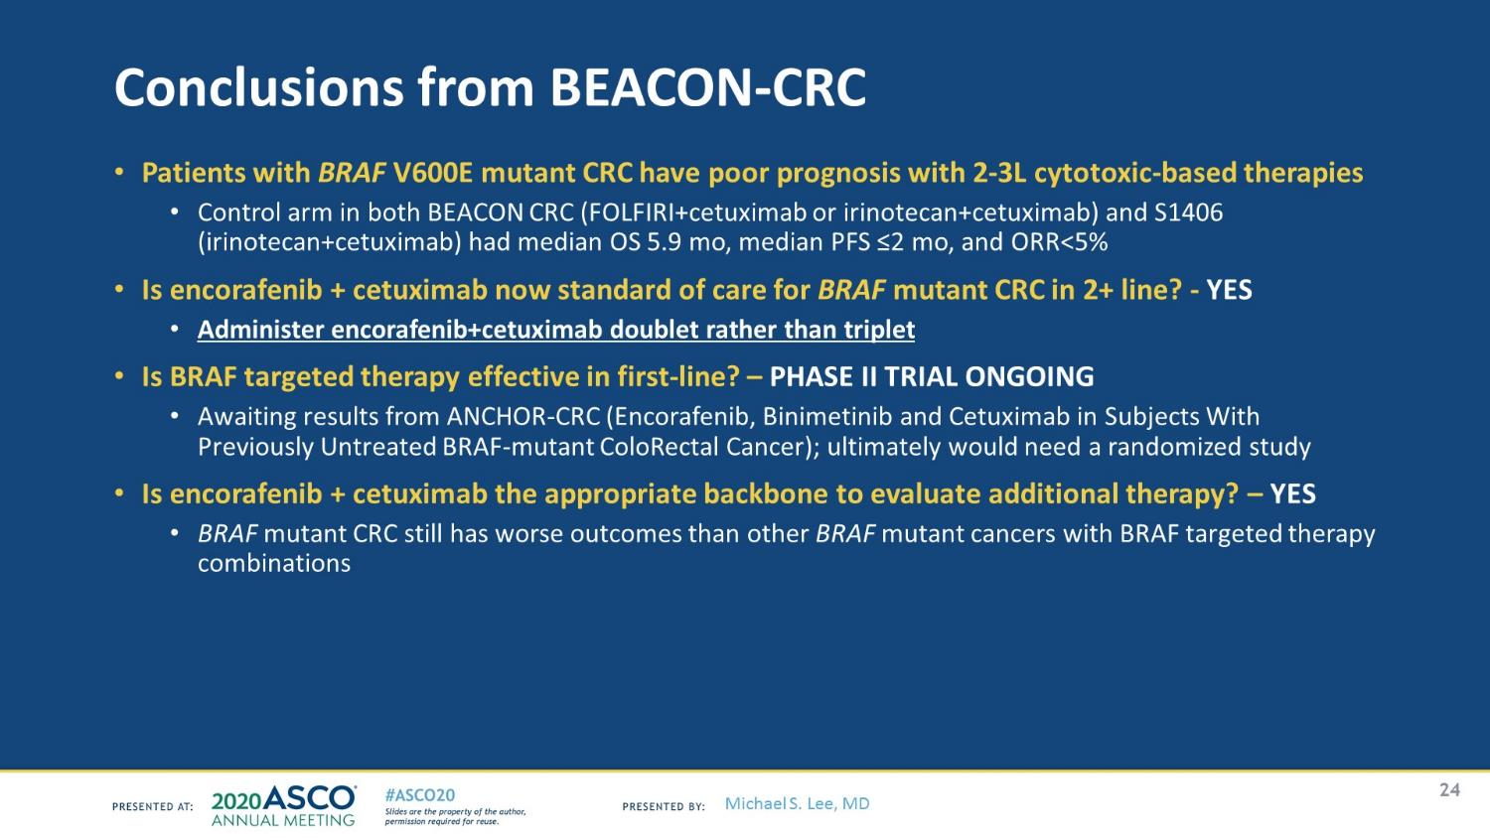

Slide 59
BRAF Mutations In CRC
BRAF activating mutations, usually mutually exclusive with KRAS mutations,
represent 5-15% of CRC
Kinase activating mutation: V600E (80-95%), codon 601 and 597
Kinase impairing mutation: codon 594 and 596
Biomarker for anti-EGFR treatment
- BRAF V600E mutation makes response to anti-EGFR (cetuximab or panitumumab)
highly unlikely unless given a BRAF inhibitor
Screening for Lynch syndrome (Loss of MLH1 and PMS2 IHC)
- Differentiate sporadic MLH1-hypermethylated CRC from Lynch, cost effective
method before germline mutation testing
- Presence of a BRAF mutation strongly favors sporadic CRC, its absence does not
completely exclude the risk of Lynch
Testing: Sequencing, IHC is also an option
Schirripa M, et al., Clin Cancer Res, 2019, 25: 3954-3961; Molina-Cerrillo J, et al., Cancers 2020, 12, 1571.

Slide 60
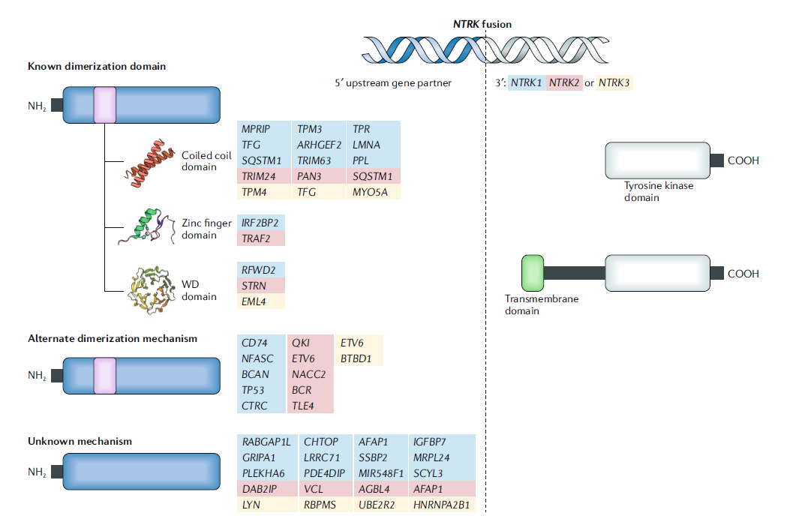
NTRK Fusions in Cancer
Neurotrophic tropomyosin-receptor kinase (NTRK)
NTRK1, 2, 3 fusions are rare oncogenic drivers in solid tumors
The treatment of patients with
NTRK fusion-positive cancers with
a 1st generation TRK inhibitor,
such as larotrectinib or entrectinib,
is associated with high response
rates (>75%), regardless of tumor
histology
FDA approved larotrectinib in 2018 and entrectinib in 2019 (tumor agnostic)
Westphalen CB, et. Al., NPJ Precis Oncol. 2021, 5: 69; Cocco E, et al., Nat Rev Clin Oncol. 2018, 15: 731-747

Slide 61
Question #2
What is the percentage of NTRK fusion in GI cancers in general?
A. 80%
B. 50%
C. 20%
D. Less than 2%

Slide 62
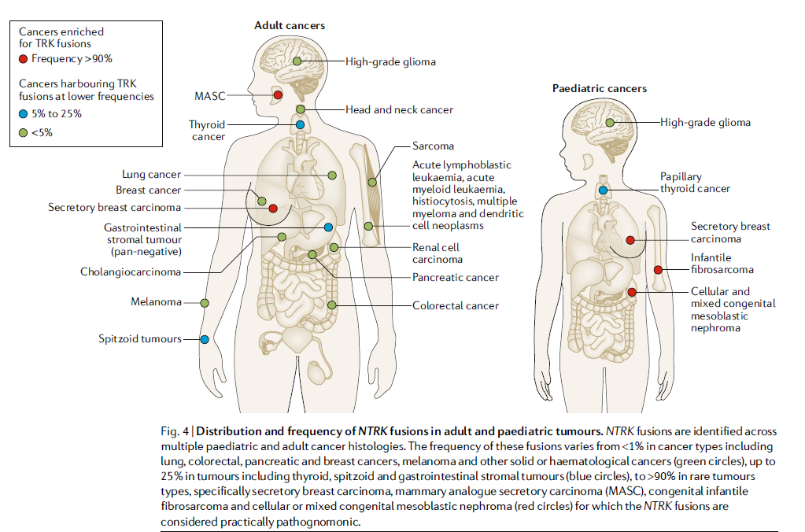
NTRK Fusions in Cancer
Cocco E, et al., Nat Rev Clin Oncol. 2018, 15: 731-747

Slide 63
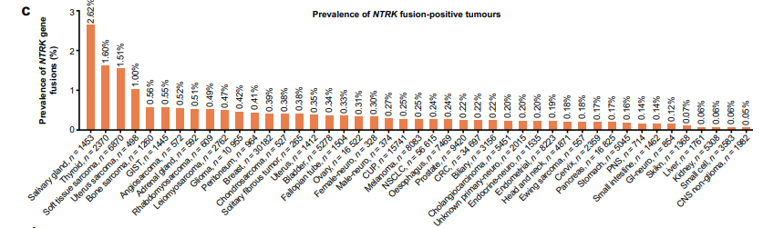
NTRK Fusions in Cancer
Overall NTRK fusion-positive tumor prevalence was 0.30% among 45 cancers with 88 unique fusion partner pairs, of which 66% were previously unreported (FoundationCORE® database of >295,000 cancer patients). Across all cases, prevalence was 0.28% (aged ≥18) and 1.34% (age <18 years).
Westphalen CB, et. Al., NPJ Precis Oncol. 2021, 5: 69

Slide 64
NTRK Fusions in Cancer
Extremely rare in CRC (0.22-0.35%)
NTRK fusions confined to the tumors that are pan-wild type KRAS, NRAS, BRAF (mutually exclusive with alterations in disease-specific driver genes; p<0.01), and most are sporadic MSI-H
Testing for NTRK gene fusions in spontaneous MSI-H and BRAF wild-type CRC cases could identify patients who may benefit from NTRK-directed therapies.
Westphalen CB, et. Al., NPJ Precis Oncol. 2021, 5: 69

Slide 65
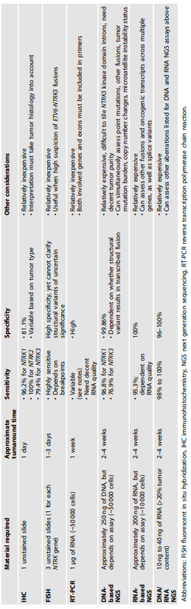
NTRK Fusions in Cancer
RNA-based NGS optimal (DNA-based NGS (less sensitive), FISH or IHC (less specific))
Hechtman JF. Mod Path. 2021; https://doi.org/10.1038/s41379-021-00913-8

Slide 66
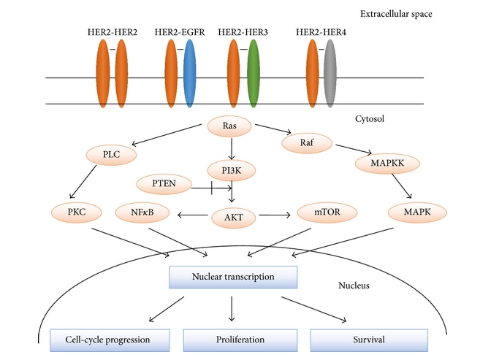
Her2
Molecular Biology International Iqbal et al Volume 2014 |Article ID 852748 | https://doi.org/10.1155/2014/852748

Slide 67
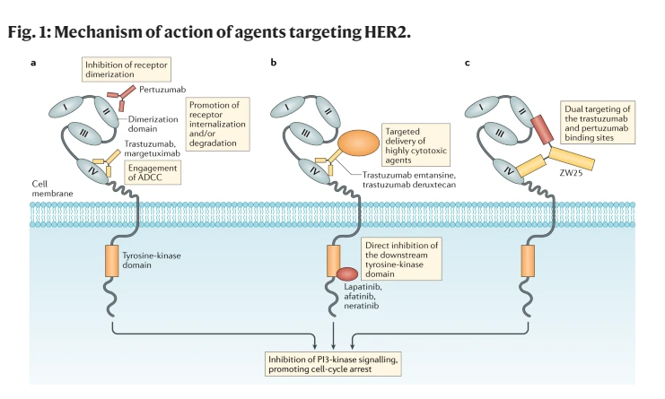
Do-Youn Oh & Yung-Jue Bang, Nat Rev Clin Onc 2020; 17: 33-48.

Slide 68
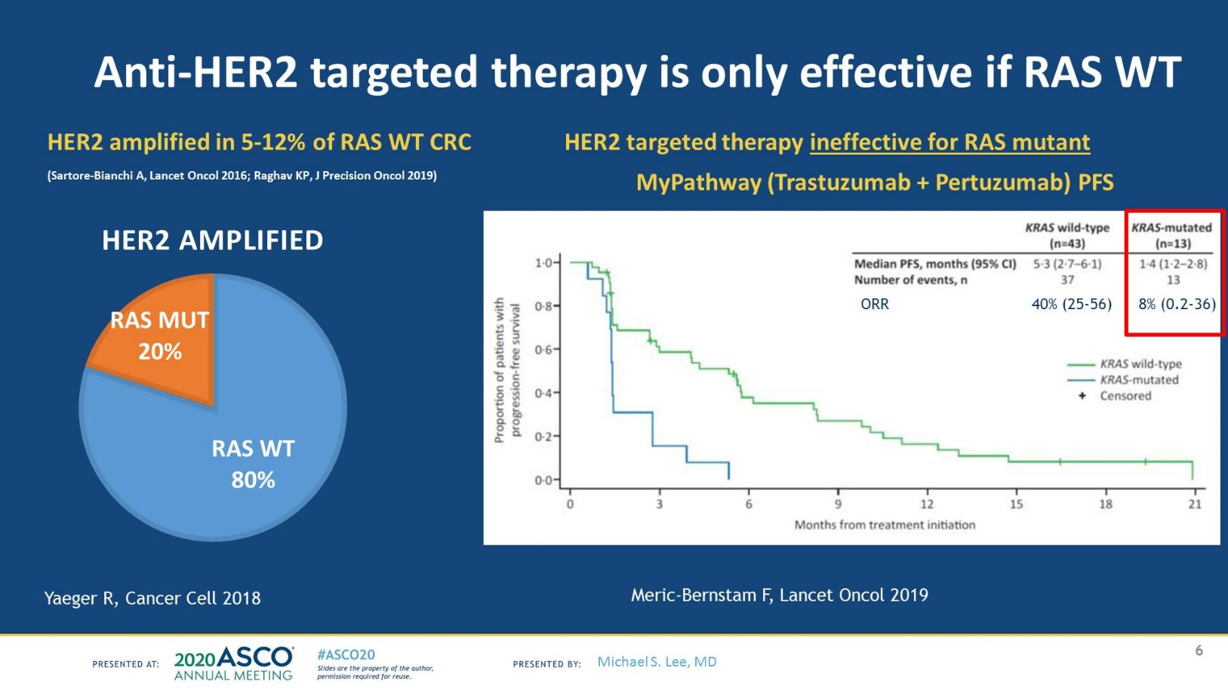

Slide 69
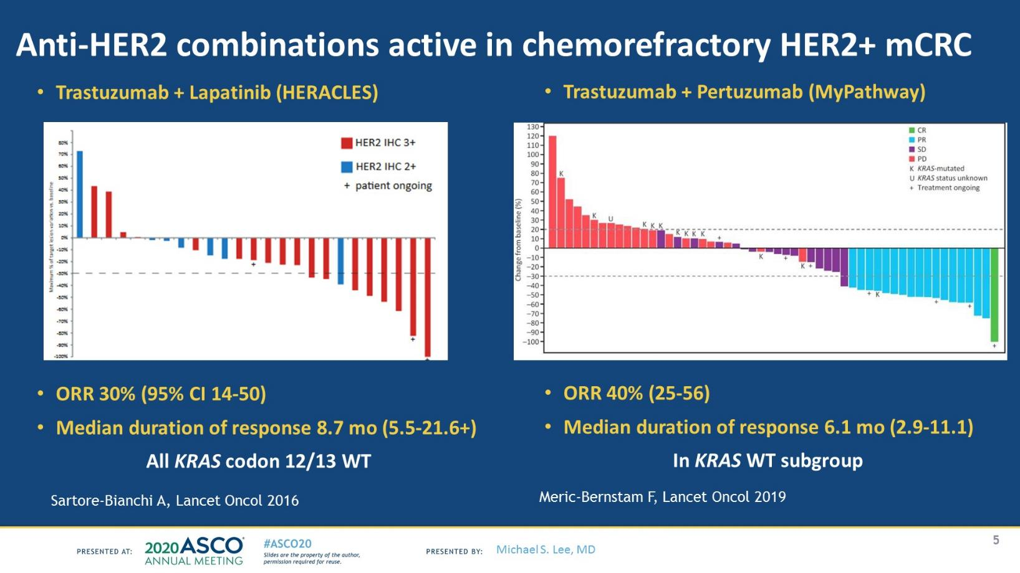

Slide 70
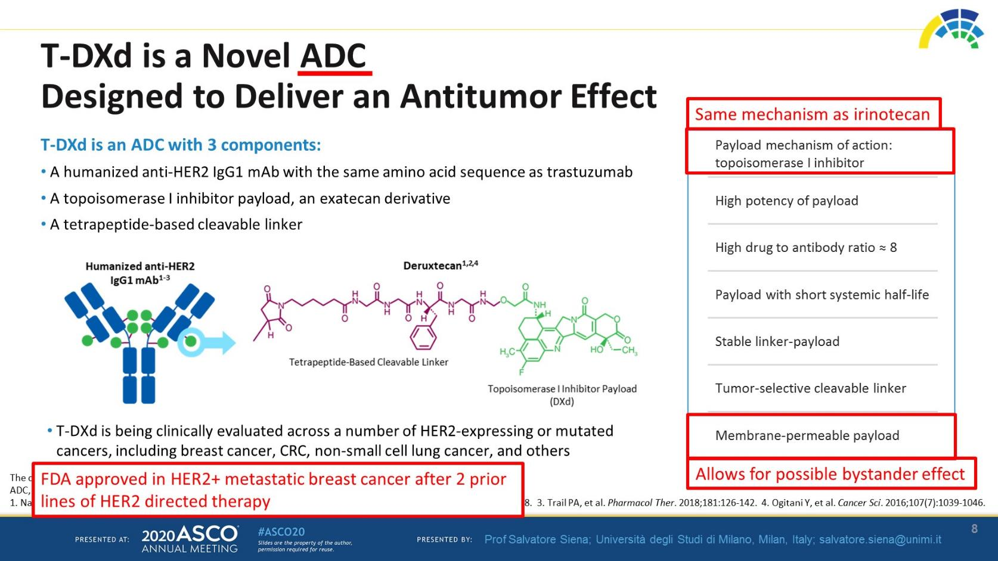

Slide 71
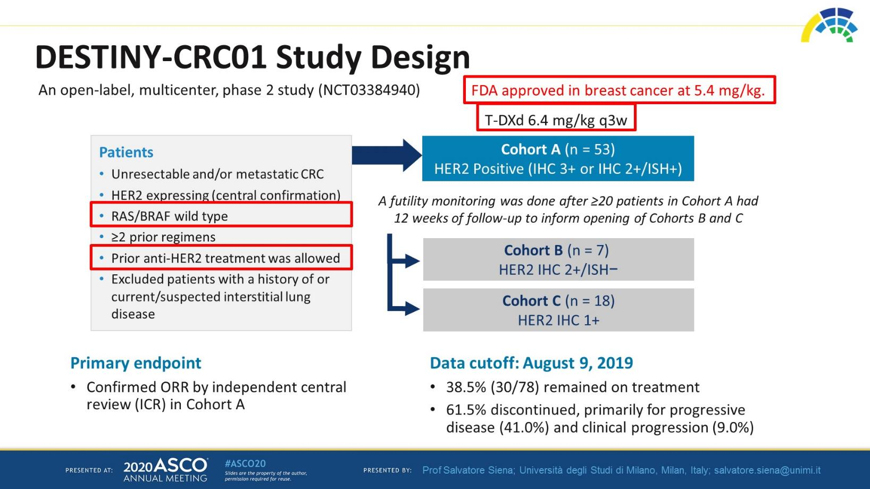

Slide 72
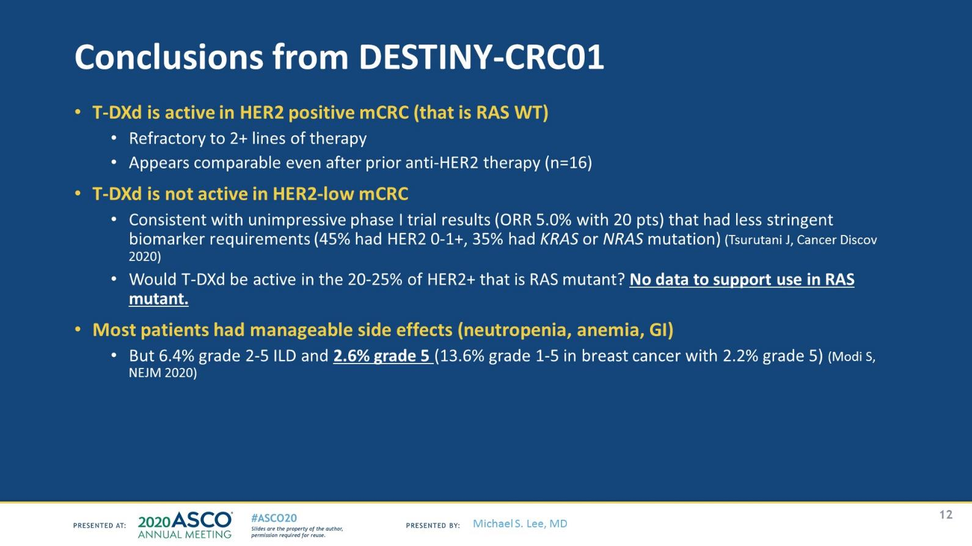

Slide 73
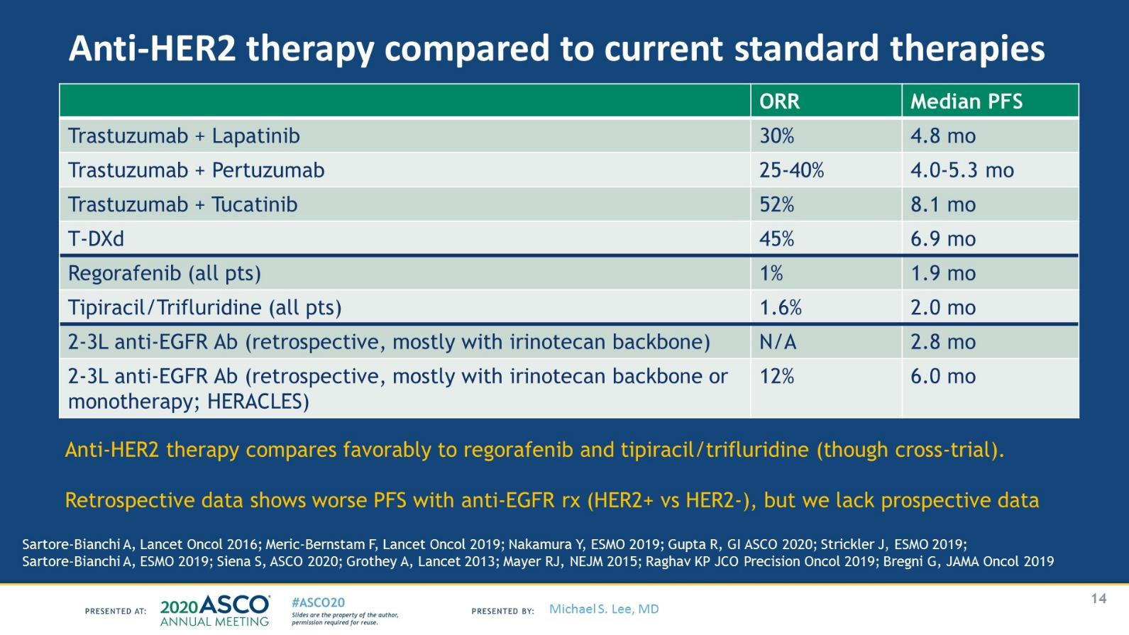

Slide 74
Question #3
Which treatment should one use in a Her-2 Positive (3+) 3rd line setting
A. Trastuzumab based
B. Regorafenib
C. Cetuximab /irinotecan
D. T-Dxt

Slide 75
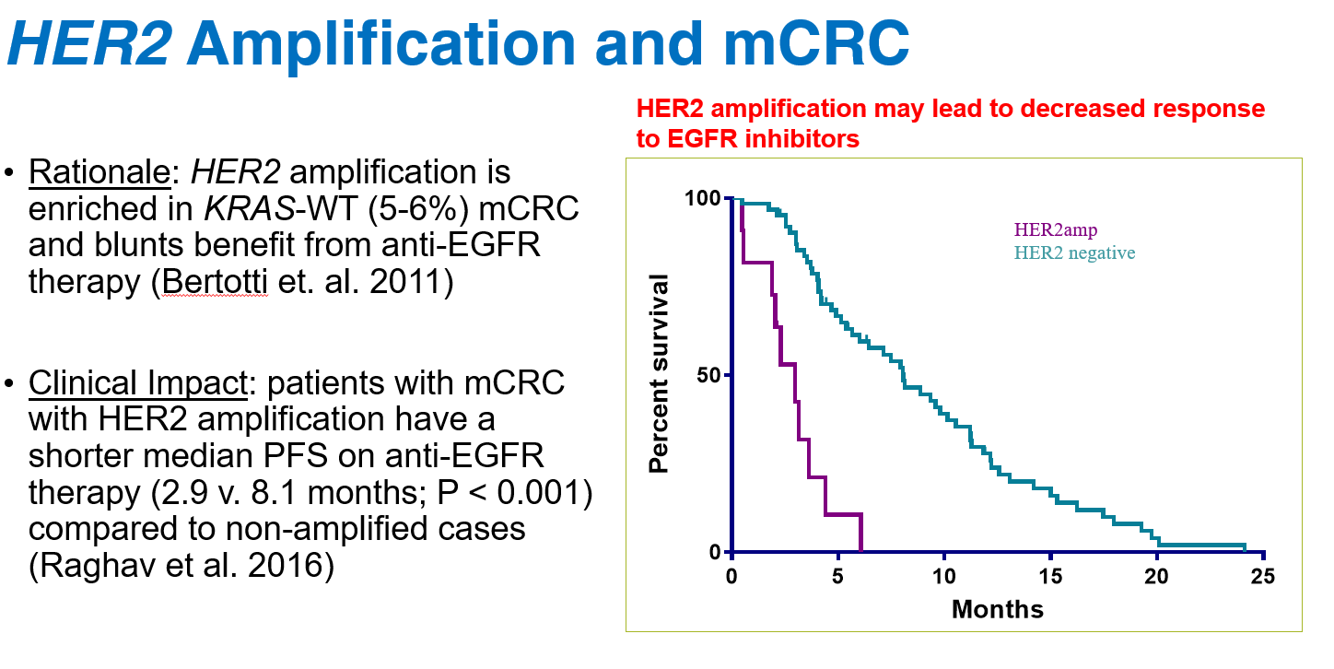

Slide 76
HER2 in CRC
Summary of 3 trials
In RAS/BRAF wild type, HER2-positive metastatic CRC refractory to therapy, anti-HER2 treatment achieves objective response in 30-45% patients
HER2 positivity defined differently
- HERACLES: the most stringent (>50% of tumor cells with 3+ IHC)
- MyPathway and Destiny: Use 2016 CAP/ASCP/ASCO HER2 Testing in
Gastroesophageal Adenocarcinoma Guideline
- The MyPathway trial also enrolled patients based on increased HER2
copy number or activating mutations as determined by molecular
methods

Slide 77
HER2 Testing in CRC- NCCN guidelines v3. 2021 (Sep 10, 2021)
IHC, FISH or NGS
HER2 positive by IHC
- 3+ staining in >50% of cells by IHC
- 3+ staining: intense membrane staining that can be circumferential,
basolateral, or lateral
- 2+ staining reflex to FISH
Her 2 amplification by FISH:
- HER2:CEP17 ratio > 2.0 in >50% of cells
NGS: copy number gain

Slide 78
HER2 Testing in CRC - CAP guideline (version1.3.0.0 June 2021)
Results
_ Negative (Score 0)
_ Negative (Score 1+)
_ Equivocal (Score 2+)
_ Positive (Score 3+)
_ Cannot be determined (explain): _________________
Scoring System
_ ASCO / CAP HER2 Breast Cancer 2018
_ CAP / ASCP / ASCO HER2 Gastroesophageal Adenocarcinoma 2016 (aka Ventana)
_ HERACLES
_ Other (specify): _________________
Staining Intensity
_ 0 (none)
_ 1+ (faint or barely perceptible)
_ 2+ (weak to moderate)
_ 3+ (strong)
_ Other (specify): _________________
Percentage of Tumor Cells with Specific Membrane Staining (i.e., complete, basolateral, or lateral membrane)
_ Less than 10%
_ 10-49%
_ Greater than or equal to 50%
_ Specify percentage: _________________ %
HER2 Testing in CRC
- CAP guideline (version1.3.0.0 June 2021)

Slide 79
GEJ/Gastric cancer

Slide 80
Biomarker Testing in Gastroesophageal Cancers
What test results must we have?
  HER2 amplification (IHC/ISH)
  MSI-H (PCR/NGS) or dMMR (IHC)
  PD-L1 elevation (IHC)
  NTRK fusion (NGS)
  Comprehensive genomic profiling (if enough tissue)
When should testing occur, and for whom?
  All newly diagnosed patients
Slide credit: clinicaloptions.com
NCCN Clinical Practice Guidelines in Oncology (NCCN Guidelines®) for Gastric Cancer v1.2022.

Slide 81
ToGA: First-line Trastuzumab + Chemotherapy in Advanced HER2+ Gastric Cancer
Randomized phase III trial of 5-FU or capecitabine + cisplatin ± trastuzumab for patients with advanced gastric cancer (N = 584)
OS in Patients With IHC 3+ or FISH+ and IHC 2+ (Exploratory Analysis) (N = 446)
1.0
Median
OS, Mo
16.0
11.8
0.9
Events, n
120
136
HR
0.65
95% CI
0.51-0.83
0.8
CT + trastuzumab
0.7
CT
0.6
0.5
Survival Probability
0.4
Established SoC in HER2+ GEC
0.3
0.2
0.1
11.8
16.0
0
0
2
4
6
8
10
12
14
16
18
20
22
24
26
28
30
32
34
36
Mo
Bang. Lancet. 2010;376:687.
Slide credit: clinicaloptions.com
Notes:
CT, chemotherapy; GEC, gastroesophageal cancer; SoC, standard of care; T, trastuzumab.

Slide 82
DESTINY-Gastric01: Trastuzumab Deruxtecan in Previously Treated, HER2+ Gastric/GEJ Adenocarcinoma
Multicenter, open-label, randomized phase II study¹
  Phase I trial: T-DXd 5.4 or 6.4 mg/kg associated with 43.2% ORR, 12.8 mo mOS in patients with advanced HER2+ gastric cancer (N = 44)²
Primary endpoint: ORR by ICR (RECIST v1.1); secondary endpoints: OS (key), DoR, PFS, DCR, confirmed ORR, safety
T-DXd 6.4 mg/kg, 3-wk cycles
(n = 126)
Adult patients with HER2+*
locally advanced or metastatic gastric or GEJ cancer that progressed on
≥2 prior regimens†
(N = 188)
Until PD, unacceptable AEs, or patient withdrawal
Randomized
2:1
Physician’s choice:
Irinotecan 150 mg/m² every 2 wk or
Paclitaxel 80 mg/m² Days 1, 8, 15 every 4 wk
(n = 62)
*HER2+ based on IHC 3+ or IHC 2+/ISH+ according to ASCO/CAP guidelines.
†Prior regimens included fluoropyrimidine, a platinum agent, and trastuzumab
or approved biosimilar.
1. Shitara. Lancet Oncol. 2019;20:827. 2. Shitara. NEJM. 2020;382:2419.
Slide credit: clinicaloptions.com
Notes:
AE, adverse event; ASCO, American Society of Clinical Oncology; CAP, College of American Pathologists; DCR, disease control rate; DoR, duration of response; GEJ, gastroesophageal junction; ICR, independent central review; IHC, immunohistochemistry; ISH, in situ hybridization; mOS, median overall survival; ORR, overall response rate; OS, overall survival; PD, progressive disease; PFS, progression-free survival; RECIST, Response Evaluation Criteria in Solid Tumors; T-DXd, trastuzumab deruxtecan.
Stratified by region (Japan vs Korea), ECOG PS (0 vs 1), HER2 status (IHC 3+ vs IHC 2+/ISH+).

Slide 83
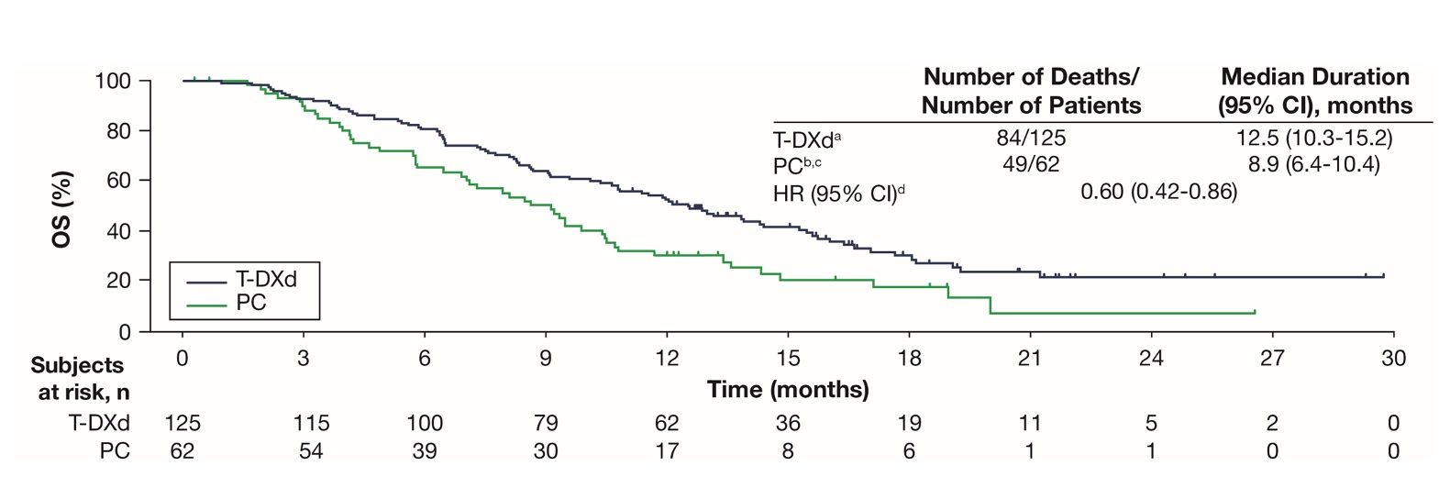
DESTINY-Gastric01: Final Overall Survival Analysis
As in the primary analysis (101 OS events; 54.0% maturity), in this updated analysis (133 OS events; 71.1% maturity), T-DXd showed superior antitumor activity compared to PC
Yamaguchi K et al. ASCO 2021;Abstract 4048.

Slide 84
DESTINY-Gastric01: Exploratory Biomarker Analysis of Overall Survival
in HER2-Positive or HER2-Low Advanced Gastric or GEJ Cancer
Exploratory Biomarker in Primary HER2-Positive Cohort | Median Overall Survival
Plasma HER2 amplification Not Amplified Amplified | 12.1 mo 13.0 mo
Plasma HER2 copy number* Above 6.0 Below 6.0 | 21.2 mo 12.0 mo
Exploratory Biomarker in Exploratory HER2-Low Cohort
Plasma HER2 extracellular domain** Above 11.6 ng/mL Below 11.6 ng/mL | 10.1 mo 4.3 mo
*An exploratory cutoff (copy number = 6.0) value was determined, which minimized p-value, estimated by log-rank test. Below 6.0 includes patients without amplification; **An exploratory cutoff value of 11.6 ng/mL in exploratory cohorts was determined, which minimized p-value, estimated by log-rank test.
Shitari K et al. ESMO World Congress on Gastrointestinal Cancer 2021;Abstract O-14.

Slide 85
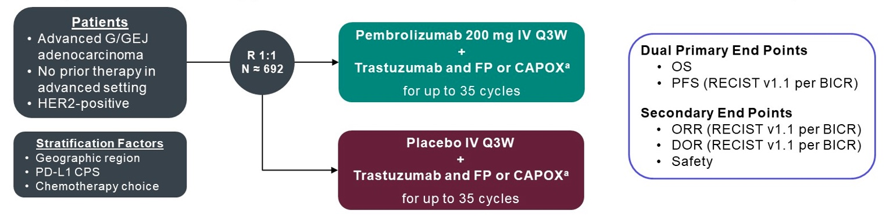
KEYNOTE-811 Phase III Study Design
Janjigian YY et al. ESMO World Congress on Gastrointestinal Cancers 2021;Abstract LBA4.

Slide 86
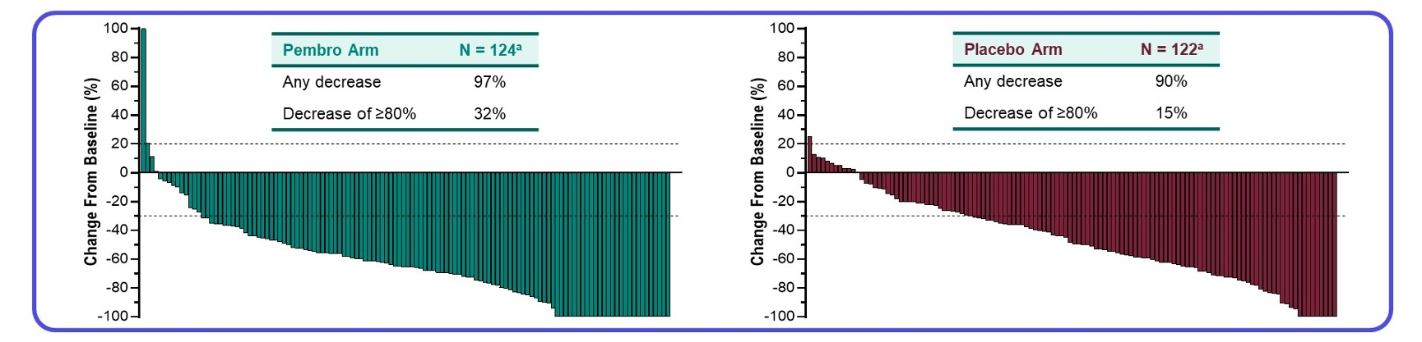
KEYNOTE-811: Confirmed Response at First Interim Analysis
ORR: 74.4%
ORR: 51.9%
Janjigian YY et al. ESMO World Congress on Gastrointestinal Cancer 2021;Abstract LBA4.

Slide 87
FDA Grants Accelerated Approval to Pembrolizumab with Trastuzumab and Chemotherapy as First-Line Therapy for HER2-Positive Gastric Cancer
Press Release – May 5, 2021
“On May 5, 2021, the Food and Drug Administration granted accelerated approval to pembrolizumab in combination with trastuzumab, fluoropyrimidine- and platinum-containing chemotherapy for the first-line treatment of patients with locally advanced unresectable or metastatic HER2 positive gastric or gastroesophageal junction (GEJ) adenocarcinoma.
Approval was based on the prespecified interim analysis of the first 264 patients of the ongoing KEYNOTE-811 (NCT03615326) trial, a multicenter, randomized, double‑blind, placebo‑controlled trial in patients with HER2‑positive advanced gastric or gastroesophageal junction (GEJ) adenocarcinoma who had not previously received systemic therapy for metastatic disease. Patients were randomized (1:1) to receive pembrolizumab 200 mg or placebo every 3 weeks, in combination with trastuzumab and either fluorouracil plus cisplatin or capecitabine plus oxaliplatin.
The main efficacy measure for this analysis was overall response rate (ORR) assessed by blinded independent review committee. The ORR was 74% in the pembrolizumab arm and 52% in the placebo arm (one-sided
p-value < 0.0001, statistically significant). The median duration of response (DoR) was 10.6 months for patients treated with pembrolizumab and 9.5 months for those in the placebo arm.”
https://www.fda.gov/drugs/drug-approvals-and-databases/fda-grants-accelerated-approval-pembrolizumab-her2-positive-gastric-cancer

Slide 88
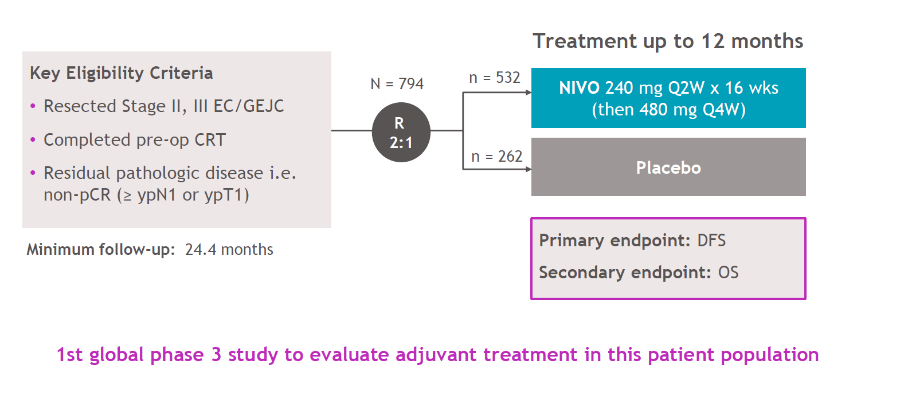
Checkmate 577 early stage EC/GEJC

Slide 89

Checkmate 577

Slide 90

Checkmate 649 Nivo+chemo in 1L gastric/GEJ/EAC

Slide 91

CheckMate 649 Dual Primary Endpoints: PFS and OS
Moehler M et al. ASCO 2021;Abstract 4002.

Slide 92
FDA Approves Nivolumab with Chemotherapy for Front-Line Advanced Gastric Cancer
Press Release – April 16, 2021
“The FDA approved nivolumab in combination with certain types of chemotherapy for the frontline treatment of patients with advanced or metastatic gastric cancer, gastroesophageal junction cancer and esophageal adenocarcinoma, making it the first approved immunotherapy for this patient population.
The agency based the approval on data from the randomized, multicenter, open-label phase 3 CheckMate-649 trial, designed to evaluate nivolumab – a monoclonal antibody that inhibits tumor growth by enhancing T-cell function – plus chemotherapy in 1,581 patients with previously untreated advanced or metastatic gastric cancer, gastroesophageal junction cancer and esophageal adenocarcinoma. Of the 789 patients treated in the nivolumab arm, median overall survival was 13.8 months, compared with 11.6 months for patients who received chemotherapy alone.”
https://www.cancernetwork.com/view/fda-approves-nivolumab-plus-chemo-for-frontline-advanced-gastric-cancer?utm_source=sfmc&utm_medium=email&utm_campaign=4.16.21_CN_Breaking&eKey=Z2tlbGx5QHJlc2VhcmNodG9wcmFjdGljZS5jb20=

Slide 93

KEYNOTE-590: Overall Survival
Kato K et al. ESMO 2020;Abstract LBA8_PR.

Slide 94

KEYNOTE-590: Progression-Free Survival
Kato K et al. ESMO 2020;Abstract LBA8_PR.

Slide 95
FDA Approves Pembrolizumab in Combination with Chemotherapy for Esophageal or GEJ Carcinoma
Press Release – March 22, 2021
“On March 22, 2021, the Food and Drug Administration approved pembrolizumab in combination with platinum and fluoropyrimidine-based chemotherapy for patients with metastatic or locally advanced esophageal or gastroesophageal (GEJ) (tumors with epicenter 1 to 5 centimeters above the gastroesophageal junction) carcinoma who are not candidates for surgical resection or definitive chemoradiation.
Efficacy was evaluated in KEYNOTE-590 (NCT03189719), a multicenter, randomized, placebo-controlled trial that enrolled 749 patients with metastatic or locally advanced esophageal or gastroesophageal junction carcinoma who were not candidates for surgical resection or definitive chemoradiation.
The recommended pembrolizumab dose for esophageal cancer is 200 mg every 3 weeks or 400 mg every 6 weeks.”
https://www.fda.gov/drugs/resources-information-approved-drugs/fda-approves-pembrolizumab-esophageal-or-gej-carcinoma?utm_medium=email&utm_source=govdelivery

Slide 96
FDA-Approved Indications for Checkpoint Inhibitors in Advanced Gastroesophageal Cancers
Indication | Pembrolizumab | Nivolumab
Gastric | HER2-positive locally advanced unresectable or metastatic gastric or GEJ adenocarcinoma (with trastuzumab and fluoropyrimidine- and platinum-containing CT) as first-line therapy PD-L1 CPS ≥1 recurrent locally advanced or metastatic gastric or GEJ adenocarcinoma with PD on or after ≥2 previous therapies, including fluoropyrimidine- and platinum-containing CT and, if appropriate, HER2-targeted therapy | Advanced or metastatic gastric or GEJ cancer and esophageal adenocarcinoma with fluoropyrimidine- and platinum-containing CT
Esophageal | Locally advanced or metastatic esophageal or GEJ carcinoma: With platinum- and fluoropyrimidine-based CT For PD-L1 CPS ≥10 squamous carcinoma after ≥1 line(s) of systemic therapy | Unresectable advanced, recurrent, or metastatic esophageal squamous cell carcinoma after prior fluoropyrimidine- and platinum-based CT See above
Tumor agnostic | MSI-H or MMR deficient or TMB-H (≥10 mut/Mb) unresectable or metastatic solid tumors with PD after previous treatment with no satisfactory alternative treatment options
Pembrolizumab PI. Nivolumab PI.
Slide credit: clinicaloptions.com
Notes:
CPS, combined positive score; GEJ, gastroesophageal junction; MMR, mismatch repair; MSI-H, microsatellite instability-high; mut, mutations; PD, progressive disease; TMB-H, tumor mutational burden-high.

Slide 97

FDA approved PD-L1 companion diagnostic assays
Wang Y, et al., Front. Oncol. 2021, 11:683419

Slide 98


PD-L1 Scoring In General
Doroshow D.B., et al., Nat Rev Clin Oncol. 2021, 18: 345-362.

Slide 99
PD-L1 IHC Reporting
Assay and tumor site specific criteria
Companion or complimentary test
Analytical concordance among different assays
- three assays (28-8, 22C3, and SP263) have similar levels
of analytical performance
Inter-observer variability (tumor cells > immune cells, higher cutoff > lower cutoff values)
Tumor heterogeneity

Slide 100
PD-L1 IHC in Esophageal/GEJ and Gastric Cancers
Squamous cell carcinoma: CPS>=10 (Pembro) (Nivo – CPS not needed)
Adenocarcinoma: CPS >=1 (Pembro) (Nivo – CPS not needed)
Minimum of 100 tumor cells required
CPS = X 100
PD-L1 staining cells (tumor cells + lymphocytes + macrophages)
Total number of viable tumor cells

Slide 101

PD-L1
Reporting
Template for Reporting Results of
Quantitative IHC Biomarker Testing
of Specimens From Patients With
Carcinoma Version: 1.0.0.0
Protocol Posting Date: June 2021

Slide 102

HER2 in Esophageal/GEJ and Gastric Adenocarcinoma
Bartley AN., et al., J Clin Oncol, 2017, 35: 446

Slide 103

HER2 in Esophageal/GEJ and Gastric Adenocarcinoma
Bartley AN., et al., J Clin Oncol,
2017, 35: 446

Slide 104
HER2 in Esophageal/GEJ and Gastric Adenocarcinoma
HER2 IHC
Negative (0 or 1+)
Equivocal (2+)
Positive (3+)
FISH/ISH for HER2 amplification
HER2:CEP17 <2.0 or average HER2 copy number <6.0 signals per cell
HER2:CEP17 >=2.0 or average HER2 copy number >=6.0 signals per cell
Eligible for Trastuzumab Treatment

Slide 105
Upfront Testing for Newly Diagnosed GEJ/Gastric Cancer
at TJUH
MMR IHC
PD-L1 IHC
Her2 IHC

Slide 106

Biliary Tract Carcinoma (BTC)

Slide 107

BTC
Journal of Hepatology 2020; 73170-185DOI: (10.1016/j.jhep.2020.03.007)

Slide 108
Targeted Approaches for BTC
Target | ~Frequency in CC | Drug | Benefit | Status
MSI-H/dMMR | 3% | Pembrolizumab | ORR 40%¹ | Tumor agnostic approval
TMB >10 mut/Mb | 2.4% | Pembrolizumab | ORR 29%¹ | Tumor agnostic approval
NTRK fusion | 1% | Larotrectinib | ORR 75%² | Tumor agnostic approval
FGFR2 fusion | 14% (intrahepatic) | Pemigatinib or infigratinib | ORR 37% (pemigatinib)³; 23% (infigratinib)⁴ | Cholangiocarcinoma approval
IDH1 mutation | 10%-20% (intrahepatic) | Ivosidenib | PFS HR: 0.37⁵ | Cholangiocarcinoma approval
BRAF V600E | 4% | Dabrafenib/trametinib | ORR 41% (ROAR)⁶ | Open-label basket study
HER2 | 9% of BTC*† | Pertuzumab/trastuzumab | ORR 23% (MyPathway)⁷ | Open-label basket study
RET | 1% | Pralsetinib | Responses⁸ | 2/2 PR in basket trial
BRCA1/2, DDR | 20%* | PARP inhibitor | Responses reported | Case reports
ROS1 | 1% | Crizotinib | Response reported | Case reports
Most common in *extrahepatic or †GB.
1. Pembrolizumab PI. 2. Lenvatinib PI. 3. Pemigatinib PI. 4. Infigratinib PI. 5. Ivosidenib PI. 6. Subbiah. Lancet Oncol. 2020;21:1234. 7. Javle. Lancet Oncol. 2021;22:1290. 8. Subbiah. ASCO 2020. Abstr 109. Thornblade. Cancers (Basel). 2021;13:4062.
Slide credit: clinicaloptions.com
Notes:
BTC, biliary tract cancer; CC, cholangiocarcinoma; dMMR, mismatch repair deficient; GB, gallbladder; MSI-H, microsatellite instability high; ORR, overall response rate; PFS, progression-free survival; PR, partial response; TMB, tumor mutational burden.

Slide 109
FIGHT-202: Pemigatinib in Previously Treated Cholangiocarcinoma With FGFR2 Fusions
A multicenter, open-label, multicohort, single-arm phase II trial
Primary endpoint: ORR in cohort A
Key secondary endpoints: ORR in cohorts B, A + B, and C; DoR, DCR, safety, PFS,
OS in all cohorts
Cohort A (FGFR2 Fusions)
Pemigatinib 13.5 mg QD in 21-day cycles
(n = 107)
Adult patients with histologically or cytologically confirmed locally advanced and/or metastatic cholangiocarcinoma and documented FGF/FGFR2 status; progressed on or after ≥1 prior line of systemic therapy; ECOG PS ≤2; adequate hepatic/renal function
(N = 146)
Until PD, intolerable toxicity, consent withdrawal, or investigator decision
Cohort B (Other FGF/FGFR Genetic Alterations)
Pemigatinib 13.5 mg QD in 21-day cycles
(n = 20)
Cohort C (No FGF/FGFR Genetic Alterations)
Pemigatinib 13.5 mg QD in 21-day cycles
(n = 18)
Abou-Alfa. Lancet Oncol. 2020;21:671.
Slide credit: clinicaloptions.com
Notes:
DCR, disease control rate; DoR, duration of response; ECOG, Eastern Cooperative Oncology Group; ICR, ORR, overall response rate; OS, overall survival; PD, progressive disease; PFS, progression-free survival; PS, performance status.

Slide 110

Median DoR: 9.1 mo
DCR: 82%
Abou-Alfa G et al. Lancet Oncology . March 20 , 2020

Slide 111
Infigratinib for Advanced Cholangiocarcinoma with FGFR2 Fusion/Rearrangement
Open-label, single-arm phase II trial
Current Analysis
Cohort 1
Patients with FGFR2 gene fusions or rearrangements, no prior selective FGFR inhibitors
(n = 108)
Infigratinib 125 mg QD x 21 days for 28-day cycles
Patients with unresectable locally advanced or metastatic cholangiocarcinoma and FGFR gene fusions or rearrangements who experienced progression on/intolerance to gemcitabine-based chemotherapy
Cohort 2
Patients with FGFR1&3 gene fusions or rearrangements and/or FGFR mutations, no prior selective
FGFR inhibitors
(planned n = 20)
Primary endpoints: ORR per BICR (RECIST v1.1), DoR
Secondary endpoints: PFS,
DCR, best overall response,
OS, safety, PK
Cohort 3
Patients with FGFR2 gene fusions progressing following a selective FGFR inhibitor other than infigratinib
(planned n = 20)
Javle. Lancet Gastroenterol Hepatol. 2021;6:803. Javle. ASCO GI 2021. Abstr 265.
Slide credit: clinicaloptions.com
Notes:
BICR, blinded independent central review; DCR, disease control rate; DoR, duration of response; ORR, overall response rate; OS, overall survival; PFS, progression-free survival; PK, pharmacokinetics; RECIST, Response Evaluation Criteria in Solid Tumors; TKI, tyrosine kinase inhibitor.

Slide 112
Infigratinib in Advanced Cholangiocarcinoma with FGFR2 Fusion/Rearrangement: Outcomes
Efficacy Outcome | Infigratinib (n = 108)
Confirmed ORR, % CR, n (%) PR, n (%) SD, n (%) PD, n (%) | 23.1 1 (1) 24 (22) 66 (61) 11 (10)
Median TTR, mo (range) | 3.6 (1.8-3.8)
DCR, % (95% CI) | 84.3 (76.0-90.6)
Median DoR, mo (range) | 5.0 (3.7-9.3)
Median PFS, mo (range) | 7.3 (5.6-7.6)
Median OS, mo | 12.2 (10.7-14.9)
Mechanism-Based Toxicities, % | Infigratinib
Calcium phosphate homeostasis | 85.2
Tissue calcification | 2.8
Pathologic fracture | 0.9
Vascular calcification/mineralization | 0.9
Eye disorders CSR/RPED | 70.4 16.7
Most common any-grade AEs (≥30%): hyperphosphatemia, stomatitis, fatigue, alopecia, dry eye, PPE syndrome, arthralgia, dysgeusia
ORR higher in those treated with ≤1 vs ≥2 prior lines of treatment (34.0% vs 13.8%)
Javle. Lancet Gastroenterol Hepatol. 2021;6:803. Javle. ASCO GI 2021. Abstr 265.
Slide credit: clinicaloptions.com
Notes:
AE, adverse event; CSR, central serous retinopathy; CR, complete response; DCR, disease control rate; DoR, duration of response; ORR, overall response rate; OS, overall survival; PD, progressive disease; PFS, progression-free survival; PPE, palmar‒plantar erythrodysesthesia; PR, partial response; RPED, retinal pigment epithelial detachment; SD, stable disease; TTR, time to response.

Slide 113

Fujiwara, H.. et al. Sci Rep 9, 18859 (2019). https://doi.org/10.1038/s41598-019-55211-w

Slide 114

Abou Alfa et al esmo 2019

Slide 115

Abou-Alfa GK et al. Lancet Oncol 2020;32(6):796-807; Abou-Alfa G et al. ESMO 2019

Slide 116
Pancreatic Ductal Adenocarcinoma

Slide 117
Pancreatic Cancers DO Harbor Actionable Mutations
Absolute
Frequencies
BRCA1/2
PALB2
BRAF
MSI-H
NTRK1/3
ALK
ROS1
NRG1
FGFR1/4
ERBB2
RET
CDK4/6
STK11
ATM
CHEK1/2
FANCA/C
TOP2A
AKT1/2/3
TSC12
5%
Platinum/PARP inhibitor
4%
BRAF inhibitor
PD-1/PD-L1 Inhibitor
Proven or Anecdotal Clinical
Data in Pancreatic Cancer
NGS efforts have consistently revealed that ≥25% of pancreatic cancers have potentially highly actionable molecular biomarkers
TRK inhibitor
ALK inhibitor
<1%
each
ROS inhibitor
Afatinib
FGFR inhibitor
HER2 inhibitor
RET TK inhibitor
CDK inhibitor
Proven or Anecdotal
Clinical Data in Other Cancers
6%
mTOR/AKT inhibitor
5%
Platinum/PARPi/DDRi
<1%
each
Anthracycline
Singhi. Gastroenterology. 2019;156:2242. Pishvaian. Clin Cancer Res. 2018;24:5018. Heeke. JCO Precis Oncol. 2018;2018:10.1200/PO.17.00286. Aguire. Cancer Discov. 2018;8:1096. Witkiewicz. Nat Commun. 2015;6:6744. Lowery. Clin Cancer Res. 2017;23:6094. Waddell. Nature. 2015;518:495. Bailey. Nature. 2016;531:47. Biankin. Nature. 2012;491:399. Collisson. Nat Med. 2011;17:500. Pishvaian. Oncology (Williston Park). 2017;31:168. Jones. Clin Cancer Res. 2019;25:4674.
mTOR/AKT inhibitor
Promising Preclinical Data
Slide credit: clinicaloptions.com

Slide 118
Gold Standard: Overall Survival Benefit
1028 pancreatic cancer patients
  All underwent molecular profiling with NGS
677 patients with outcome information
  189 with actionable findings
    46 received molecularly matched therapy
    143 received “unmatched” therapy
  488 with no actionable findings
Overall survival
  Matched 1 yr > unmatched
  Matched 1.3 yr > no actionable marker
100
Group | mOS, Yr
Matched (n = 46) | 2.85
Unmatched (n = 143) | 1.51
No actionable marker (n = 488) | 1.32
80
60
OS (%)
40
20
Matched
Unmatched
No marker
0
0
0.5
1.0
1.5
2.0
2.5
3.0
3.5
4.0
4.5
5.0
Yr Since Diagnosis of Advanced Disease
Comparison | HR (95% CI)
Matched vs unmatched (highly actionable) | 0.42 (0.26-0.68); P = .0004
Matched vs no actionable marker | 0.34 (0.22-0.53); P <.0001
Pishvaian. Lancet Oncol. 2020;21:508.
Slide credit: clinicaloptions.com

Slide 119
DDR Mutations in Pancreatic Cancer
KYT Dataset (16.5% HR-DDR)
Caris Dataset (17.4% HR-DDR)
17% to 25% of pancreatic adenocarcinomas harbor mutations in DDR genes
  Homologous recombination DNA damage response and repair (HR-DDR) mutations
  BRCA1, BRCA2, ATM, PALB2, ATRX, RAD51, and others
Frequency, n (%) | Patients (N = 616)
ATM | 28 (4.5)
BRCA2 | 18 (2.9)
SMARC4 | 10 (1.6)
BAP1 | 8 (1.3)
BRCA1 | 8 (1.3)
BRIP1 | 6 (1.0)
PALB2 | 5 (0.8)
CHEK2 | 4 (0.6)
FANCA | 4 (0.6)
FANCC | 3 (0.5)
RAD50 | 3 (0.5)
STAG2 | 2 (0.3)
BARD1 | 1 (0.2)
CHEK1 | 1 (0.2)
FANCG | 1 (0.2)
Pancreas Gene Frequency, % | Patients (N = 833)
ATM | 3.60
BRCA2 | 3.33
BRCA1 | 1.41
PALB2 | 1.20
CHEK2 | 0.60
BAP1 | 0.48
BRIP1 | 0.48
NBN | 0.12
WRN | 0.12
ATRX | 0
BLM | 0
FANCC | 0
MRE11A | 0
RAD50 | 0
ARID1A | 5.54
Pishvaian. Clin Cancer Res. 2018;24:5018. Heeke. JCO Precis Oncol. 2018;2018. Aguirre. Cancer Discov. 2018;8:1096. Witkiewicz. Nat Commun. 2015;6:6744. Lowery. Clin Cancer Res. 2017;23:6094. Waddell. Nature. 2015;518:495.
Bailey. Nature. 2016;531:47. Biankin. Nature. 2012;491:399. Collisson. Nat Med. 2011;17:500.
Slide credit: clinicaloptions.com
Notes:
HR-DDR, homologous recombination DNA damage response; KYT, Know Your Tumor.

Slide 120
DDR Deficiencies Predict OS Improvement in Platinum-Treated Pancreatic Adenocarcinoma
1.0
Prior Platinum
Resected
1.0
Prior Platinum
Advanced
0.8
0.8
0.6
0.6
Survival Probability
Survival Probability
0.4
0.4
0.2
0.2
P = .093
P = .00021
0
0
0
1
2
3
4
5
0
1
2
3
Yr
Yr
DDR Status
Deficient
Proficient
n
48
212
mOS, Yr
3.8
3.0
DDR Status
Deficient
Proficient
n
50
251
mOS, Yr
2.1
1.5
Pishvaian. ASCO GI 2019. Abstr 191.
Slide credit: clinicaloptions.com

Slide 121
BRCA1/2 Mutations in Pancreatic Cancer
5% to 7% of patients with pancreatic cancer have germline BRCA1/2 mutations
  Ashkenazi Jewish heritage: 5% to 16%
  Familial pancreatic cancer: 5% to 19%
  Familial breast/ovarian cancer: 5% to 10%
40% of patients who are germline BRCA1/2 mutation carriers do NOT have a family history of breast/ovarian cancer
Slide credit: clinicaloptions.com

Slide 122
POLO: Maintenance Olaparib vs Placebo after First-line Platinum-based Therapy in Metastatic Pancreatic Cancer
International, randomized, double-blind phase III trial
Patients with metastatic pancreatic cancer and deleterious/suspected deleterious germline BRCA1/2 mutation, ≥16 wk of first-line platinum-based therapy without progression
(4-8 wk from last dose)
(N = 154)
Pts with PSR serous OC and germline BRCA1/2 mutation, ≥2 prior lines of platinum-based therapy, CR or PR on most recent therapy
(N = 295)
Olaparib 300 mg BID
(n = 92)
Continue until PD or unacceptable toxicity
Placebo
(n = 62)
*n = 195 received treatment.
3315 patients screened; 247 had germline BRCA mutation (7.5%)
Primary endpoint: PFS by blinded independent central review
Key secondary endpoints: safety/tolerability, PFS2, ORR, OS, HRQoL
Golan. NEJM. 2019;381:317.
Slide credit: clinicaloptions.com
Notes:
HRQoL, health-related quality of life; PD, progressive disease; PFS2, time from randomization to second progression or death; RECIST, Response Evaluation Criteria in Solid Tumors.

Slide 123
POLO: PFS and OS
1.0
1.0
Median PFS, Mo
Median OS, Mos
Olaparib
Placebo
Olaparib
Placebo
7.4
3.8
18.9
18.1
0.8
0.8
HR: 0.53 (95% CI: 0.35-0.82; P = .004)
HR: 0.91 (95% CI: 0.56-1.46; P = .68)
0.6
0.6
Probability of PFS
Probability of OS
0.4
0.4
0.2
0.2
0
0
2
4
6
8
0
2
4
6
8
10
14
18
22
26
30
34
38
42
46
50
10
14
18
22
26
30
34
38
42
46
50
Mo Since Randomization
Mo Since Randomization
ORR: olaparib, 23.1%; placebo, 11.5%
Golan. NEJM. 2019;381:317.
Slide credit: clinicaloptions.com

Slide 124
POLO: Final OS
 | Olaparib (n = 92) | Placebo (n = 62)
Events, n (%) | 61 (66.3) | 47 (75.8)
Median OS, mo | 19.0 | 19.2
HR (95% CI) | 0.83 (0.56-1.22); P = .3487
Ongoing assigned treatment at data cutoff, n (%) | 13 (14.1) | 2 (3.2)
100
80
60
OS (%)
40
33.9%
20
Olaparib (n = 92)
Placebo (n = 62)
17.8%
0
Mo
0
2
4
6
8
10
12
14
16
18
20
22
24
26
28
30
32
34
36
38
40
42
44
46
48
50
52
54
56
58
60
62
64
66
68
Golan. ASCO GI 2021. Abstr 378.
Slide credit: clinicaloptions.com

Slide 125
Therapy Based on Predictive Biomarkers in GI Oncology
Immune checkpoint inhibitor therapy (ICI)
Biomarkers Tested: PD-L1 (IHC) (Gastric/GEJ cancers), MMR-IHC/MSI (tumor
agnostic), TMB (Tumor agnostic)
Anti-EGFR therapy (CRC)
Biomarkers Tested: KRAS, NRAS, BRAF (wild type)
Anti-BRAF and anti-EGFR therapy in BRAF V600 mutation CRC
Biomarkers Tested: BRAF V600 mut
Anti-Her2 therapy (Gastric/GEJ adenocarcinoma, CRC)
Biomarkers Tested: HER2 amplification or overexpression
Other TKI (Tyrosine Kinase Inhibitor) therapy
Biomarker tested: NTRK1/2/3 fusion (tumor agnostic)
FGFR2 fusion or rearrangement (BTC)
KIT, PDGFRA mutations (GIST)
PARP inhibitors
Biomarker tested: BRCA1/2
IDH inhibitor for IDH mut BTC
Biomarker tested: IDH1 mutation

Slide 126
Biomarker Testing Methodologies
Immunohistochemistry (IHC)
Mismatch repair proteins (MMR)
PD-L1
Her2
Fluorescence in situ hybridization (FISH)
HER2
PCR
Microsatellite instability (MSI)
Gene mutations
Next generation sequencing (NGS)
Gene mutational panel
Gene fusion panel
Tumor mutational burden (TMB)

Slide 127
Future directions
New biomarkers
  NRG1 Fusion
  ARID1A Loss
  KRAS G12C
  AKT/MTOR pathway –PIK3,STK11, AKT,TSC1,2
New testing methods
  Liquid biopsy ( more frequent use)

Slide 128
CodeBreaK100 (Sotorasib): Tumor Burden Change from Baseline in CRC Cohort
80
60
PD
Planned Dose 180 mg 360 mg 720 mg 960 mg
PD
40
PD
PD
SD
20
PD
SD
SD
PD
PD
SD
SD
SD
SD
SD
SD
SD
SD
SD
SD
0
SD
PD
PD
SD
Change in Tumor Size From Baseline* (%)
SD
SD
SD
-20
SD
SD
SD
SD
SD
SD
SD
SD
SD
SD
-40
PR
PR
PR
-60
-80
-100
Evaluable Patients With CRC (n = 39)
*Change in tumor size from baseline was taken from longest diameter.
3 patients missing postbaseline tumor data not included (1 PD, 1 SD, 1 not done with clinical progression)
Hong. NEJM. 2020;383:1207.
Slide credit: clinicaloptions.com
Notes:
CRC, colorectal cancer; PD, progressive disease; SD, stable disease.

Slide 129

Weiss J. et al., ESMO 2021. Abstract LBA6

Slide 130
THANK YOU
Questions:
wei.jiang@jefferson.edu
atrayee.basumallick@jefferson.edu

Slide 131
Multidisciplinary Approach to Diagnosis and Biomarker Testing
Provided by a partnership between the American Society for Clinical Pathology and Clinical Care Options, LLC.
Access additional resources on gastrointestinal cancer:
https://www.ascp.org/content/learning/gastrointestinal-cancer/#

